Slide 1
We're going to need a bigger boat:
Insights from improving STEM Canvas content
Dr Catherine Sutton, Education Focused Lecturer in Chemical Engineering, Faculty of Engineering and Information Technology
Reuben Fry, Learning Designer, Teaching and Learning Innovation, Scholarly Services
Rebecca Yang, Digital Learning Assistant, Teaching and Learning Innovation, Scholarly Services

Slide 2

Copyright warning
WARNING
This material has been reproduced and communicated to you by or on behalf of the University of Melbourne in accordance with section 113P of the Copyright Act 1968 (Act).
The material in this communication may be subject to copyright under the Act.
Any further reproduction or communication of this material by you may be the subject of copyright protection under the Act.
Do not remove this notice

Slide 3
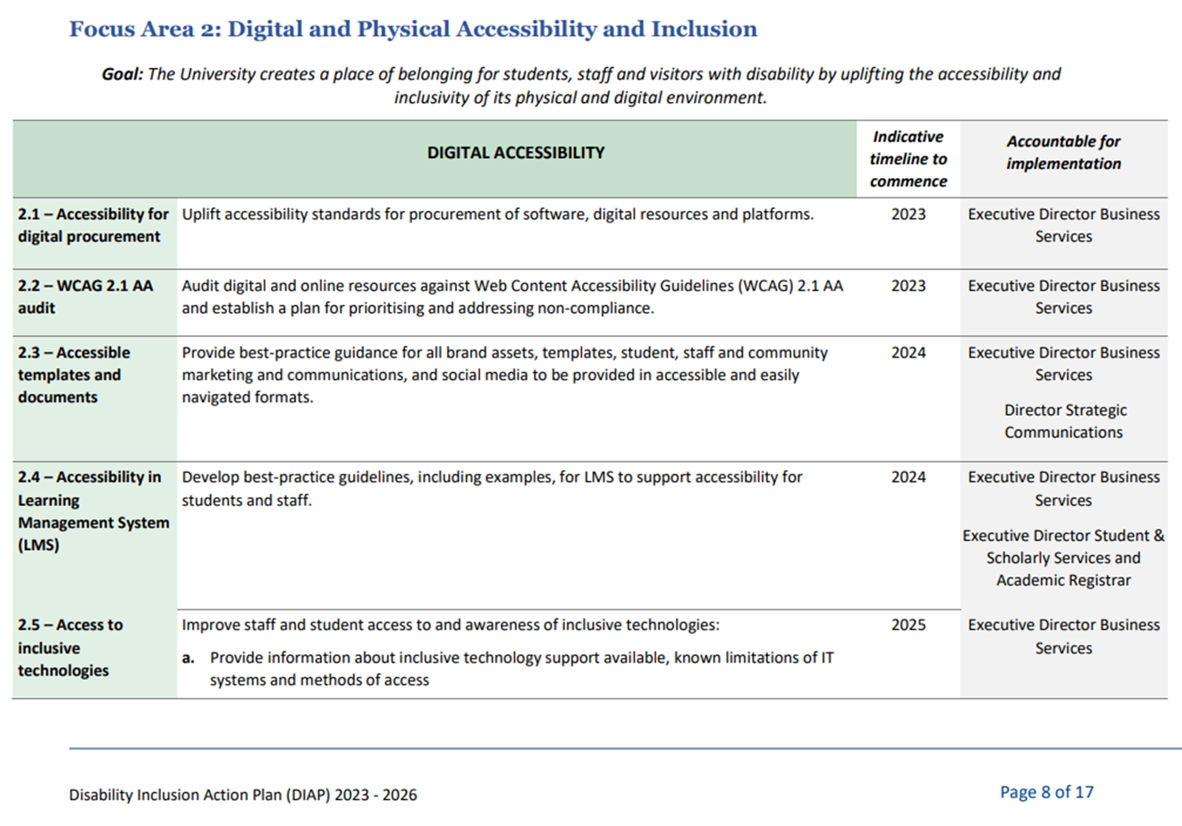
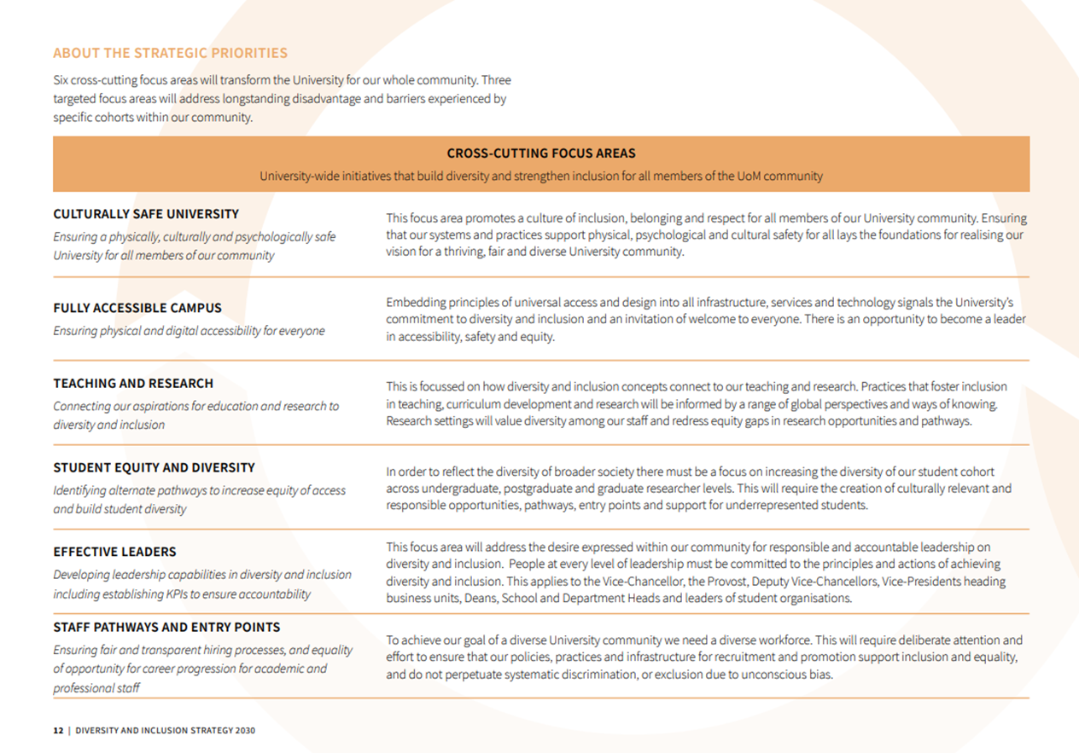
The Call Came: Volunteering to improve accessibility

Slide 4
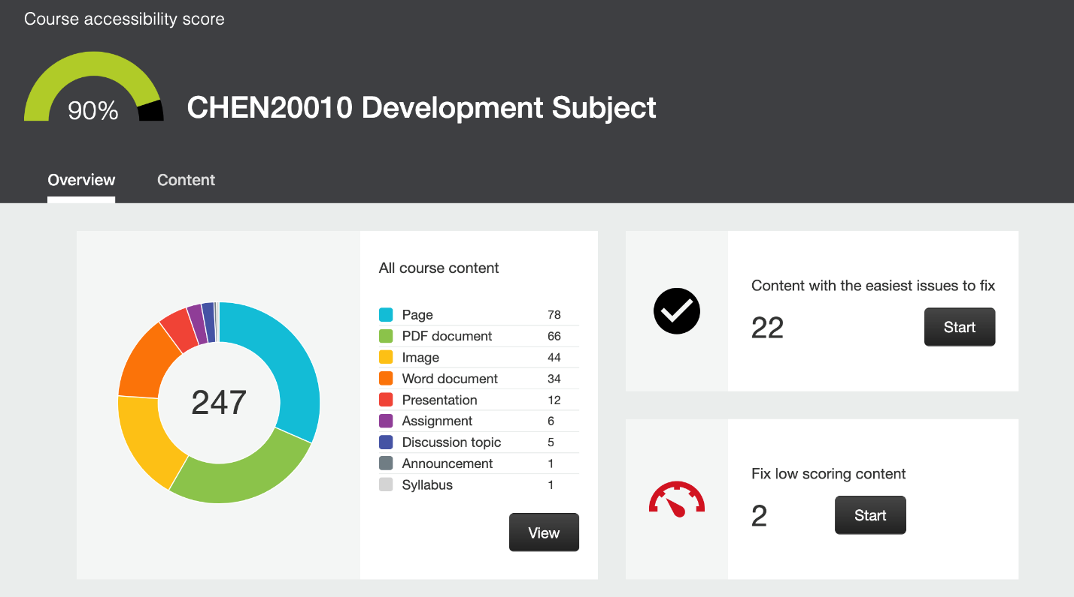
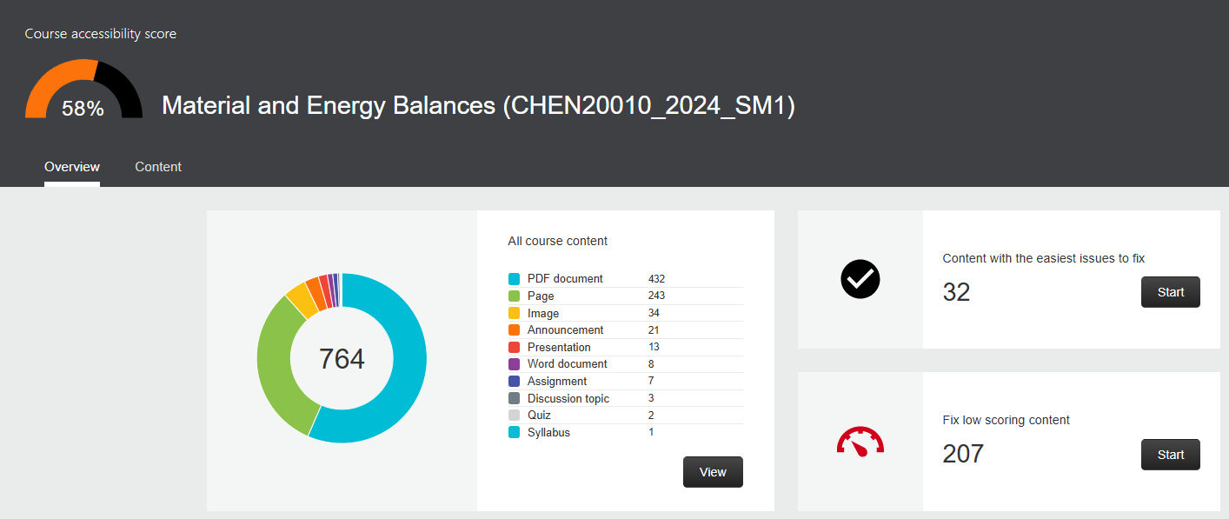
Before and after: Accessibility scores

Slide 5
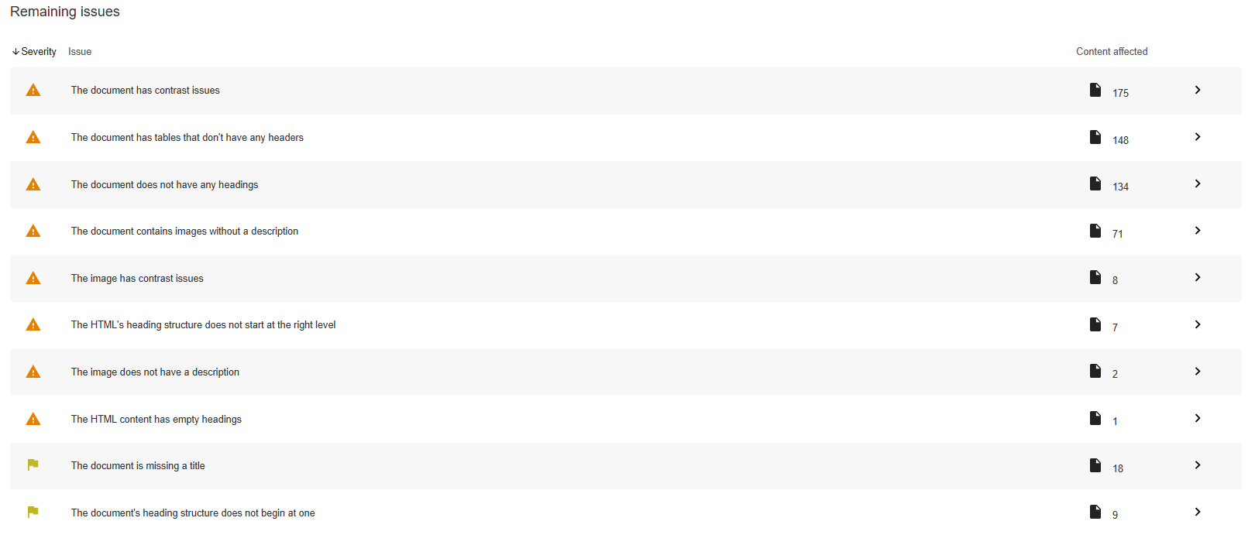
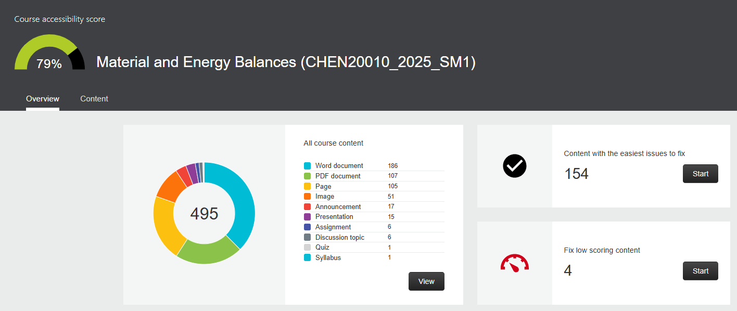
Before and after: Accessibility scores

Slide 6
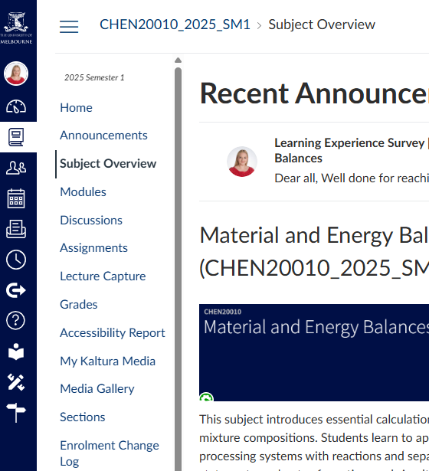

Activity! Check your own accessibility scores
Enable Accessibility Report (Ally tool) in your LMS subject – it's in the left-hand menu
Check your accessibility scores now!

Slide 7
What we identified:
PDFs
Captions
PPTs
Alt-text
Assessment templates
LMS structure

Slide 8
PDFs
Engineering students want PDFs – but they aren't inherently accessible.
Word and PowerPoint are.
Cater for everyone.

Slide 9
Video captions
Students who don't need captions still read them.
Employed REV for captioning.
We can do this with tools that we have (but some editing is required).

Slide 10
PowerPoints
Lecture slides were the main content.
All in PowerPoints.
Lots to do!
Slide titles, heading structure, table headers, reading order, alt-text...

Slide 11
Assessment templates
Previously, there was no consistent formatting for assessments.
Assessment templates provided consistency and predictability across assignments for students, reducing cognitive load.
Catering to different student needs and helps students plan and organise their study time.

Slide 12
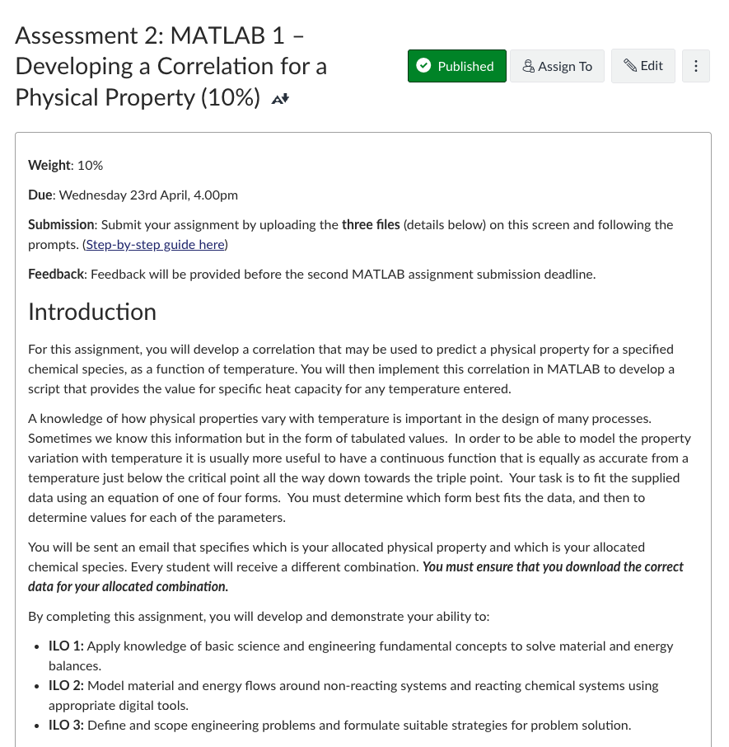
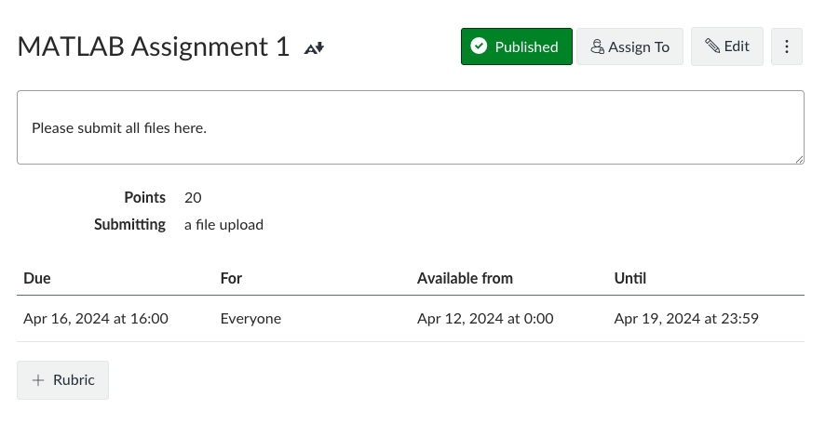
Assessment templates – Before and after

Slide 13
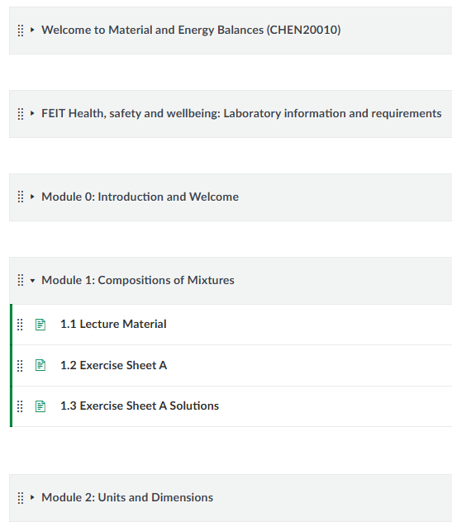
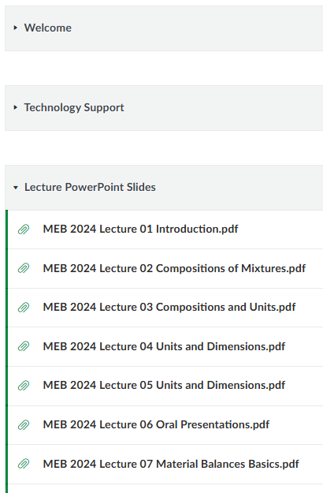
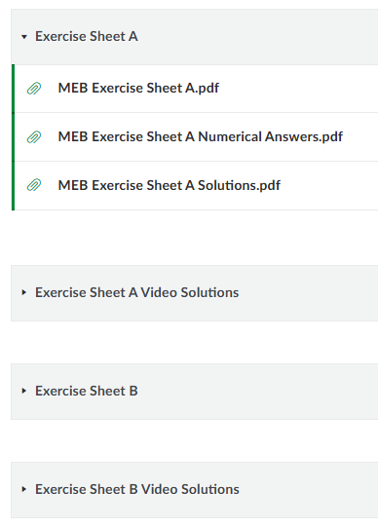
LMS structure and design – Before and after

Slide 14
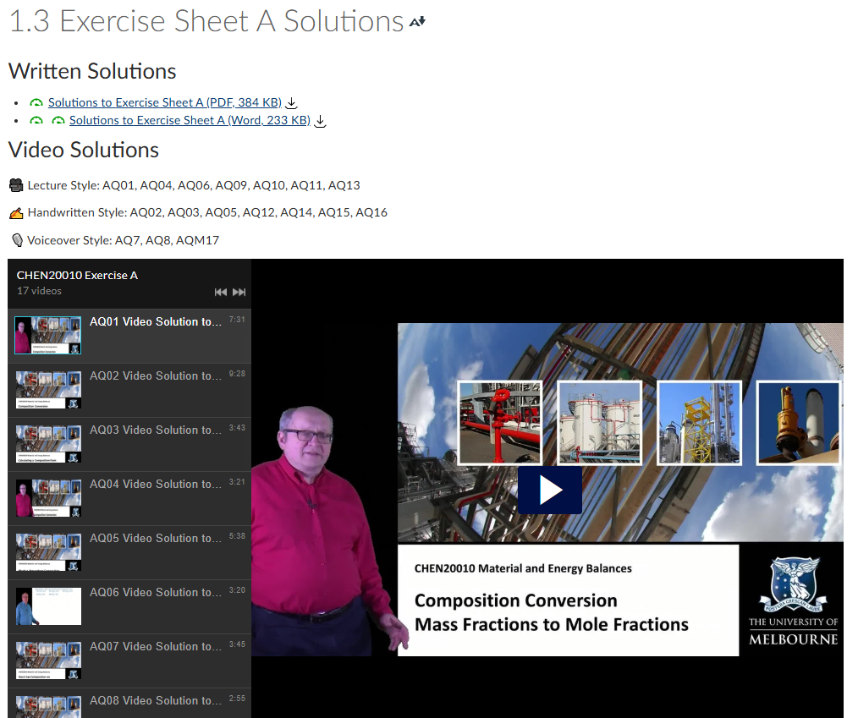
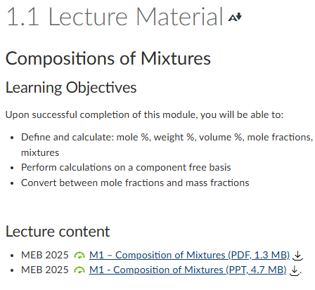
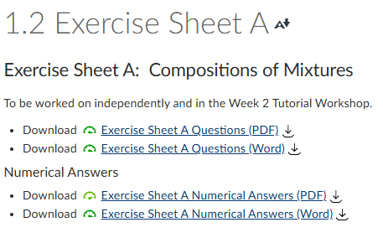
LMS structure and design – After in detail

Slide 15
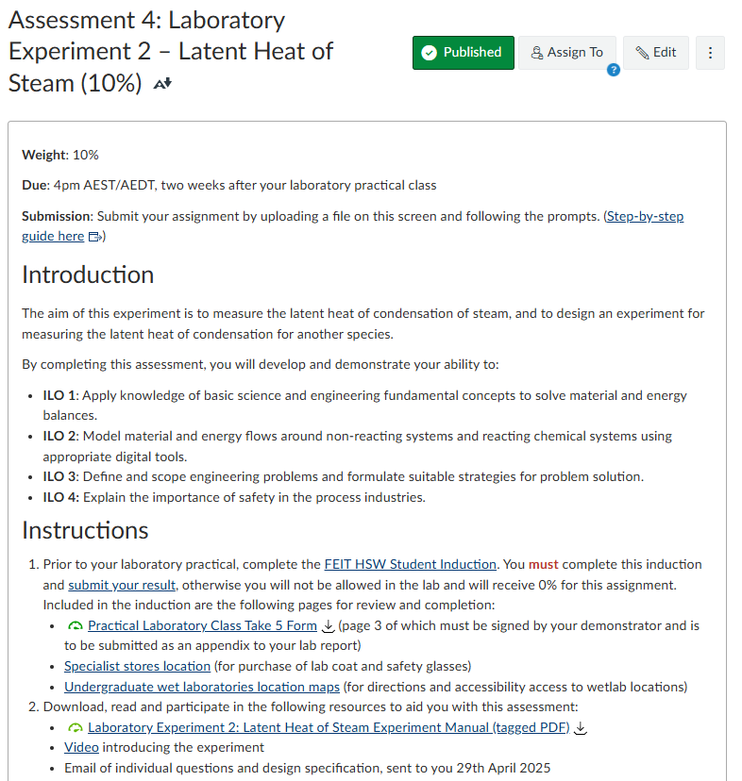
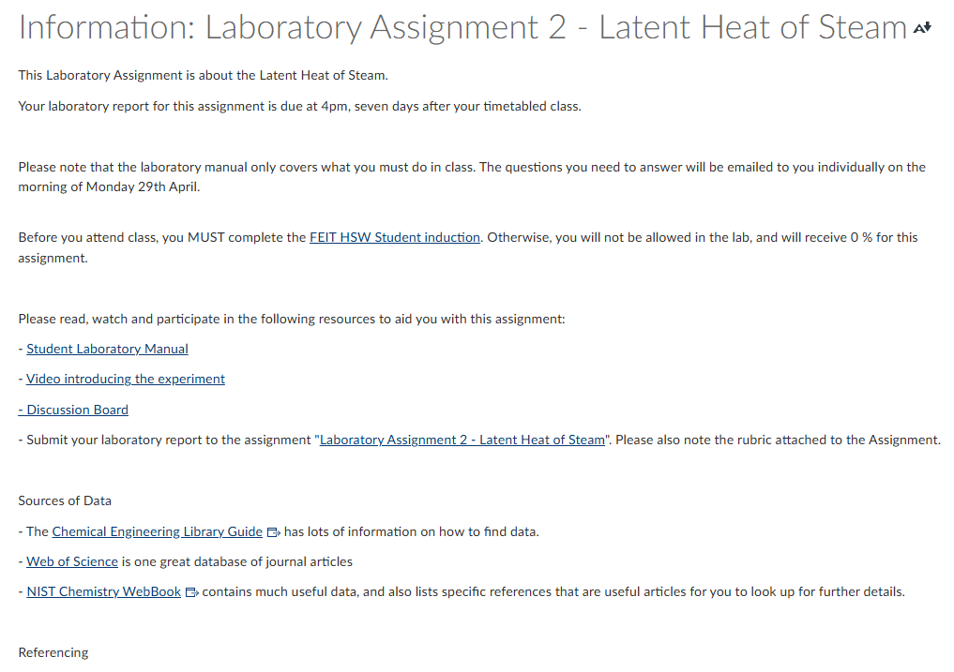
LMS structure and design – Before and after

Slide 16
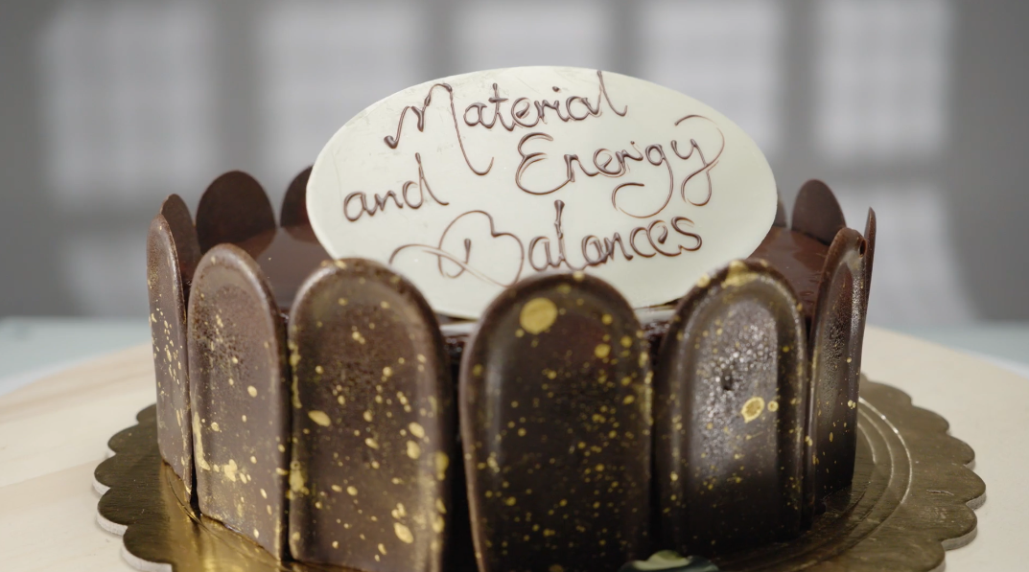
LMS structure and design: Welcome video
Inclusion from the start
CHEN20010 Welcome video
https://go.unimelb.edu.au/bpa2
A winner in the Best of Asia-Pacific Awards by Circle for Advancement and Support of Education (CASE).

Slide 17
Lessons learned
Page [17]

Slide 18
Quick wins!
Complimentary formats to PDFs – Word and PowerPoint versions
Provide options!
Student version of PowerPoints without speaker notes
Start early!

Slide 19
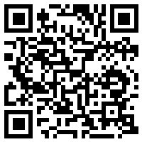
Build with accessibility in mind
It's easier to make your subject accessible first
But if you already have a subject built...
Make small changes over time
Prioritise student requests/needs
Ten tips: Creating accessible subjects in the LMS
https://go.unimelb.edu.au/n3j8

Slide 20
Support is needed
This needs support:
Subject matter experts
Tutors
Time

Slide 21
Take-away message

Slide 22
If you learnt nothing else…
We should be doing this.
We need to support this.
Students should be focused on learning, not the tech.

Slide 23
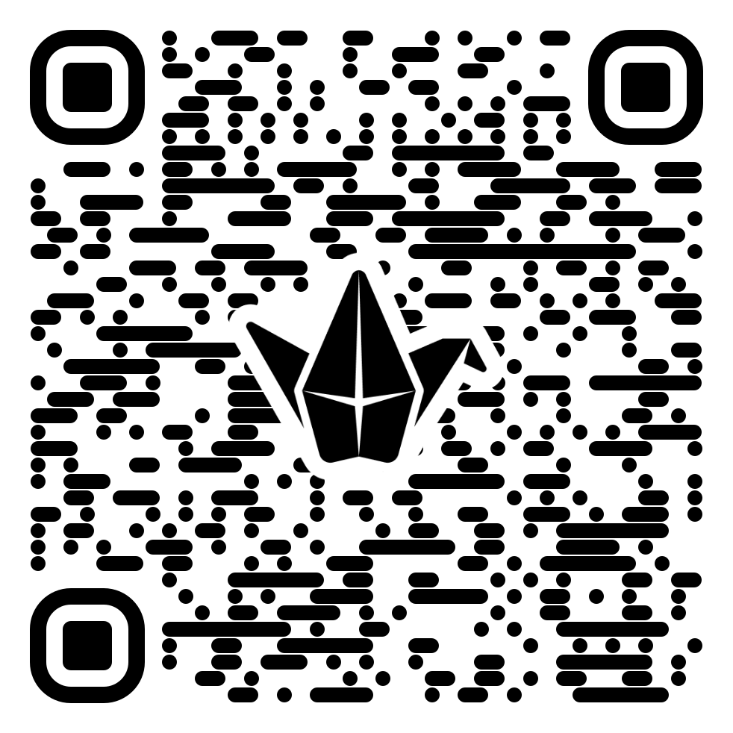
What is one change you can commit to?
https://go.unimelb.edu.au/psa2
Padlet: What change can you commit to?

Slide 24
Thank you
Dr Catherine Sutton, Education Focused Lecturer in Chemical Engineering, Faculty of Engineering and Information Technology
Email: ccsutton@unimelb.edu.au
Reuben Fry, Learning Designer, Teaching and Learning Innovation, Scholarly Services
Email: reuben.fry@unimelb.edu.au
Rebecca Yang, Digital Learning Assistant, Teaching and Learning Innovation, Scholarly Services
Email: rebecca.yang2@unimelb.edu.au

