Slide 1
Navigating ADHD Together student support group:
Key learnings and insights from the mental health professionals facilitating the program
Counselling and Psychological Services (CAPS)
Presenters:
Dr Bridget Moller – Clinical Psychologist, CAPS Counsellor & Group Lead/Facilitator
Rebecca Gomo – Clinical Psychologist, CAPS Counsellor & Group Program Coordinator
Co Author:
Travis Addison – Clinical Psychology Registrar, CAPS Counsellor & Group Facilitator

Slide 2
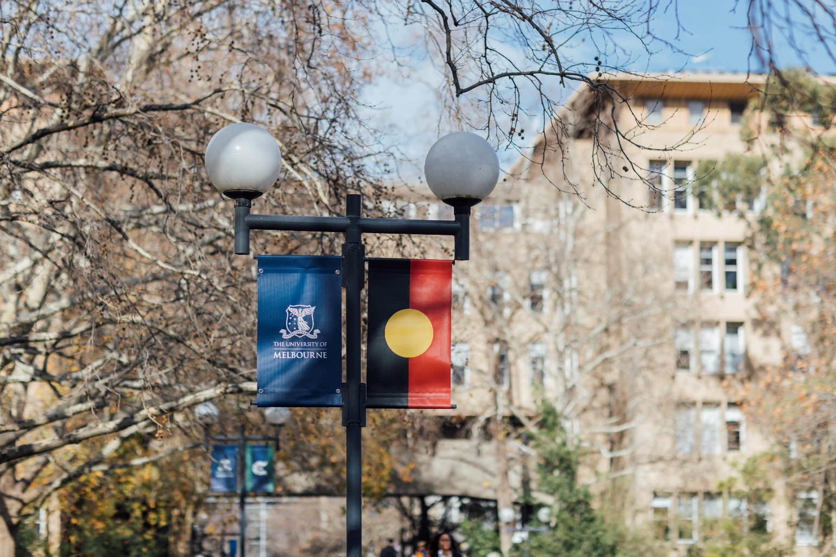
Acknowledgement of Country

Slide 3
Introduction and rationale for the group
Students with ADHD can struggle with a reduced sense of belonging at University (Möller et al., 2025).
A sense of belonging is essential to students’ academic success and wellbeing (Crawford et al., 2024).
Key learnings from running the group include:
    the importance of fostering a sense of connection and community
    tailor content to support students with their academic performance.

Slide 4

Students with ADHD told us they want…
Safe spaces where they feel connection and belonging to learn strategies and tools, with and from other students with ADHD.

Slide 5

Navigating ADHD Together
Participant demographic data:
A total of 62 students have participated across four groups (2024 – 2025)
Study status and level: 68% Domestic, 37% undergraduate
Gender identity: 47% female, 42% male, 11% gender diverse*
*includes non-binary, transgender and other self-described identities

Slide 6
Facilitating a greater sense of belonging
Consistent structure and environment (incl. setting group guidelines)
Making space for diversity within students with ADHD
Fostering self-compassion – modeling curiosity, non-judgement, and empathy. Including mindfulness exercises.
Facilitating sharing, learning and supporting between participants. Learning from/through others, rather than just learning alongside others.
Modelling imperfection and vulnerability.

Slide 7
Supporting a diverse student group
Group screening calls (identifying preference, needs, suitability)
Encourage self-regulation (movement, fidgets)
Regular environment checks (noise, lighting, breaks)
Multiple formats for information (verbal, written, audio, video)
Varied interaction styles (group, one-on-one, solo)
Accommodating for varied processing speeds (mixed mediums, inclusive turn taking)

Slide 8
Summary of ADHD Group Program Feedback, Sem 1 2025 (N = 9)
Following participation in most participants agreed or strongly agreed that they felt….
More aware of University-based supports – 100%
More socially connected to others – 88.9%
More able to look after mental health and wellbeing - 88.9%
A stronger sense of belonging to UoM community - 66.7%

Slide 9

Student Feedback – In their words
Sharing experiences and strategies to address Adhd difficulties
Connection, friendliness, familiarity in different shades, diversity in experience, joy in not feeling alone
This is a very nice and amazing learning and comforting experience to ADHD Uni students. I feel glad that the Uni and CAPS team invited me to join this peer support group
A lovely enlightening experience which helped myself to give myself some slack with the ADHD symptoms

Slide 10
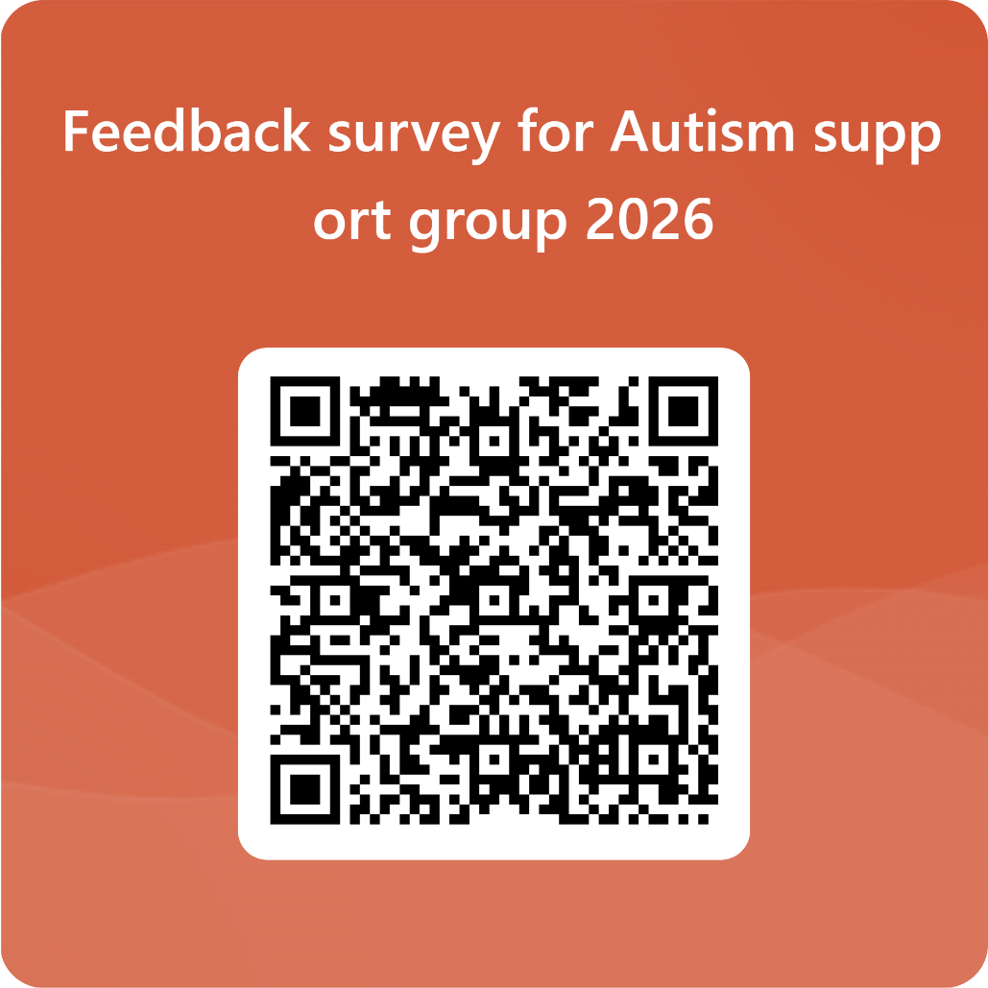
Key takeaways and next steps
Link: https://forms.office.com/r/vQimLzGjaP

Slide 11

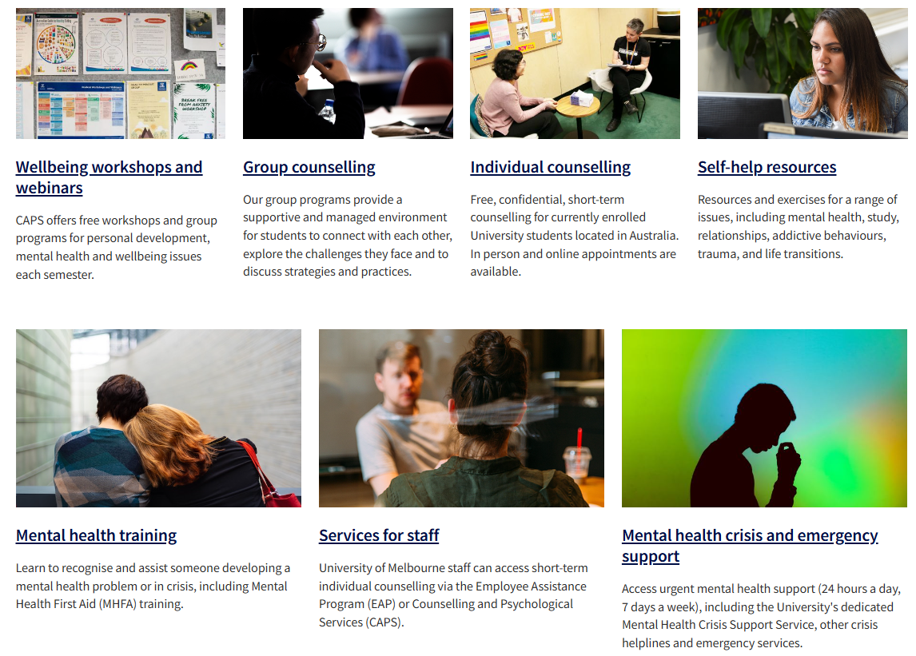
CAPS Website

Slide 12
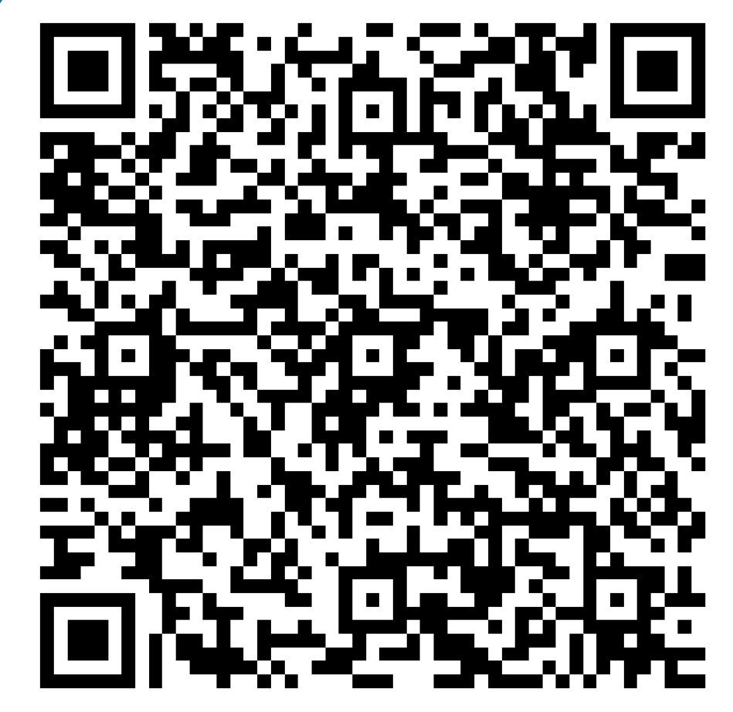
Keep Up to Date
Students Only - Group programs email contact list
Link: https://forms.office.com/r/6nwdH5JGQ5
Staff - student-enrichment@lists.unimelb.edu.au

Slide 13
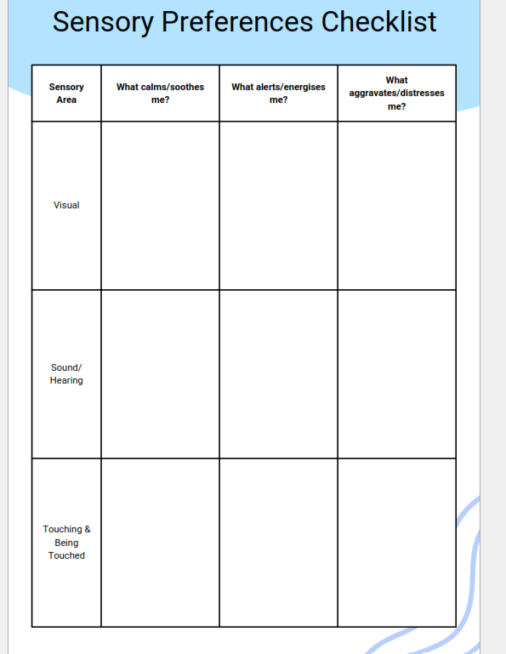
Sensory preferences checklist

