Slide 1
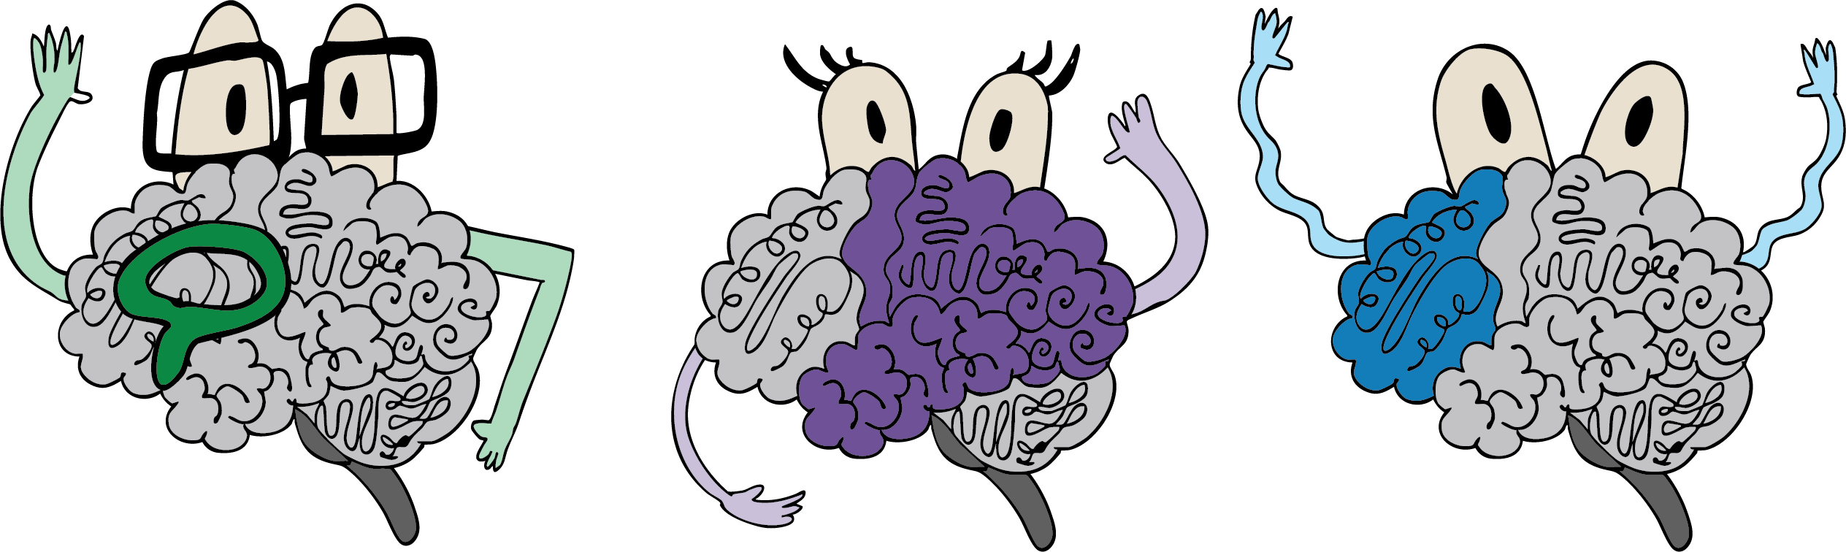
Enhancing Canvas LMS accessibility: A co-adaptation approach
CoIL x CSHE Inclusive Teaching Symposium
Illustrations by Mel Vallence

Slide 2

Acknowledgement of Country

Slide 3

An invitation to be yourself
      We want this to be a neurodivergent-friendly space
      Feel free to move around, stim, use sensory tools, and/or take breaks when needed
      Please let me know if there is anything you need to make the space more comfortable, such as changing our position or the lighting (if possible).
      We will be using identity-first language as a default (e.g., Autistic person, ADHDer, dyslexic person) but follow the lead of the neurodivergent people in your team.

Slide 4
Overview of this session
    Introducing our team (2 minutes)
    Introduction to this research project (3 minutes)
    Analysis of survey data (5 minutes)
    Analysis of focus group data (2 minutes)
    Key takeaways and next steps for this project (2 minutes)

Slide 5
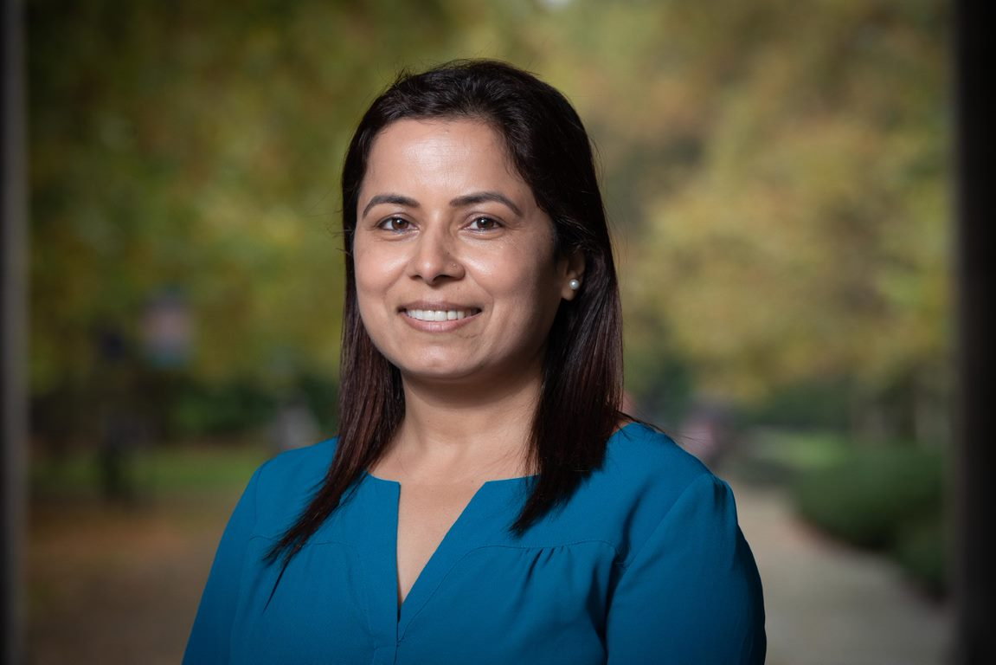
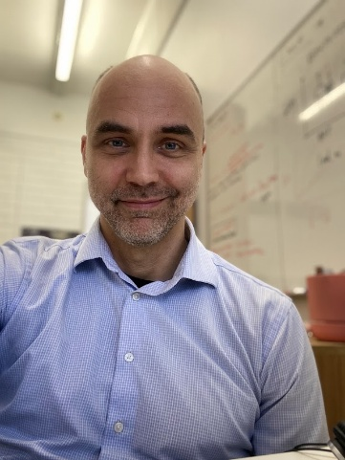

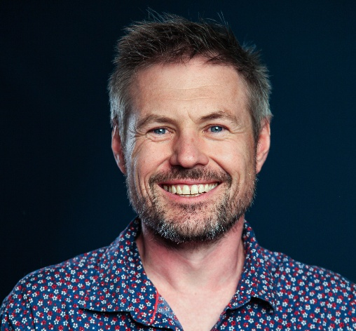
Our project team
Dr. Bhawana Bhatta Kaudal (CI)
Dr. Emile van Lieshout
Meredith Hinze
A/Prof. Matthew Harrison
Faculty of Science
Faculty of Science
Faculty of Arts
Faculty of Education, University of Melbourne Neurodiversity Project

Slide 6
Introduction to this research project
  Our co-adaptation project engages neurodivergent students through
  surveys and focus group workshops, to inform the design of accessible
  Canvas subject templates.
  Guided by Universal Design for Learning (UDL) principles, the project seeks to create Canvas templates with clear navigation, sensory-friendly options, and consistent layouts.
  The outcome aims to enhance digital accessibility, improve engagement and overall student experience.
The key challenge that we wanted to address:
How can we co-design Canvas templates that genuinely reflect the lived experiences of neurodivergent students, while remaining practical and easy for educators to implement?

Slide 7
Project overview
Phase 1: Ethics application, prepare canvas template
1
Phase 2: Data collection (Aug-Sept 2025)
2
Phase 3: Evaluation of survey and workshop data
3
Phase 4: Co-adaptation of inclusive canvas LMS template
4
Phase 5: Dissemination of inclusive LMS template
5

Slide 8
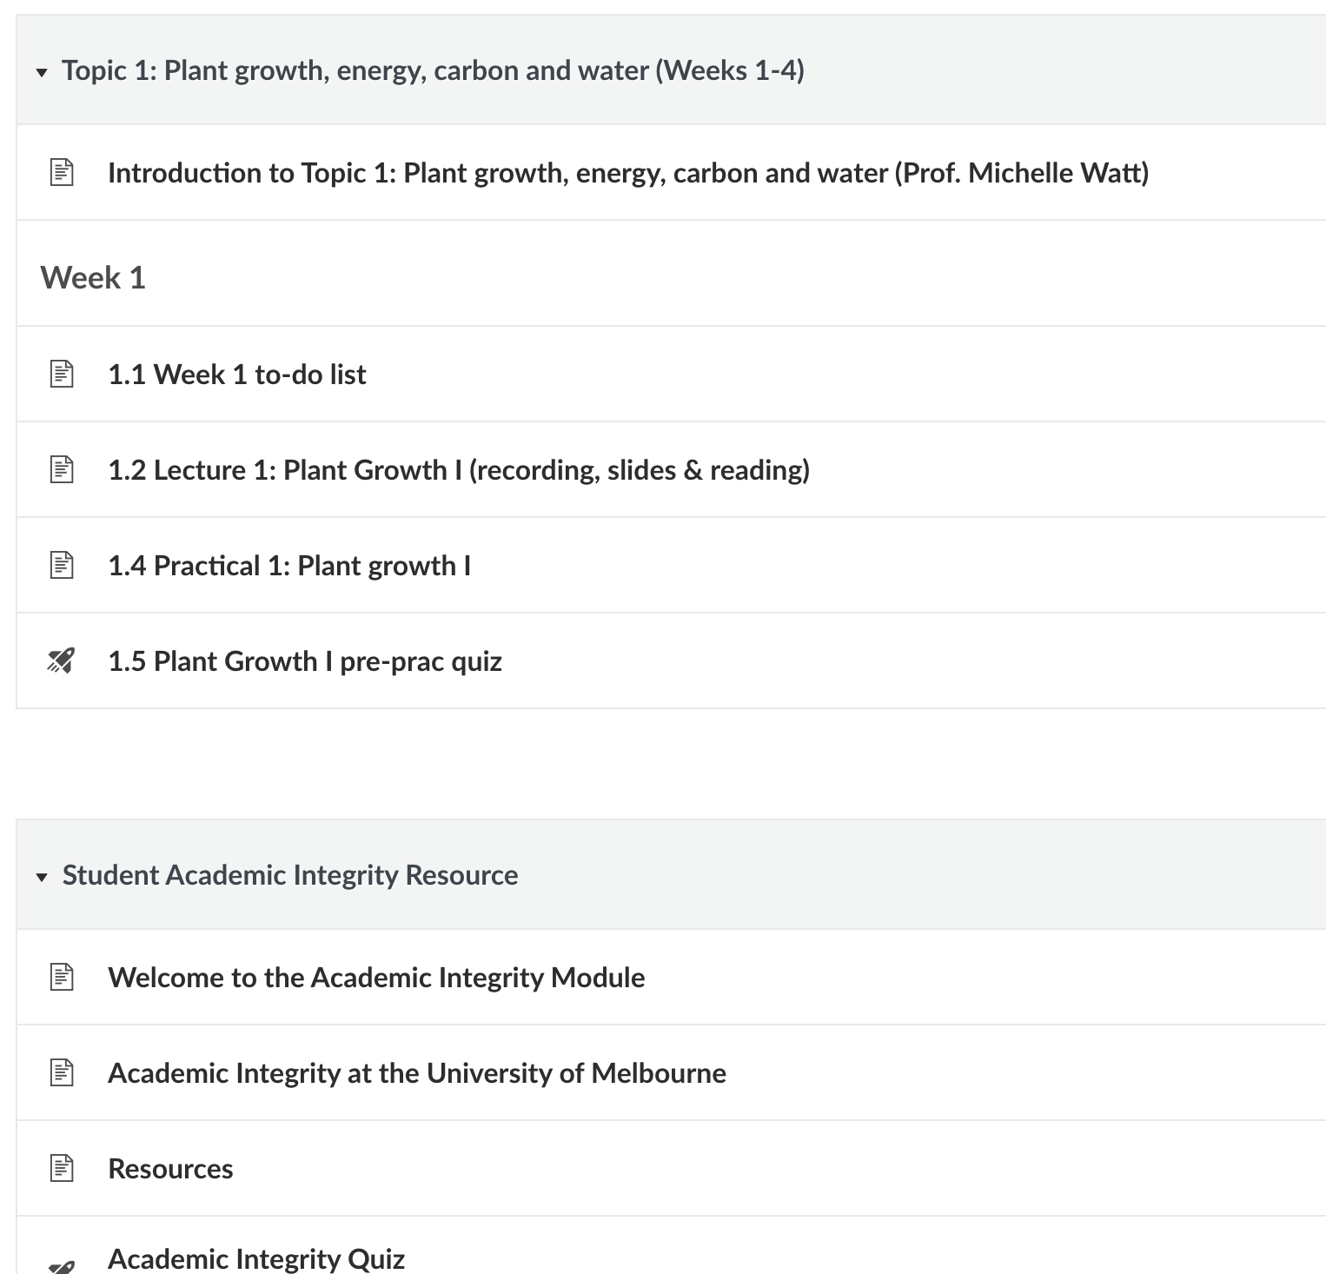
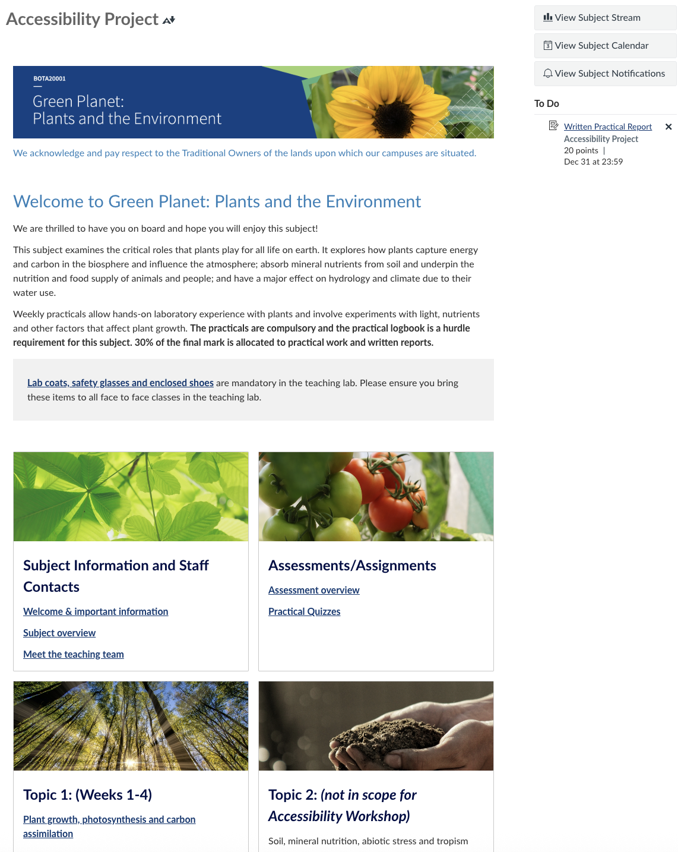
Test canvas site

Slide 9
Canvas design applied to test subject site
Universal Design for Learning framing and other accessibility guidelines were applied to
eliminate as many barriers as possible, focusing on the context of the content and implementation of it
Clarity in structure, labelling of modules, organisation of learning materials
Clarity and consistency in language
Use of built-in heading styles
Alt text on images that concise, descriptive and meaningful of context
Link text that is concise, descriptive and meaningful of context
Ally Accessibility dashboard to address identified issues

Slide 10

Results of Phase 1 survey data
Results of Phase 1 (survey data completed by Australian neurodivergent students)

Slide 11
Overview of our survey
Purpose of the survey
To understand user needs and experience of canvas LMS
Key survey questions
Age
Neurotype
Canvas LMS experience (navigation, organization, clarity)
Canvas LMS accessibility features: How much students value them versus what is there
Accessibility aids used (other than what is offered in Canvas)
Suggestion of further improvements for canvas LMS

Slide 12
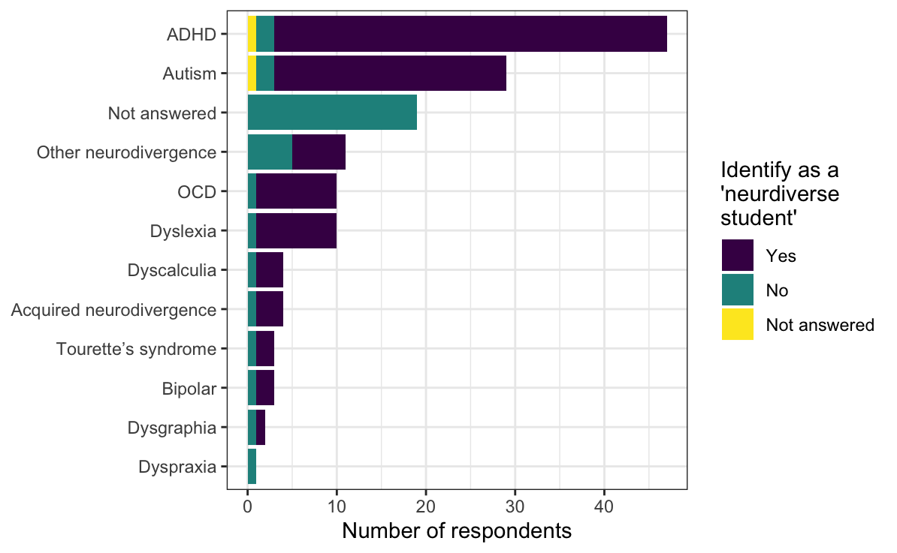
Overview of Phase 1 participants
90 respondents (UoM students), 71 of whom identified as a ‘neurodiverse student’
58 participants had more than one neurotype
No
Identify as a 'neurodiverse student'

Slide 13
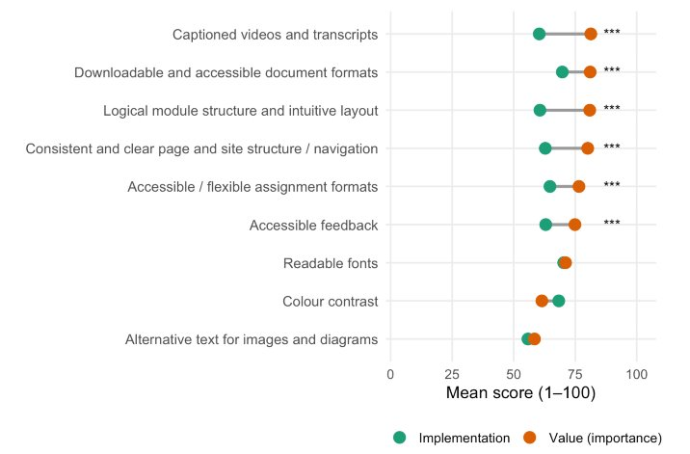
Key finding 1: Significant accessibility gaps remain
All features valued over 75% seen as lagging in implementation.
Implementation gap for two features exceeded 20 points
Perceived value and quality of implementation of different LMS features among survey respondents (asterisks denote significant gap. *** p < 0.001)

Slide 14
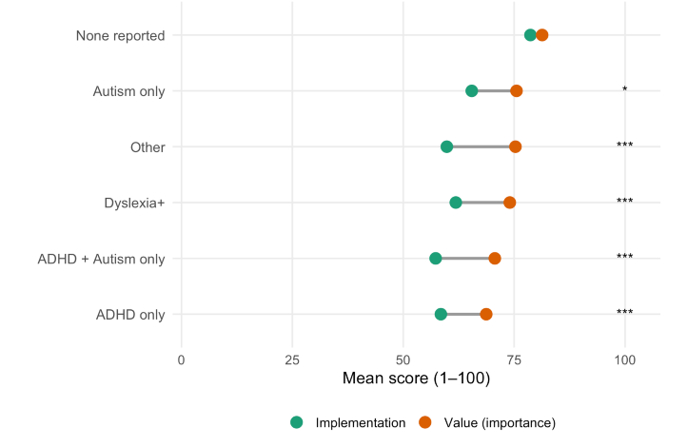
Key finding 2: Bigger gaps for neurodivergent students
Only students who did not report identifying with any neurotypes considered Canvas as meeting their needs
All other groups experienced gaps in implementation of features of 7-15%.
No interaction with feature type.
Perceived value and quality of implementation of different LMS features by neurotype among survey respondents (asterisks denote significant gap. * p < 0.05; *** p < 0.001)

Slide 15
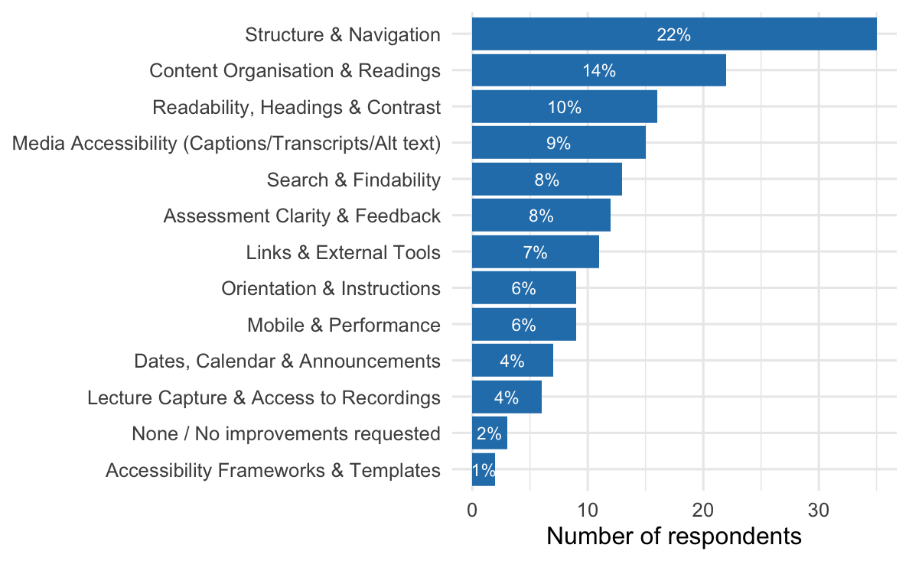
Key finding 3: Clear avenues for LMS improvement
Most common suggestion for improvement (Structure & Navigation) aligns well with leading accessibility gaps identified
Typically not addressed in LMS accessibility guidelines
Counts of themes identified in respondent suggested improvements to canvas accessibility (n = 90)

Slide 16
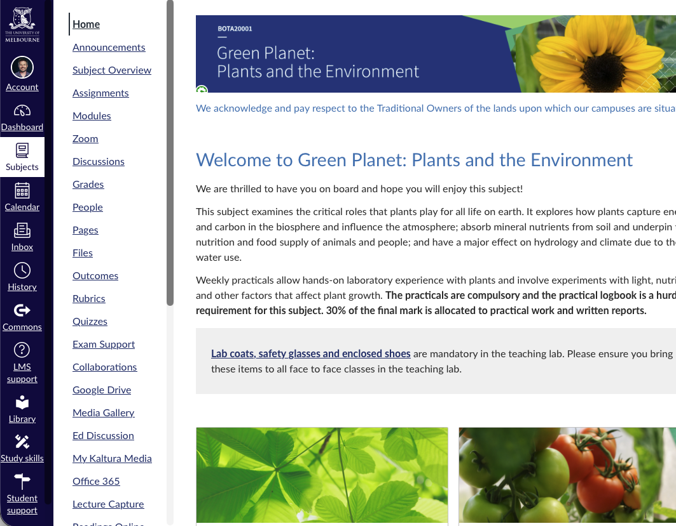
Results of Phase 2 – focus group
Results of Phase 2 (focus group of neurodivergent University of Melbourne students)

Slide 17
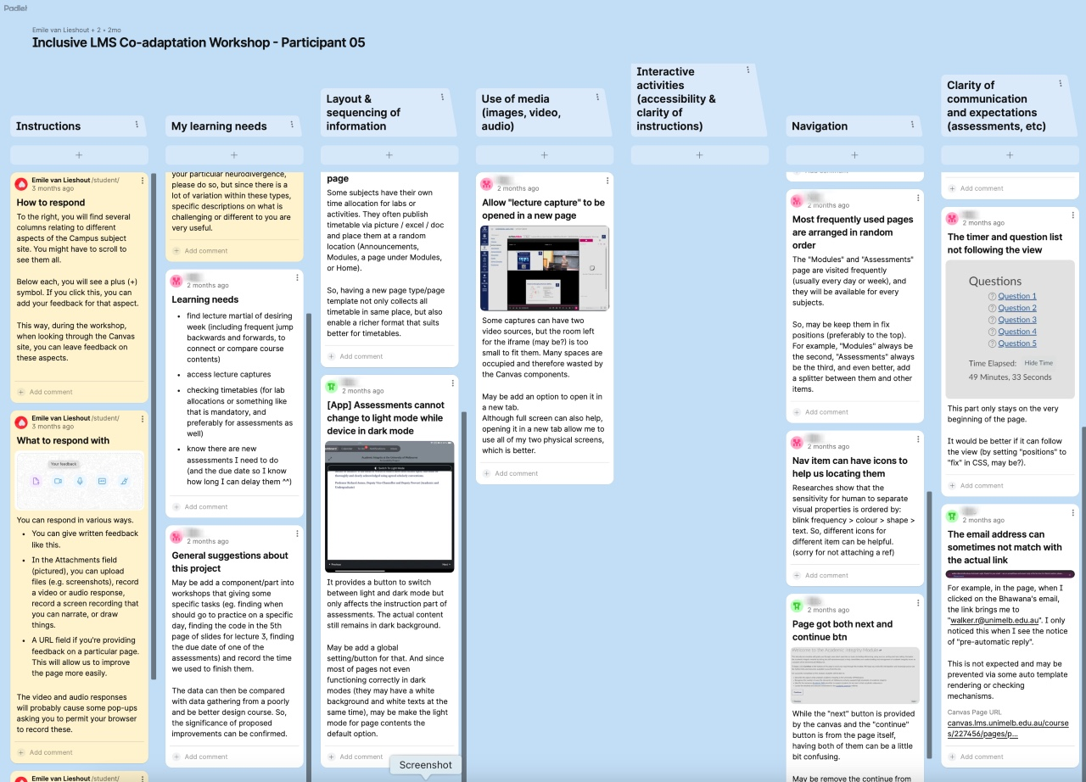
Example 1 participant response

Slide 18
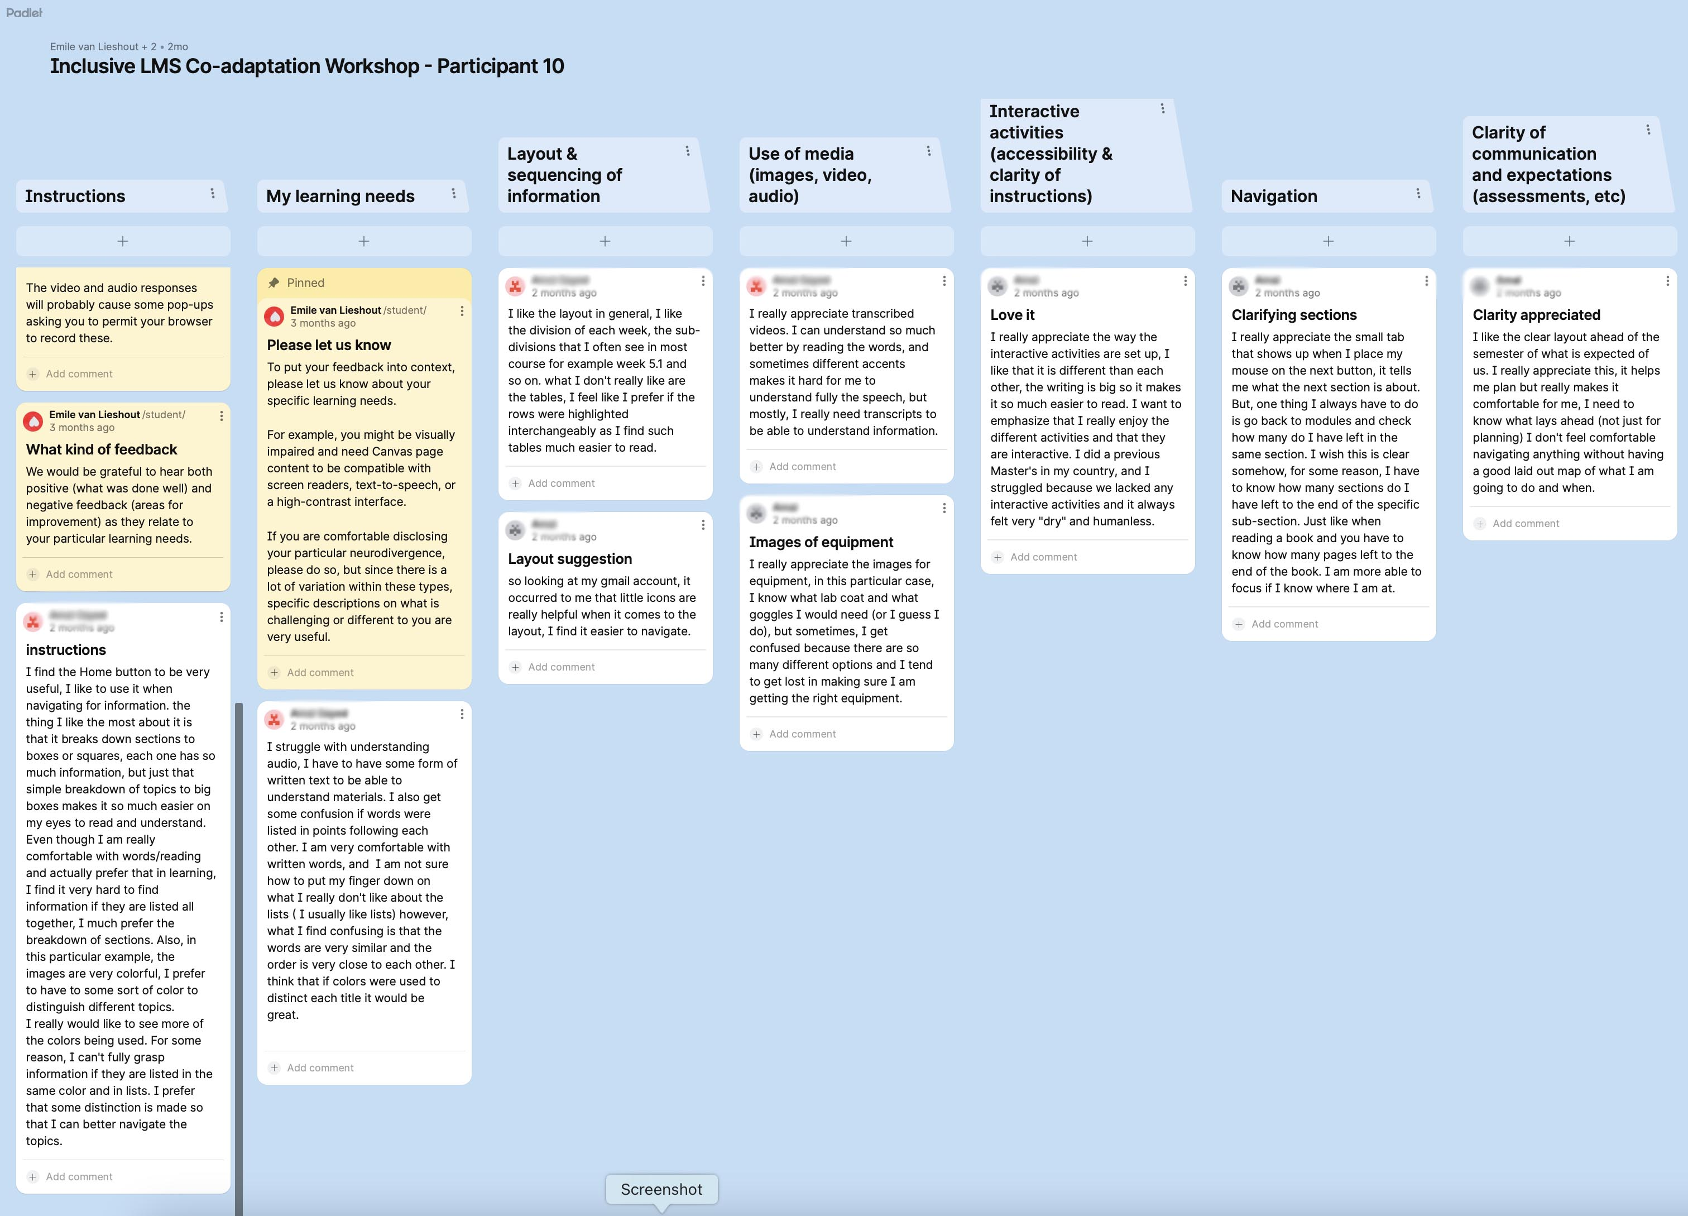
Example 2 participant response

Slide 19

Overview of Phase 2 participants
A
B
C

Slide 20
Key Themes from focus group workshop
Theme 1: Desire for predictable, structured navigation
Theme 2: Visual clarity and use of colour as a cognitive aid
Theme 3: Importance of clear communication and expectations
Theme 4: Preference for multimodal media with customisation options
Theme 5: Valuing interactive and supportive design

Slide 21
Next steps for this project
Complete co-designed version of canvas LMS template
Disseminate the co-designed template widely
Publish manuscript

Slide 22

Key Messages
Neurodivergent students consistently identified gaps between the value and implementation of LMS features, highlighting the need for improved Canvas accessibility.
Project findings revealed crucial themes for enhancing LMS accessibility, including structured navigation, visual clarity, clear communication, multimodal content, and interactive design.

Slide 23
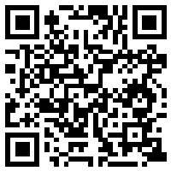

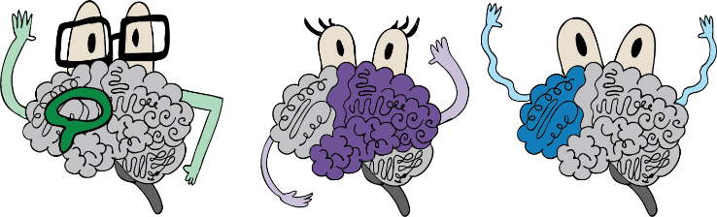
Questions and answers
Was anything unclear about our presentation?
Do you have any feedback or ideas about our next steps?
Comments and suggestions can be left anonymously on our padlet wall by following the QR code
  URL: https://go.unimelb.edu.au/g4a2

Slide 24
Extra slides if needed for question time

Slide 25
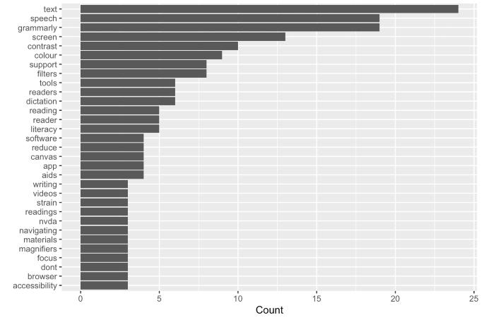
Most common words in ‘external aids’ reponses

Slide 26
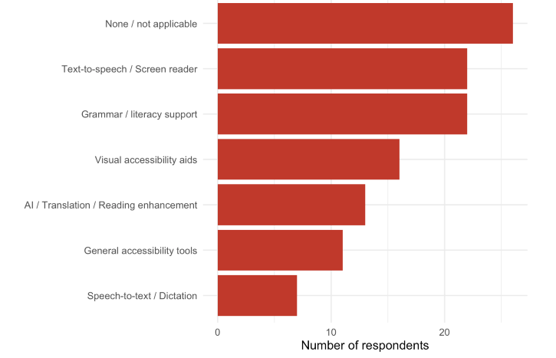
Categories for external tools

Slide 27
Differences between participants
Consideration | Participant A | Participant B | Participant C
Visual preferences | Prefers structured layout, minimalist interface | Neutral, focuses on process more than visuals | Prefers colour, icons, and visual segmentation
Information access | Wants compact navigation, fewer sidebar links | Requests more centralised and explicit guidance (FAQs, onboarding) | Prefers broad overviews and “maps” of content
Media use | Seeks efficient access (e.g., open lecture videos in new tabs) | Wants adaptive controls like playback speed | Needs transcripts and visual reinforcement

