Slide 1
Creating an inclusive learning environment for Students with disability: What I learned from my 'Plus One Pledge’
COIL – Community of Inclusive Learning | Symposium November 2025
Speaker: A/Prof Judith Marychurch, Assistant Dean – Teaching & Learning, MLS

Slide 2
Acknowledgement of Country
The University of Melbourne acknowledges the Traditional Owners of the unceded land on which we work, learn and live: the Wurundjeri Woi-wurrung and Bunurong peoples (Burnley, Fishermans Bend, Parkville, Southbank and Werribee campuses), the Yorta Yorta Nation (Dookie and Shepparton campuses), and the Dja Dja Wurrung people (Creswick campus).
The University also acknowledges and is grateful to the Traditional Owners, Elders and Knowledge Holders of all Indigenous nations and clans who have been instrumental in our reconciliation journey.
We recognise the unique place held by Aboriginal and Torres Strait Islander peoples as the original owners and custodians of the lands and waterways across the Australian continent, with histories of continuous connection dating back more than 60,000 years. We also acknowledge their enduring cultural practices of caring for Country.
We pay respect to Elders past, present and future, and acknowledge the importance of Indigenous knowledge in the Academy. As a community of researchers, teachers, professional staff and students we are privileged to work and learn every day with Indigenous colleagues and partners.

Slide 3
My Plus One Pledge
To make my classroom a more inclusive space for people with disabilities, especially invisible disabilities
Context:
I teach a core subject as an intensive in July
Students are in class for six hours a day for six days over two weeks
This can be overwhelming, especially for students who are masking in class

Slide 4
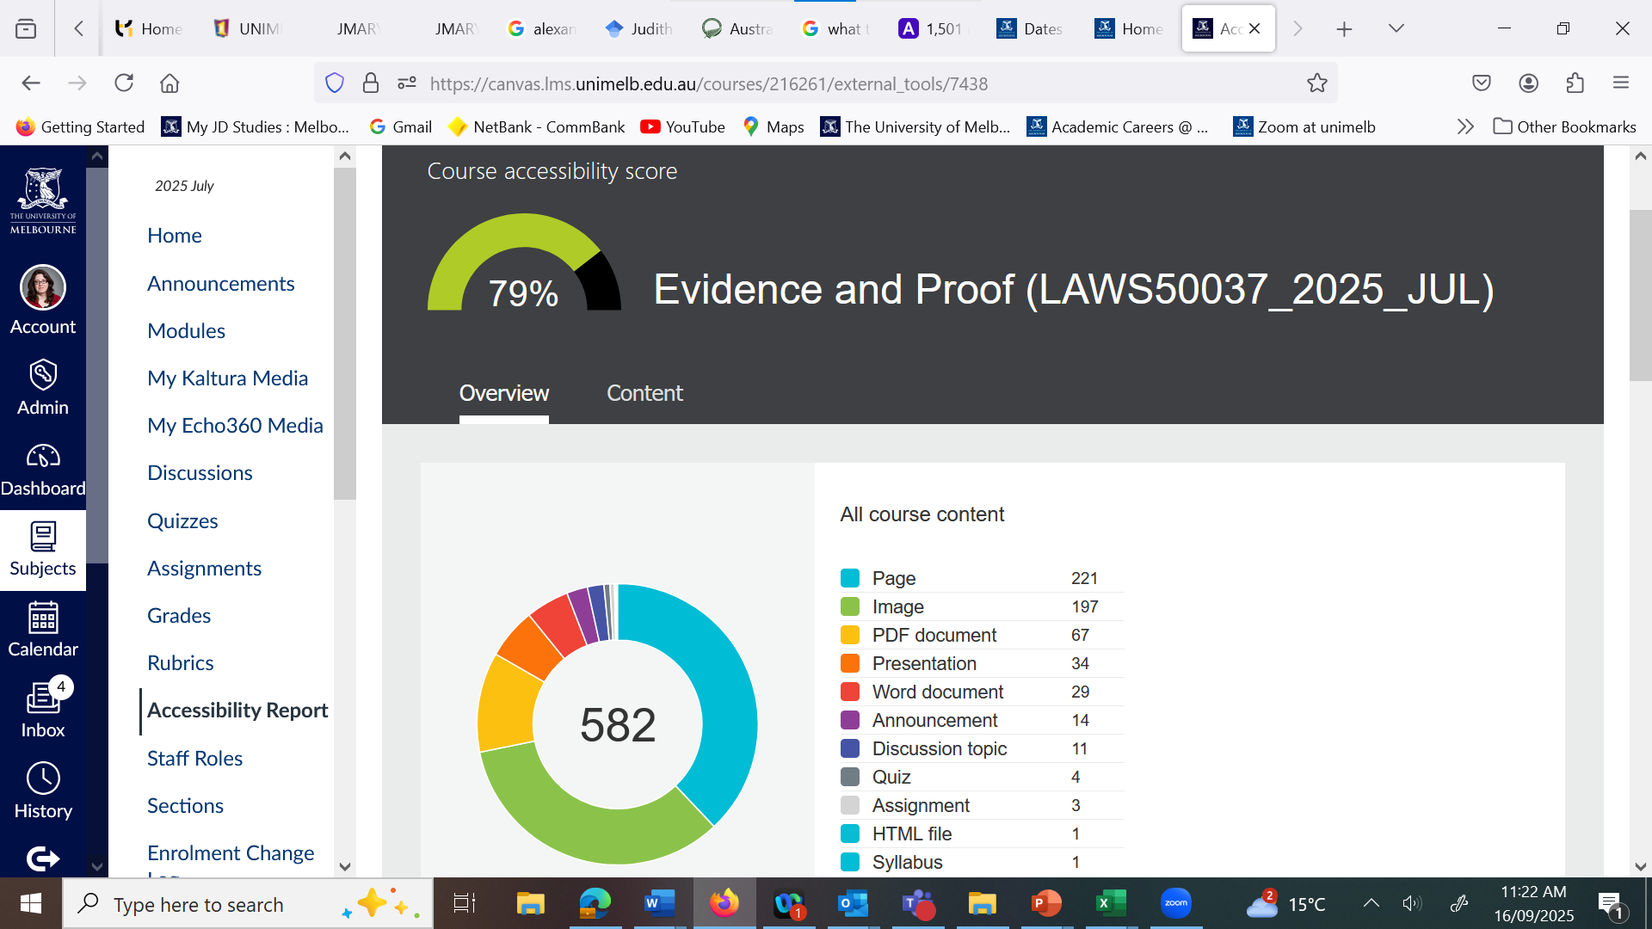
Supports already in place: Accessibility of the LMS

Slide 5
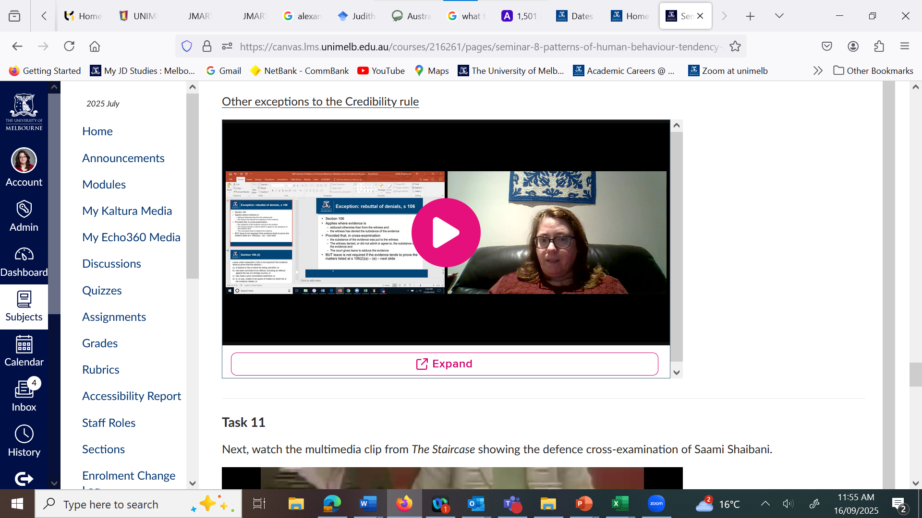
Pre-recorded videos for primary content available enabling catch up in case of illness, for accessibility purposes, and for revision

Slide 6
Anticipating the needs of students in the classroom
The most likely reasons for which students may register for ongoing support are:
Mental health issues are likely, at a rate of at least 25 percent
Medical conditions
Neurological conditions
Physical/mobility
Learning disorders
Hearing and/or vision related
Any student who registers for ongoing support has to provide evidence of a diagnosis of a disability that will impact their learning and provide details on what accommodations would support their learning: ‘This two-step requirement results in many students failing to obtain accommodations, and also mis-understanding what support is available.’
  (Grimes, S., Southgate, E., Scevak, J., & Buchanan, R. (2021) Learning impacts reported by students living with learning challenges/disability. Studies in Higher Education, 46(6), 1146–1158, 1147)

Slide 7
Other factors affecting what teachers actually know about student learning challenges
There are also many reasons why students may choose not to register for ongoing support, including due to stigma or fear of discrimination, resulting in disparities between the reported levels of students with disabilities compared with the actual population size of students with disabilities
(Grimes, S., Scevak, J., Southgate, E., & Buchanan, R. (2017). Non-disclosing students with disabilities or learning challenges: Characteristics and size of a hidden population. The Australian Educational Researcher, 44(4), 425–441, 427)
This is also a highly personal choice, which is likely to change over time. Aside from fear of stigma, other reasons may include :
* Low self worth * Being uncomfortable with sharing personal information
* Lack of experience in self-advocacy * Belief they don’t meet the threshold for eligibility
* Lack of documentation * Anticipation disclosure will not be of benefit
Fear of discrimination
(Edwards, M., Poed, S., Al-Nawab, H., & Penna, O. (2022). Academic accommodations for university students living with disability and the potential of universal design to address their needs. Higher Education, 84(4), 779–799, 781)

Slide 8
Back to my intensive and motivation for my Plus One Pledge
Given lack of certainty about exactly what learning challenges would be present in my classroom, but knowing what may be present, I wanted to explore how I could make my classroom more inclusive for all students without requiring disclosure of any specific challenges
In particular, I was concerned about how taxing it is for a student who is in pain or masking or overloaded or struggling with anxiety (as examples, and more than one may apply) to be in a situation where they are in class for six hours a day and they need to maintain their focus and concentration, even with clear breaks during the day and between teaching days. So how could I make their life a bit easier?
So I wanted to learn more about Universal Design for Learning, including classroom-specific strategies

Slide 9
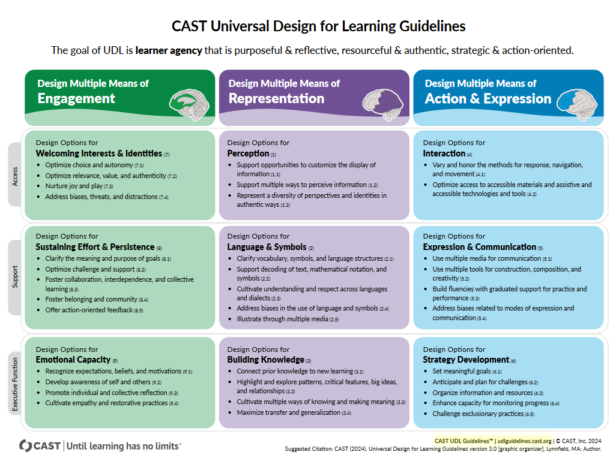





Slide 10
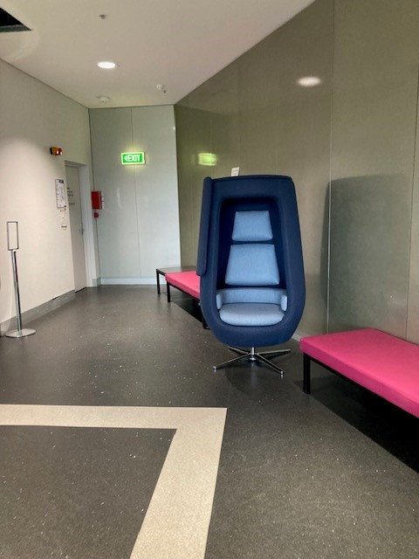
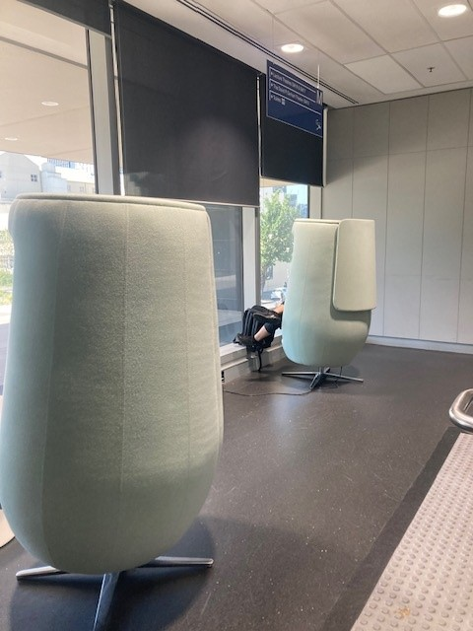
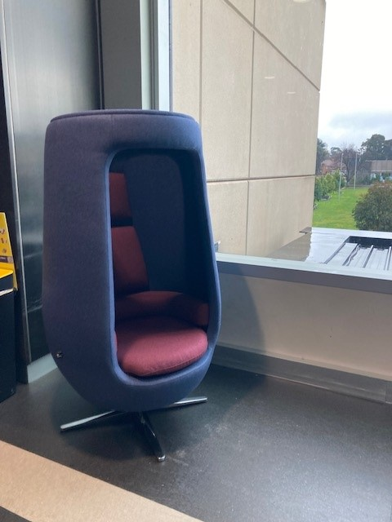
Example slide:
Have you noticed the sensory pods on the Mezz, Levels 1, 2, 3 and 6?

Slide 11
Contextualising the pledge, for students
I already cover ‘rules of engagement’ for discussing sensitive topics in the first class, so decided to add to expand this section to cover what I was doing and why:
I am participating in a pilot at the University on inclusive teaching and am trialling strategies to deliberately create a more inclusive classroom learning environment through the use of Universal Design for Learning (UDL) principles.
UDL is an educational approach that recognises learners have diverse abilities and needs, and seeks to remove barriers to learning by offering flexible methods of instruction and assessment
UDL is an educational framework developed by CAST, see https://www.cast.org/what-we-do/universal-design-for-learning/. To download a copy of the current UDL guidelines, got to https://udlguidelines.cast.org/more/downloads/#v3-0

Slide 12
Example slide:
Engaging appropriately in class discussions
Listen respectfully, without interrupting
Listen actively and with an ear to understanding others' views.
Criticise ideas, not individuals
Commit to learning, not debating. Comment in order to share information, not to persuade
Avoid blame, speculation, and inflammatory language
Use careful language when discussing things that might offend other students
Allow everyone the chance to speak
Avoid assumptions about any member of the class or generalisations about social groups. Do not ask individuals to speak for their (perceived) social group

Slide 13
If you are (or think you may be) affected during class discussion …
Review the class materials for the next class ahead of time
You may skip an entire class if the material/content is too confronting
      You may like to make a time to see me to discuss the subject content missed in a way that minimises exposure to distressing material
You may leave class without providing reason or notice (if a fellow student wants to go with you, this is alright, too)
If you need more support …
Just in case, remember that you can:
  Make a time to see me after class to discuss
  Access MLS and UoM support services available to you, eg MLS Student Academic Adjustment and Wellbeing Officer (law-wellbeing@unimelb.edu.au) and UoM Counselling Service, see https://services.unimelb.edu.au/counsel

Slide 14
Example slide from class (with thanks to Ashley!):
Conventions for our learning space
Do what you need to do to aid your own Do what you need to do to aid your own learning!​
We welcome:​
Stimming​
Fidgeting​ (we have plenty to share!)
Tics​
Echolalia and coprolalia​
Standing and stretching or moving​
Similar
Engagement is always optional
You may take a break at any time​
  This is in addition to class break times
You may opt out of an activity
Communicate in a way that works for you

Slide 15
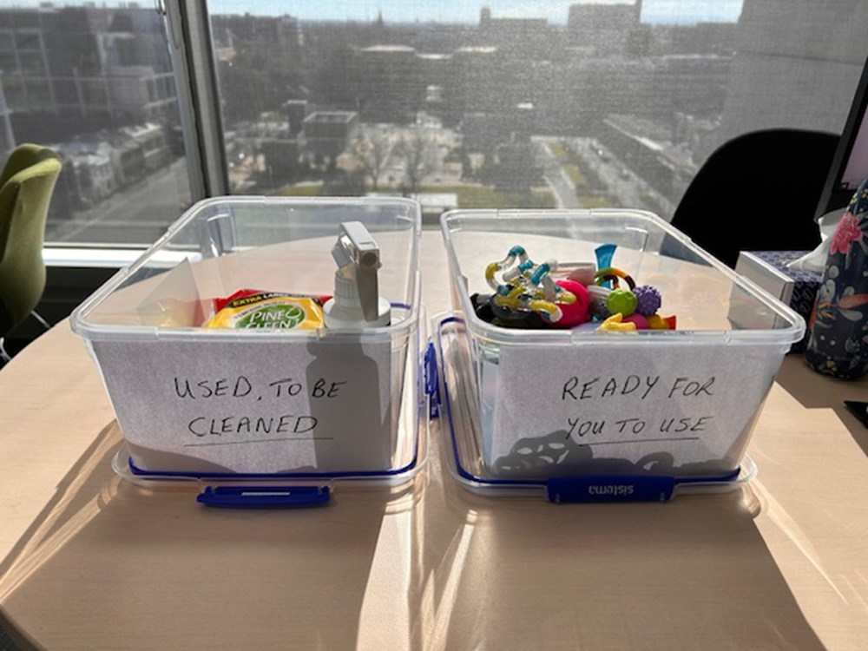
Fidget toys, and equipment
Disinfectant wipes and alcohol spray
Labels for fidgets to be cleaned or ready for use
Alternative text:
Photograph of two containers, one with a label that says ‘Used, to be cleaned’ and the other with text ‘Ready for you to use’. One container holds fidget toys, and the other holds cleaning equipment
The contained with fidgets also holds the wipes and spray, so the containers can be put inside one another for easier transport to and from class. I cleaned the toys while I spoke to students immediately after class ended.

Slide 16
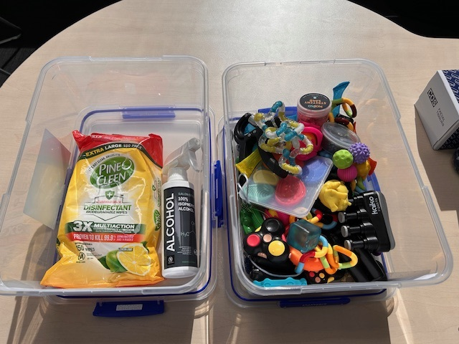
Inside the containers
A combination of good quality fidgets from https://kaikofidgets.com/ supplemented with others from Amazon, including packs
Alternative text: Photograph of two containers, one with cleaning equipment and one with a range of fidget toys

Slide 17

Example slide:
How’s your social battery?
Next time, I would also link to an online activity for students who wanted to engage in an activity individually
You can add a poll to this

Slide 18
What did I learn?
Be open about why you are doing this – students respect the honesty
Get students to pass them around so all have an opportunity to take a fidget – this means the whole class participates and no-one is singled out by coming up to get one
Put half the clean toys in the other container in the first class so students can pass around two containers, to speeds things up
In later classes, I found having them on a desk at the front was enough – nearly everyone would take one each day as they came in and some would swap fidgets part way through the day
Some fidgets will break, some may disappear (and hopefully be put to good use!) – so allow extras in the tubs, and if you will do this in multiple classes across a semester or year, get extras for topping up as needed.

Slide 19
Would I do it again?
I would ABSOLUTELY do this again!
Once I had the equipment and worked out set up, it was easy to implement and clean up is quick and easy. When you get back to your office, remove the lid overnight, just to allow the toys to air dry a bit (some are deliberately a bit sticky)
Next time, I would:
Have a feedback questionnaire already loaded into the LMS to evaluate the fidget toy initiative
Add some online methods for students to engage in real time whilst in class, if they want to engage individually in class activities

Slide 20
References
CAST. (2024) CAST Universal Design for Learning Guidelines 3.0. https://udlguidelines.cast.org
Edwards, M., Poed, S., Al-Nawab, H., & Penna, O. (2022). Academic accommodations for university students living with disability and the potential of universal design to address their needs. Higher Education, 84(4), 779–799. https://doi.org/10.1007/s10734-021-00800-w
Grimes, S., Scevak, J., Southgate, E., & Buchanan, R. (2017). Non-disclosing students with disabilities or learning challenges: Characteristics and size of a hidden population. The Australian Educational Researcher, 44(4), 425–441. https://doi.org/10.1007/s13384-017-0242-y
Grimes, S., Southgate, E., Scevak, J., & Buchanan, R. (2021). Learning impacts reported by students living with learning challenges/disability. Studies in Higher Education, 46(6), 1146–1158. https://doi.org/10.1080/03075079.2019.1661986
Vogel, S., & Schwabe, L. (2016). Learning and memory under stress: Implications for the classroom. NPI Science of Learning, 1(1), 16011. https://doi.org/10.1038/npjscilearn.2016.11

Slide 21
Questions?
Thank you!

