Slide 1
2e: Teaching using Radical Flexibility…

Slide 2
Acknowledgement of Country
The University of Melbourne acknowledges the Traditional Owners of the unceded land on which we work, learn and live: the Wurundjeri Woi-wurrung and Bunurong peoples (Burnley, Fishermans Bend, Parkville, Southbank and Werribee campuses), the Yorta Yorta Nation (Dookie and Shepparton campuses), and the Dja Dja Wurrung people (Creswick campus).
The University also acknowledges and is grateful to the Traditional Owners, Elders and Knowledge Holders of all Indigenous nations and clans who have been instrumental in our reconciliation journey.
We recognise the unique place held by Aboriginal and Torres Strait Islander peoples as the original owners and custodians of the lands and waterways across the Australian continent, with histories of continuous connection dating back more than 60,000 years. We also acknowledge their enduring cultural practices of caring for Country.
We pay respect to Elders past, present and future, and acknowledge the importance of Indigenous knowledge in the Academy. As a community of researchers, teachers, professional staff and students we are privileged to work and learn every day with Indigenous colleagues and partners.

Slide 3

Copyright warning
WARNING
This material has been reproduced and communicated to you by or on behalf of the University of Melbourne in accordance with section 113P of the Copyright Act 1968 (Act).
The material in this communication may be subject to copyright under the Act.
Any further reproduction or communication of this material by you may be the subject of copyright protection under the Act.
Do not remove this notice

Slide 4
Conventions for our space
Stimming is welcome!
We welcome:
  Fidgeting
  Stimming
  Tics
  Echolalia and coprolalia
  Standing and stretching or moving.
  Engagement is always optional.
  You may take a break at any time
  You may opt out of any activity.
  Communicate in a way that works for you.
  Communicate out loud or in writing.
  Online folks: It’s okay to have cameras off!
  Consider turning on cameras to speak vocally. (Some people lip read.)

Slide 5
The Flickering Light
Maya (vision impairment),
Theo (ADHD + gifted),
Kavi (autistic, multilingual)
All studying at Melbourne University and Gifted Learners
Grace, a new lecturer, asks: How can I teach all of them?
‘To teach at the edges is to teach for the middle — and beyond.’

Slide 6
From Perfection to Presence
Grace shifts from perfection to presence.
Retrofit → Pre-fit (Too Quirky, Too Quick,2e)
Practical inclusions:
  Pre-emailed notes
  Auto-captioned lectures
  Accessible PDFs
Design for dignity, not compliance.

Slide 7
Teaching for Uneven Minds
Theo’s story: high ability + executive challenges.
Micro-scaffolds = weekly 100-word reflections.
Outcome: engagement, momentum, mentorship.
Lesson: scaffolding supports excellence, not dependency.

Slide 8
Multiple Modes, Singular Purpose
Choice in expression: essay, podcast, infographic, video.
Same rubric — different mode.
Kavi’s bilingual podcast revealed hidden strengths.
Radical flexibility = strengths scaffolding.

Slide 9
Quiet Data, Loud Learning
Engagement ↑ even as attendance ↓.
Asynchronous participation creates access.
‘Flexibility creates access, not apathy.’
ASE Themes: participation and success.

Slide 10
Sensory Learning
Peppermint scent anchors cognition and focus.
Predictable sensory cues support regulation.
Sensory inclusivity = neurological realism.
Predictability, not sameness, fosters learning.

Slide 11
Minimal Effort, Maximum Inclusion
Five inclusions:
1. Auto-captioning
2. Micro-reflections
3. Choice in assessments
4. Peer discussion summaries
5. Sensory predictability
Five actions. Zero extra marking. Full inclusion.

Slide 12
The Invisible Cohort
Students benefit even without disclosure.
‘Visibility should not depend on vulnerability.’ (Too Quirky, Too Quick,2e)
Inclusive design supports unseen learners.

Slide 13
From Compliance to Creativity
End-of-semester showcase: podcasts, models, art.
Diverse outputs reveal deeper understanding.
Inclusion realised through creativity, not compliance.

Slide 14
Defining Radical Flexibility
Structure with give - a pedagogy of elasticity.
UDL + strengths scaffolding + environmental predictability.
Inclusion as epistemology of respect.

Slide 15
Provocation:
‘If excellence and disability coexist in one mind, can our institutions hold both in one policy?’
‘If we can caption videos automatically, why can’t we caption learning itself?’
‘What one thing could you loosen, shift, or open in your own teaching to make brilliance more visible?’

Slide 16
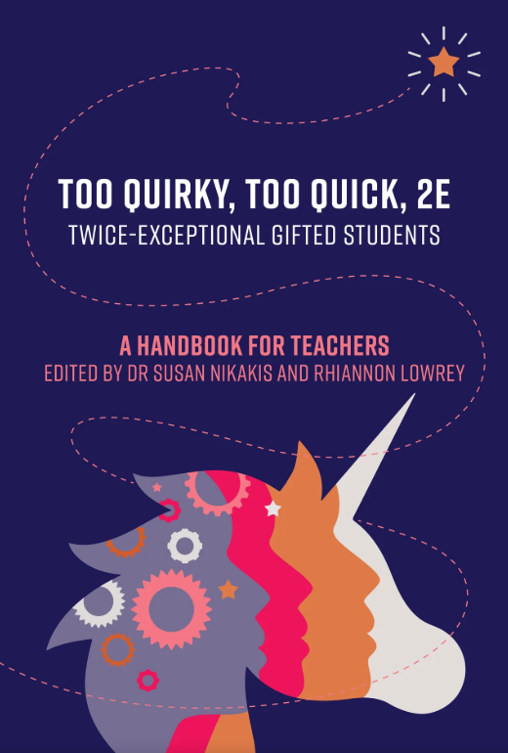
Too Quirky Too Quick 2e
– Nikakis, S. & Lowrey, R. (2025). Too quirky, too quick, 2e: A handbook for teachers. Amba Press.
Book on Amazon

Slide 17
Questions:
Feel free to ask questions live:
Email questions welcome at:
r.lowrey@unimelb.edu.au

Slide 18
Invitation
‘When we teach with radical flexibility, we don’t just reach the margins - we redraw them.’

Slide 19
References
Nidakis, J., & Lowrey, R. (Eds.). (2025). Too Quirky, Too Quick: 2E – A Handbook for Teachers. AMBA Press.
Ronksley-Pavia, M. (2020). A Model of Twice-Exceptionality. Frontiers in Education, 5, 115.
McCoach, D. B., Siegle, D., & Reis, S. M. (2018). Gifted Child Quarterly, 62(1), 2–23.
CAST. (2018). Universal Design for Learning Guidelines.

Slide 20
Thankyou

