Slide 1
Designing more inclusive assessment while maintaining secure learning
A/Prof Grace Thompson
Music Therapy Area
Faculty of Fine Arts and Music

Slide 2
Acknowledgement of Country
The University of Melbourne acknowledges the Traditional Owners of the unceded land on which we work, learn and live: the Wurundjeri Woi-wurrung and Bunurong peoples (Burnley, Fishermans Bend, Parkville, Southbank and Werribee campuses), the Yorta Yorta Nation (Dookie and Shepparton campuses), and the Dja Dja Wurrung people (Creswick campus).
The University also acknowledges and is grateful to the Traditional Owners, Elders and Knowledge Holders of all Indigenous nations and clans who have been instrumental in our reconciliation journey.
We recognise the unique place held by Aboriginal and Torres Strait Islander peoples as the original owners and custodians of the lands and waterways across the Australian continent, with histories of continuous connection dating back more than 60,000 years. We also acknowledge their enduring cultural practices of caring for Country.
We pay respect to Elders past, present and future, and acknowledge the importance of Indigenous knowledge in the Academy. As a community of researchers, teachers, professional staff and students we are privileged to work and learn every day with Indigenous colleagues and partners.

Slide 3
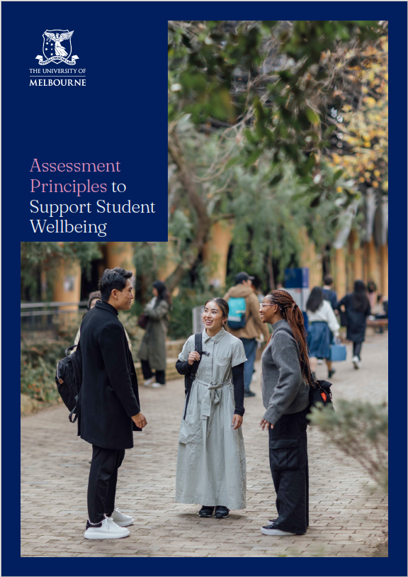
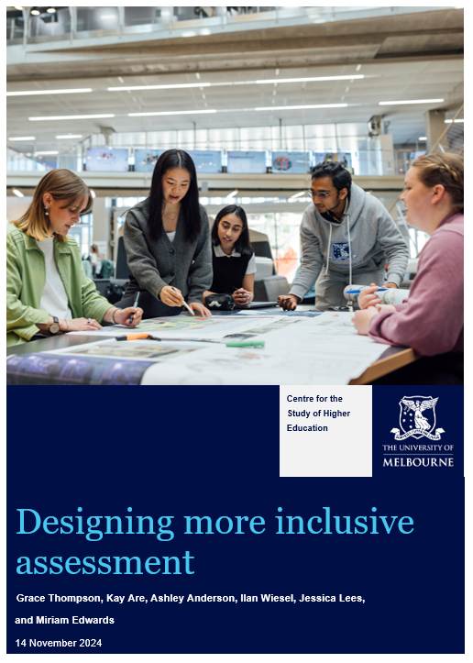
Introduction

Slide 4
Assessment intentions and experiences
What is valuable in learning
How success is measured
How students are tracking
Stress or pressure can create high expectations AND drive excellence
Clear feedback can enhance sense of growth and competence
Excessive stress or pressure can lead to negative life and learning experiences

Slide 5
Assessment intentions and experiences
What is valuable in learning
How success is measured
How students are tracking
Stress or pressure can create high expectations AND drive excellence
Clear feedback can enhance sense of growth and competence
Excessive stress or pressure can lead to negative life and learning experiences

Slide 6
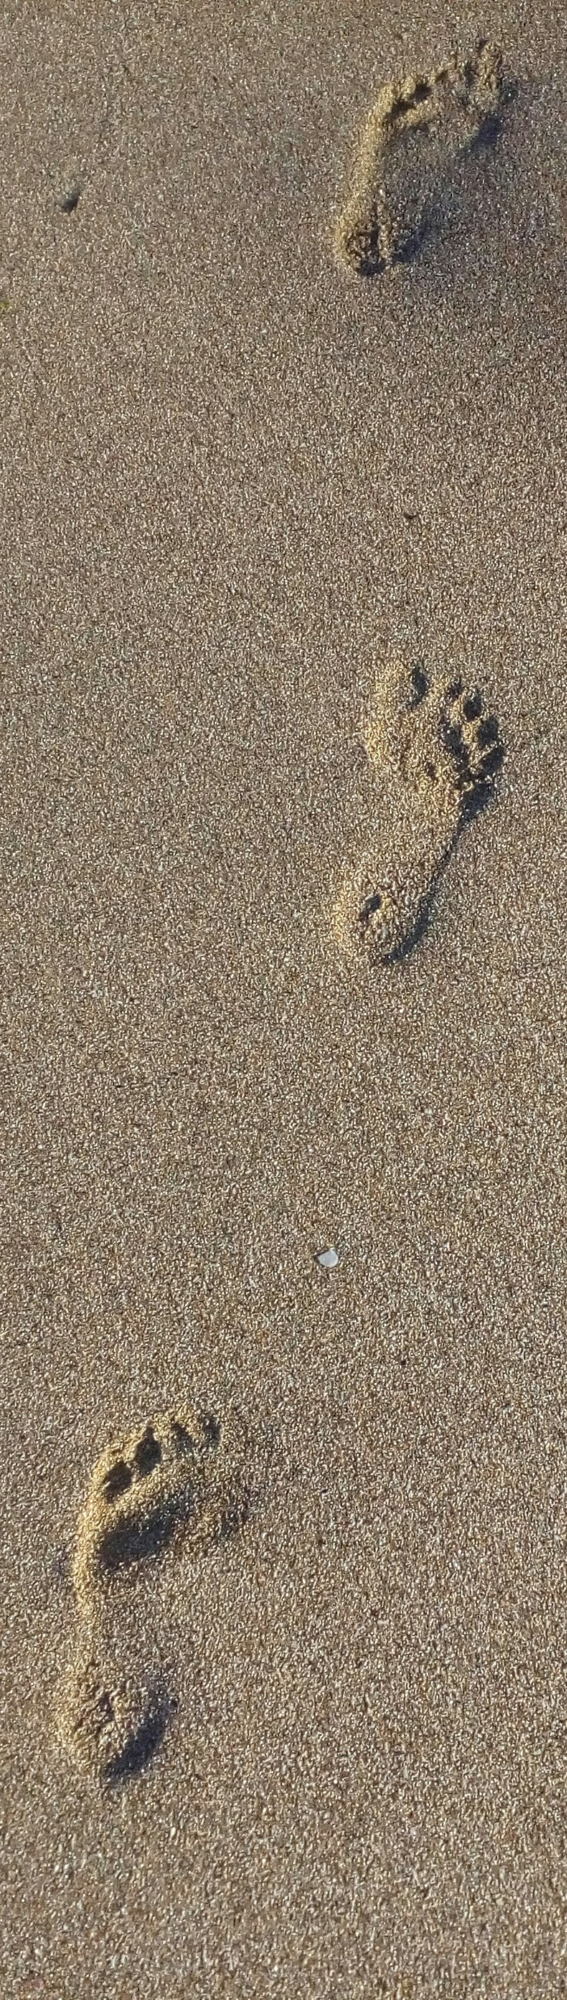
Inclusion and disability: What lead me here?
2nd generation migrant (family’s first language not English)
Physical disability requiring 10 surgeries before age 12 (educational impact)
Chronic pain experiences
First in family to have a PhD
Registered music therapist supporting children with disability and their families
Research investigating music therapy to support community access
My 25 yr old son recently diagnosed with ADHD
What are your connections to the topic of inclusion and accessibility?

Slide 7

Why focus on disability?
“Disability is part of being human. Almost everyone will temporarily or permanently experience disability at some point in their life. An estimated 1.3 billion people – about 16% of the global population – currently experience significant disability. This number is increasing due in part to population ageing and an increase in the prevalence of noncommunicable diseases.” (World Health Organisation)

Slide 8

Australian statistics
21.4% of people had a recorded disability in Australia (ABS, 2022).
Disability varies with your age:
One in seven (15.0%) people aged under 64 years
One in two (52%) of people aged 65 and over

Slide 9
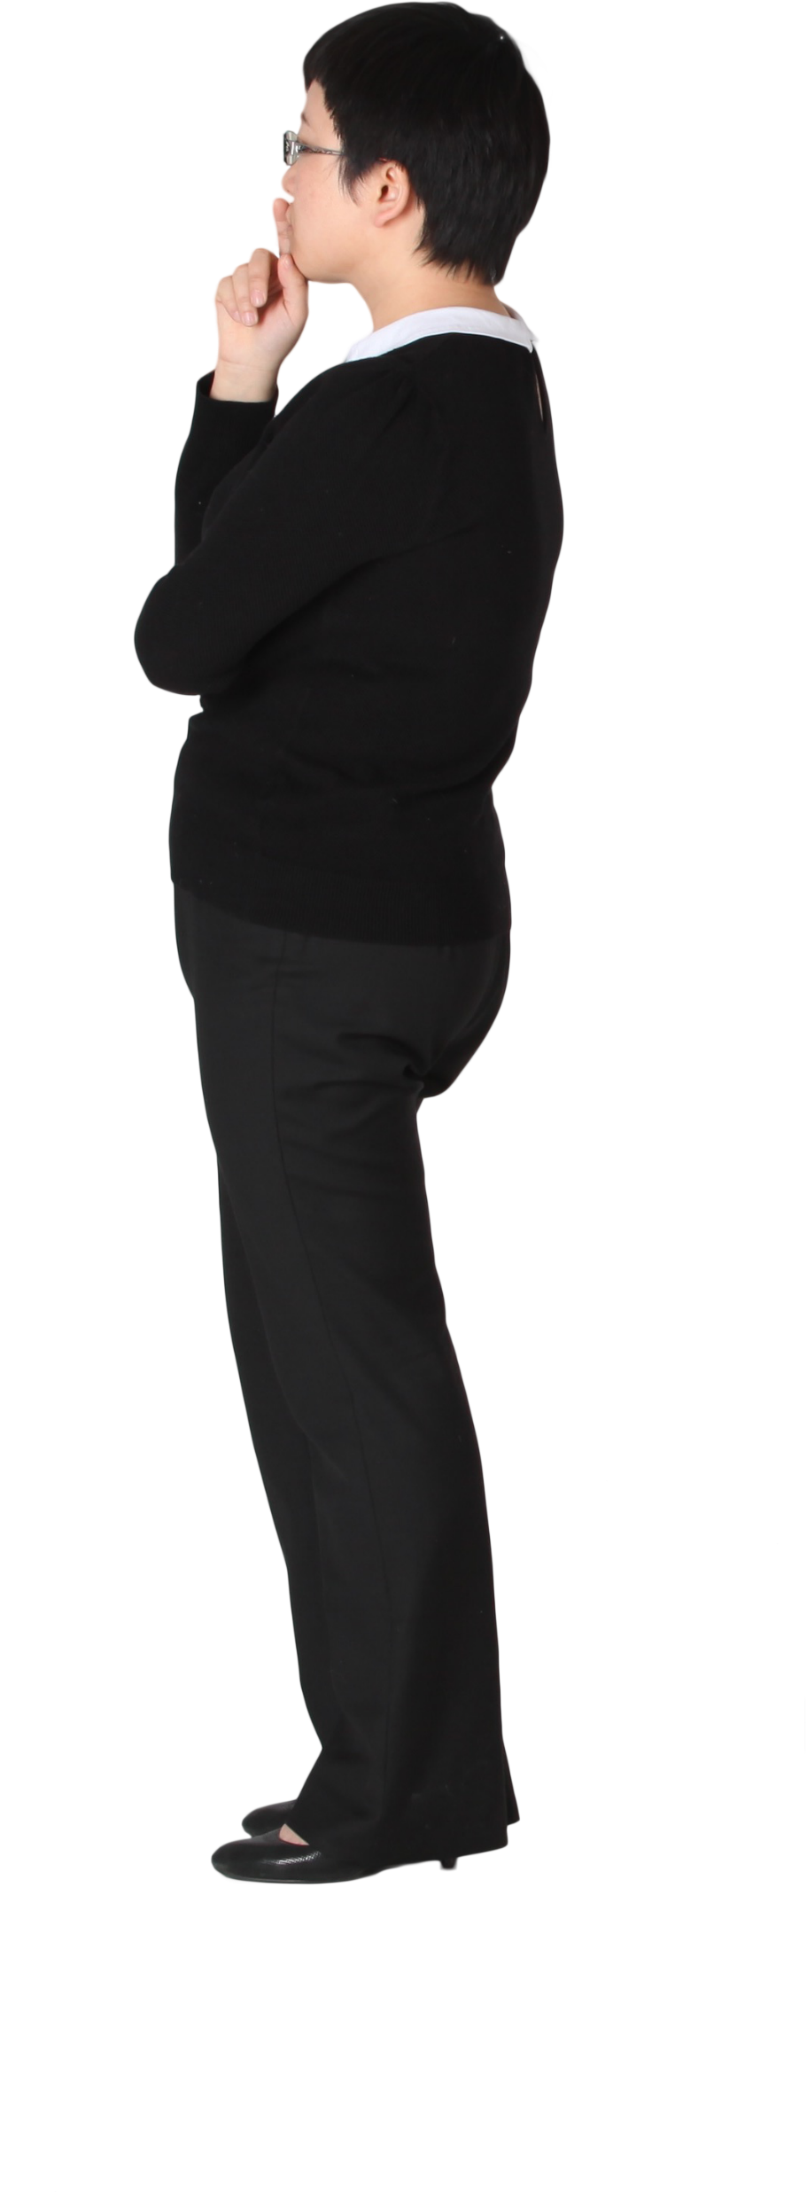
Disability rates at The University of Melbourne
15% of people under the age of 65 are disabled in Australia.
Is this reflected in enrolment at UniMelb?
Why, or why not?

Slide 10
Disability rates at The University of Melbourne
15% of people under the age of 65 are disabled in Australia.
Is this reflected in enrolment at UniMelb?
Domestic students who disclosed a disability at the time of enrolment has increased from 8.5% in 2019 to 12.8% in 2024
The percentage of international students who disclosed a disability at the time of enrolment has increased from 1.8% in 2019 to 2.0% in 2024.

Slide 11
Key consideration
We should expect to have students with disability in every course and every subject.

Slide 12

Universal Design for Learning (UDL)

Slide 13

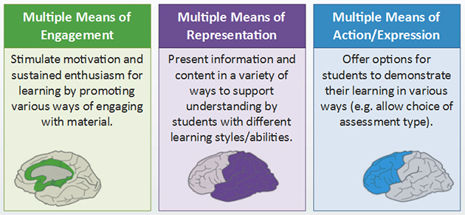
Three principles of UDL
https://www.cast.org/impact/universal-design-for-learning-udl

Slide 14
Multiple means of action and expression
Designing multiple ways for students to demonstrate their learning
and
Meeting Assuring Learning Assessment Principle 1:
At least 50% of the total mark in a subject must be based on secure assessment types (which are limited in terms of variety).

Slide 15
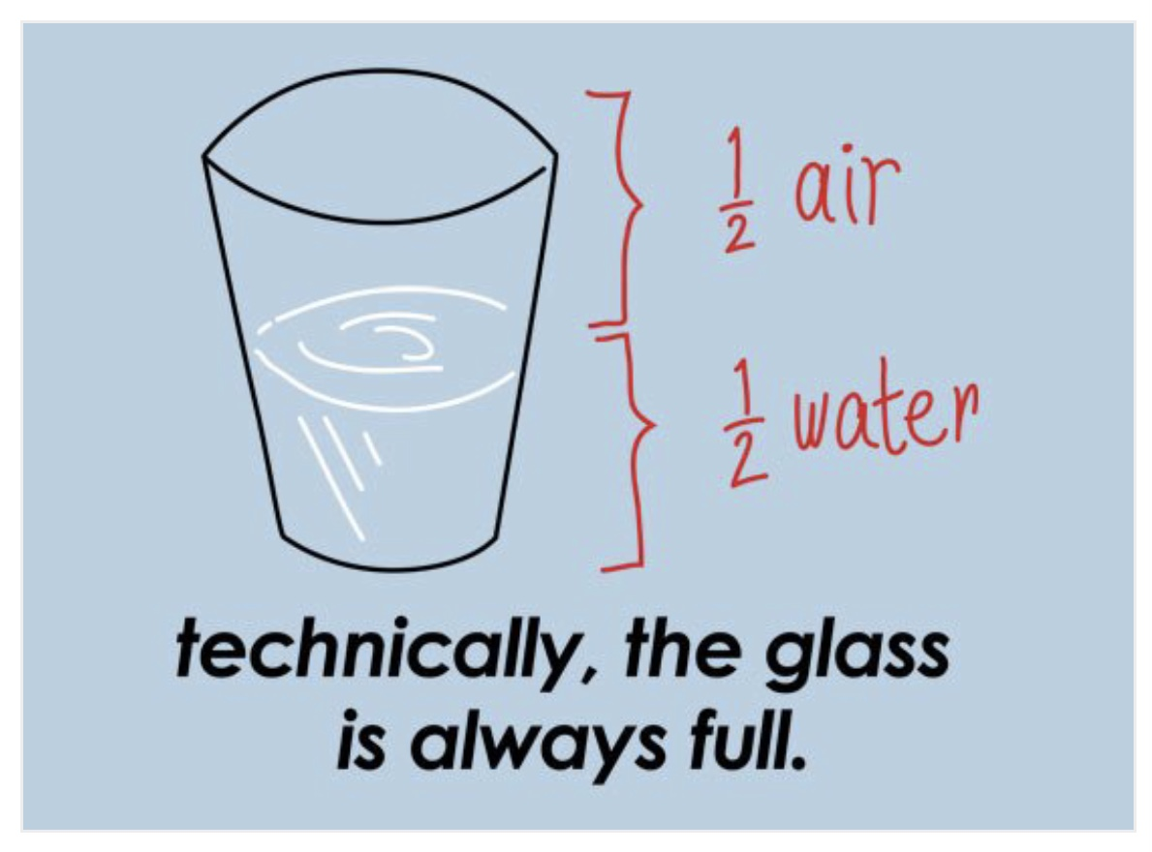
A tension or an opportunity?
https://steamfest.woodlawnschool.org/is-the-glass-half-empty-or-half-full/

Slide 16
How much variety is possible?
Subject coordinator plans a variety of assessment formats
Pre-determined list of open assessment choices for students
High degree of student choice in open assessment
Examples:
Required secure assessment (50%)
Selection of open assessment:
Oral group presentation (20%)
Written critical reflection (30%)
Practical demonstration (20%)
Examples:
Choice of topic/problem from set list.
Choice of written or video reflection
Choice of group members.
Example (more relevant to capstone subjects):
Folio of learning where different components can be determined by the student.

Slide 17
Extra considerations
If a particular format of assessment is essential within your discipline:
Scaffold student skills through formative assessment
Pre-plan alternative assessment options for students with an approved AAP
E.g. group presentations; interactive orals

Slide 18
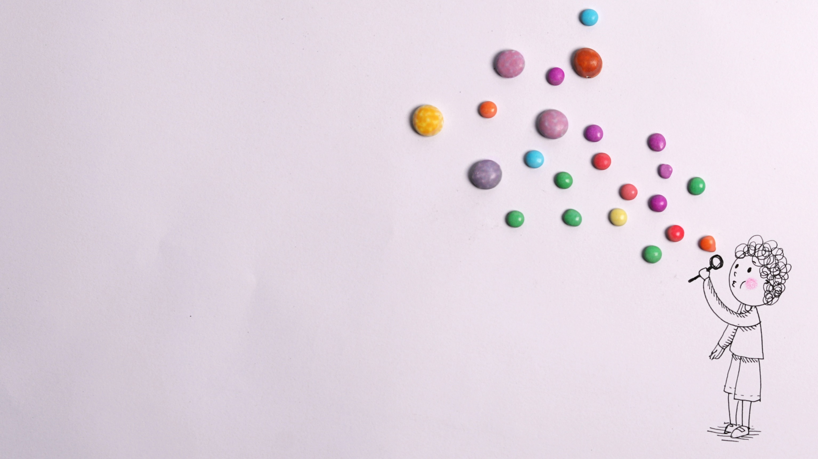
Summing up
Secure assessments will limit accessibility for certain students, particularly those from marginalised groups including disabled students.
Creatively consider how you will use the 50% allocated to open assessment in your subject.
Plan to scaffold learning and build student capacity to engage with specific assessment formats that may be highly demanding or stressful.
Seek feedback from your students about their experience of various assessment formats (seek anonymous feedback)

Slide 19
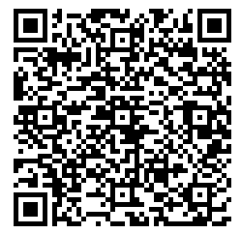
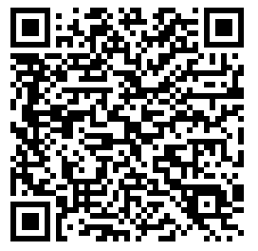
Key resources

Slide 20

Copyright warning
WARNING
This material has been reproduced and communicated to you by or on behalf of the University of Melbourne in accordance with section 113P of the Copyright Act 1968 (Act).
The material in this communication may be subject to copyright under the Act.
Any further reproduction or communication of this material by you may be the subject of copyright protection under the Act.
Do not remove this notice

