Slide 1
Inclusive Assessment by Design: Collaborative Approaches to Equitable Assessment in ABP
Sarah Sarah (Hui seung) Song and Michael Burville

Slide 2
Acknowledgement of Country
The University of Melbourne acknowledges the Traditional Owners of the unceded land on which we work, learn and live: the Wurundjeri Woi-wurrung and Bunurong peoples (Burnley, Fishermans Bend, Parkville, Southbank and Werribee campuses), the Yorta Yorta Nation (Dookie and Shepparton campuses), and the Dja Dja Wurrung people (Creswick campus).
The University also acknowledges and is grateful to the Traditional Owners, Elders and Knowledge Holders of all Indigenous nations and clans who have been instrumental in our reconciliation journey.
We recognise the unique place held by Aboriginal and Torres Strait Islander peoples as the original owners and custodians of the lands and waterways across the Australian continent, with histories of continuous connection dating back more than 60,000 years. We also acknowledge their enduring cultural practices of caring for Country.
We pay respect to Elders past, present and future, and acknowledge the importance of Indigenous knowledge in the Academy. As a community of researchers, teachers, professional staff and students we are privileged to work and learn every day with Indigenous colleagues and partners.

Slide 3
Conventions for our space
  Engagement is always optional.
  You may take a break at any time
  You may opt out of any activity.
  Communicate in a way that works for you.
Stimming is welcome!
We welcome:
  Fidgeting
  Stimming
  Tics
  Echolalia and coprolalia
  Standing and stretching or moving.

Slide 4
Project Purpose
To help ensure that ABP’s assessment practices comply with the reasonable adjustment requirements as outlined in the Disability Standards for Education 2005 and provide contextualised guidance on effective assessment design that promotes inclusion.

Slide 5
Aligning with ABP Assessment Practice Needs
Objective
Assessment Tasks
Judgement-based
Assessment Tasks
Select Response Items
  Multiple choice
  Alternative choice
  Ordering
  Labelling
Quizzes
Exams
Design portfolios
Posters/panels
Physical/3D models
Oral presentation
Essays
Reports
Exams

Slide 6


The partnership

Slide 7
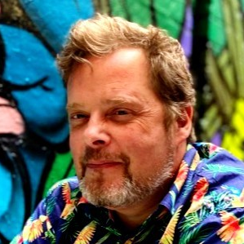
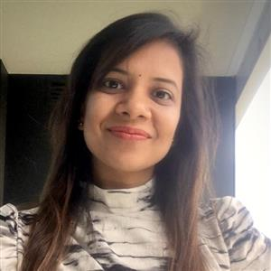
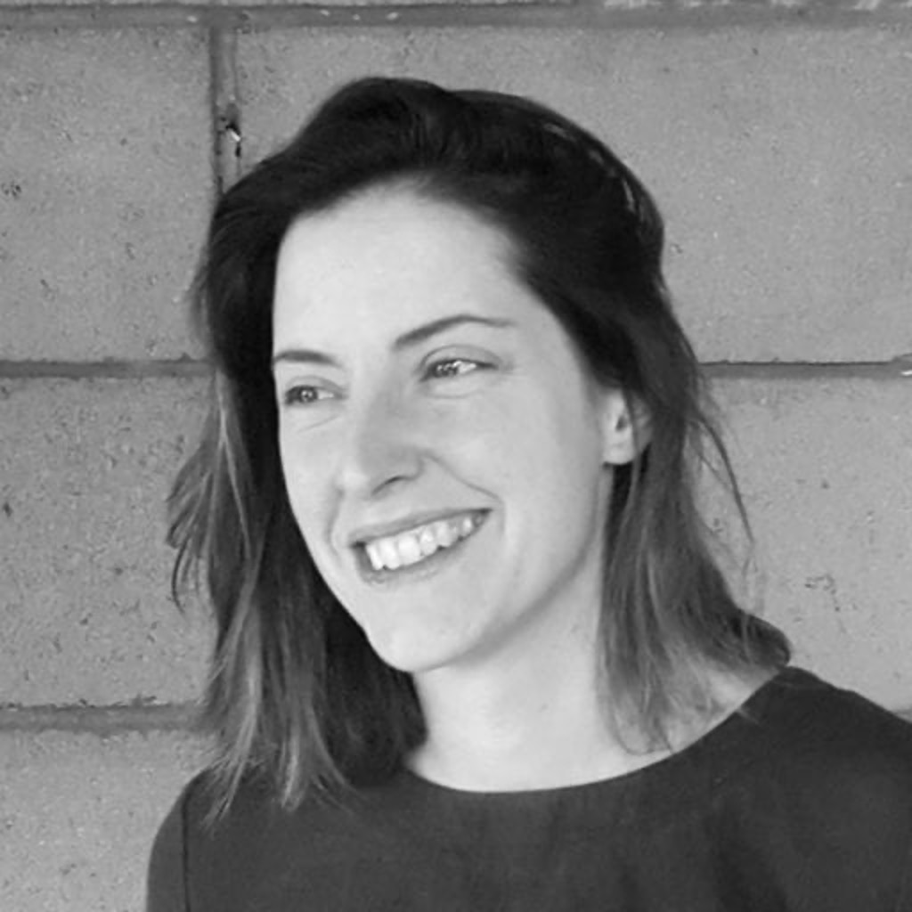
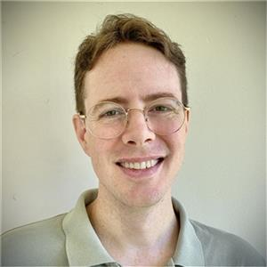

The partnership
Michael Burville
Timsy Gupta
Bridget Keane
Geoff Kelly
Sarah Song

Slide 8
The partnership
ABP Working GRP:
Andre Martel
Wendy Walls
Soon-Tzu Speechley
Sidh Sintusingha
Derlie Mateo-Babiano
Xavier Cadorel
Kathryn Davidson
Anna Hurliman
Hao Wu
Margaret Grose
Shang Gao
Giogio Marfella
Michael Burville
Timsy Gupta
Bridget Keane
Geoff Kelly
Sarah Song

Slide 9

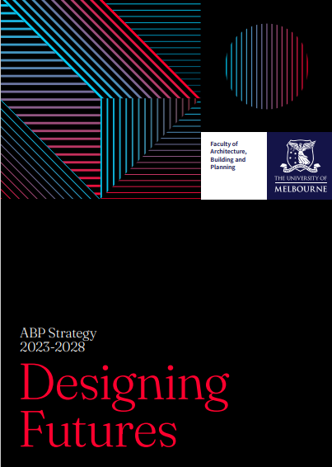


Aligning with University Strategy
Diversity and Inclusion Strategy
“Diversity and inclusion is embedded in all our systems, processes and work”
ASE
Nurturing excellent students from all backgrounds
Equity group participation and completion
Designing Futures
Page 16-17
Review and revise assessment practices in relation to equity for students
People Strategy
Focus Area 2
“a thriving, fair and diverse University”

Slide 10
How we worked together
Project Plan & Scoping:
Engage Working Group & Stakeholders: 31/05/2024
Test and Develop tools and guidance:
Review Assessment Tasks & Practices:
Provide Initial Documentation and Guidance:
Handover and Final Sign-Off:
Workshop 1:
Workshop 2
Academic Working Group Focus
Supporting Inclusive and Equitable Assessment Practices in ABP

Slide 11
Our approach
Designing for Inclusion
Three elements of assessment
UDL for assessment design
Strengths-based and realistic

Slide 12

Moving past responding to individuals
…shifting to inclusion in assessment moves past responding to the needs of a single equity group, or a reactive stance… to creating assessments that are accessible for a wide range of students
-- Tai et al, 2022

Slide 13

A proactive, design approach
… inclusive assessment is therefore not about catering for specific individual differences through case-by-case adjustments to assessment. Rather, it’s about being proactive in approaches to assessment design.
Tai et al, 2022

Slide 14
Three elements of assessment
IncludED: A guide to designing inclusive assessments | Centre for Teaching and Learning (ox.ac.uk)
TASK
Inclusive Assessment
.
TIMING
CONDITIONS

Slide 15

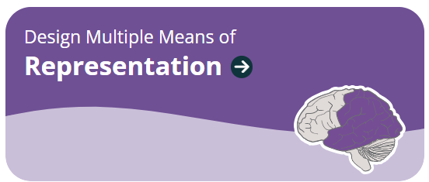
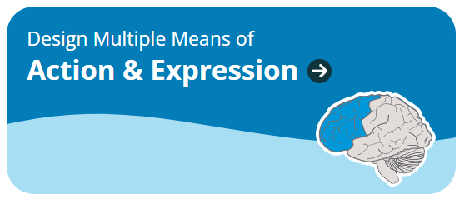
UDL for Assessment Design
UDL principles: https://udlguidelines.cast.org /
UDL On Campus: UDL and Assessment (cast.org)

Slide 16
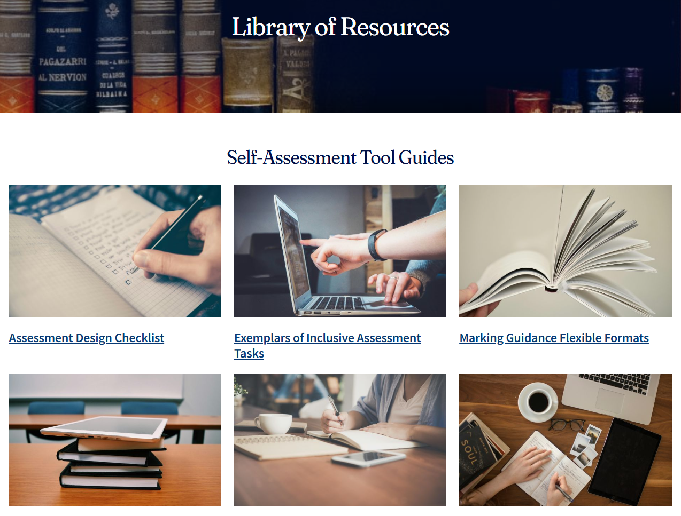
What we built together
Library of Resources
Self-Assessment Tool Guides
Assessment Design Checklist
Inclusive Assessment Exemplars
Flexible Marking Guidance
Assessment Adjustments Table
Neurodiversity-Aware Design Checklist (Canvas LMS)
Guidance for Managing Inclusive Assessment Adjustments

Slide 17
Self-Assessment Tool
Purpose: To help educators confirm where the design of an assessment is already inclusive and identify areas for improvement.•
Objectives
Enable educators to reflect on their assessment practices
Provide evidence-based, contextualized guidance on inclusive assessment design.
Highlight strengths in current assessment designs.
Help educators prioritise changes that have maximum impact for minimum effort
Support the development of policies, procedures, and systems that facilitate inclusive assessment design

Slide 18
Self Assessment Tool Structure
One
Rate your confidence
Two
Recommended resources
Three
Plan one change

Slide 19
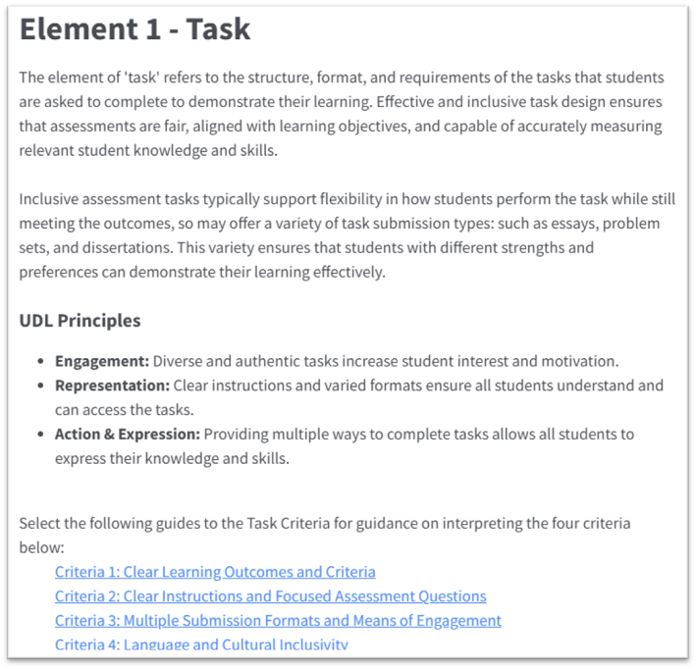
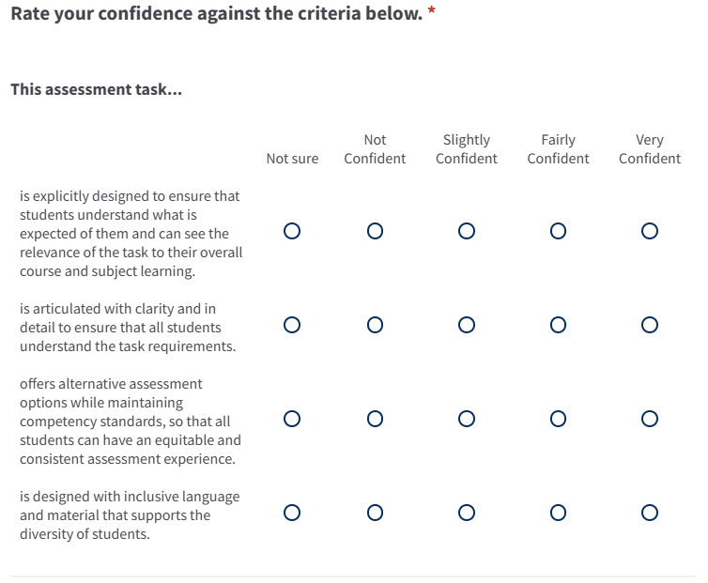
Step One: Rate your confidence

Slide 20
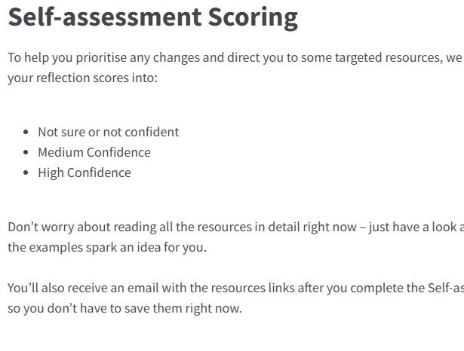
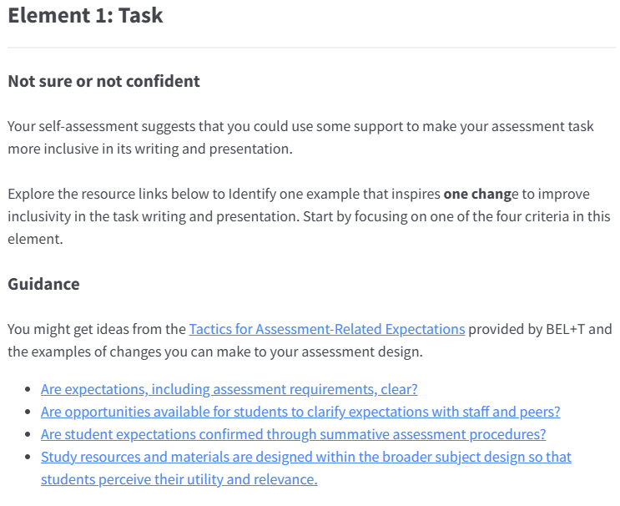
Step Two: Recommended Resources

Slide 21
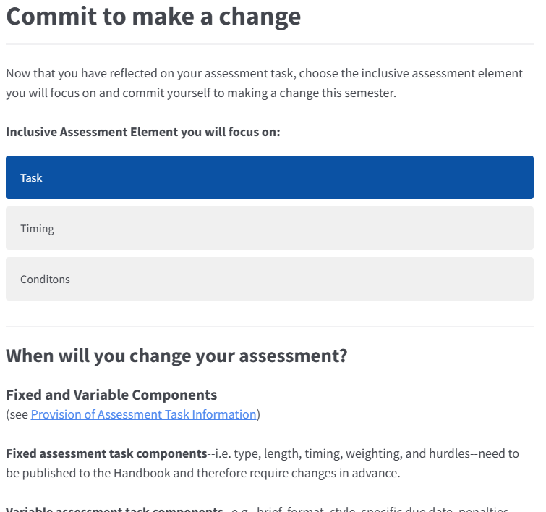
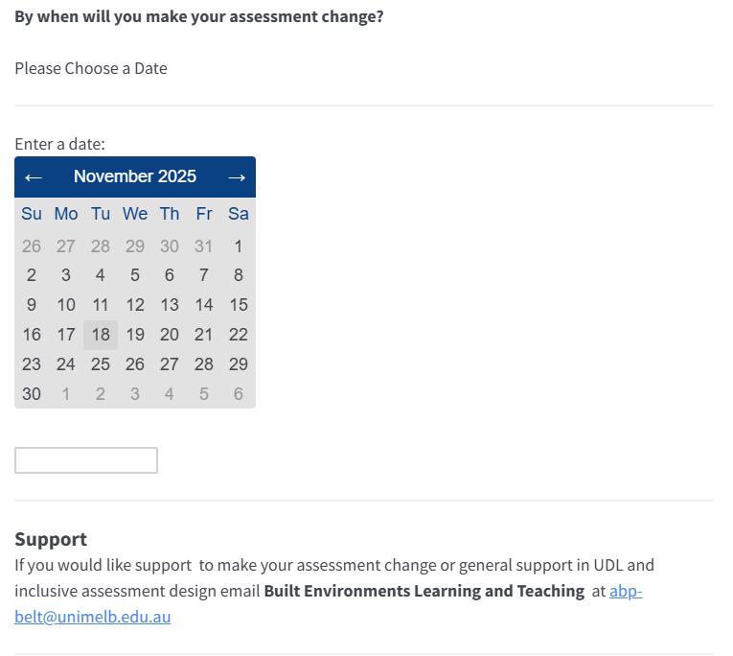
Step Three: Commit to make a change

Slide 22
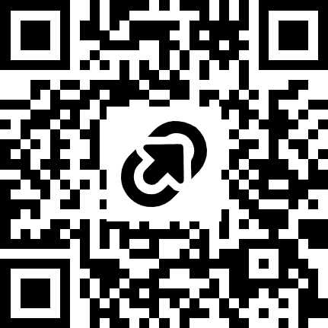
Explore and follow-up
Self-Assessment Tool
Resource pack
General | Inclusive Assessment | Microsoft Teams
Contact us
Sarah Song
huiseung.song@unimelb.edu.au
Michael Burville
michael.Burville@unimelb.edu.au
https://tinyurl.com/bdzbvs95

Slide 23
End of presentation

