Slide 1
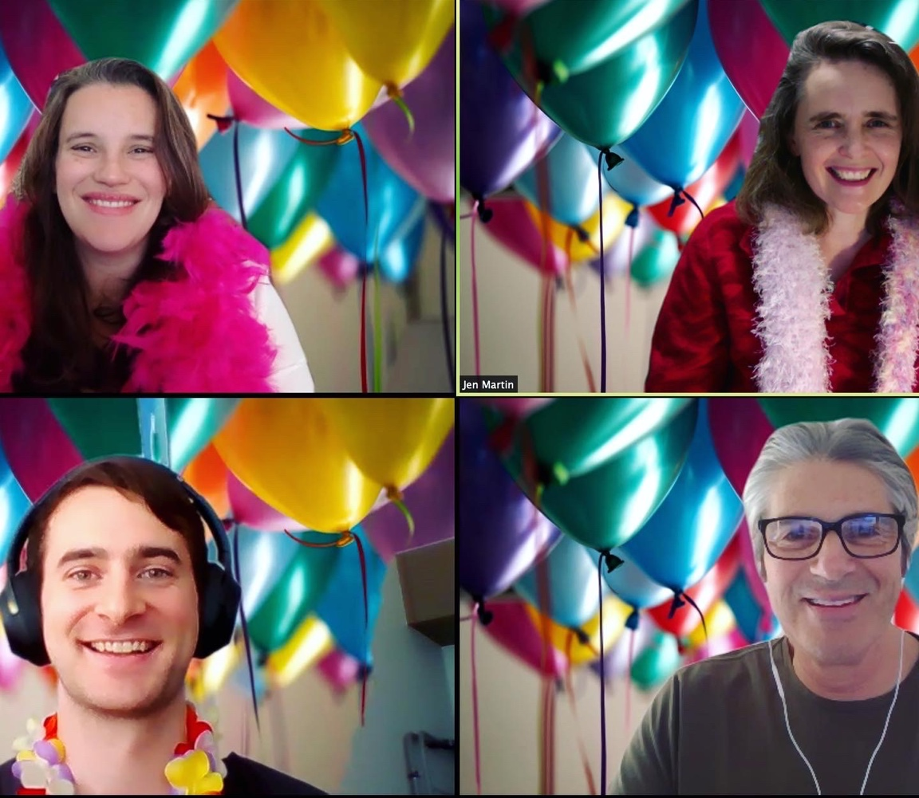
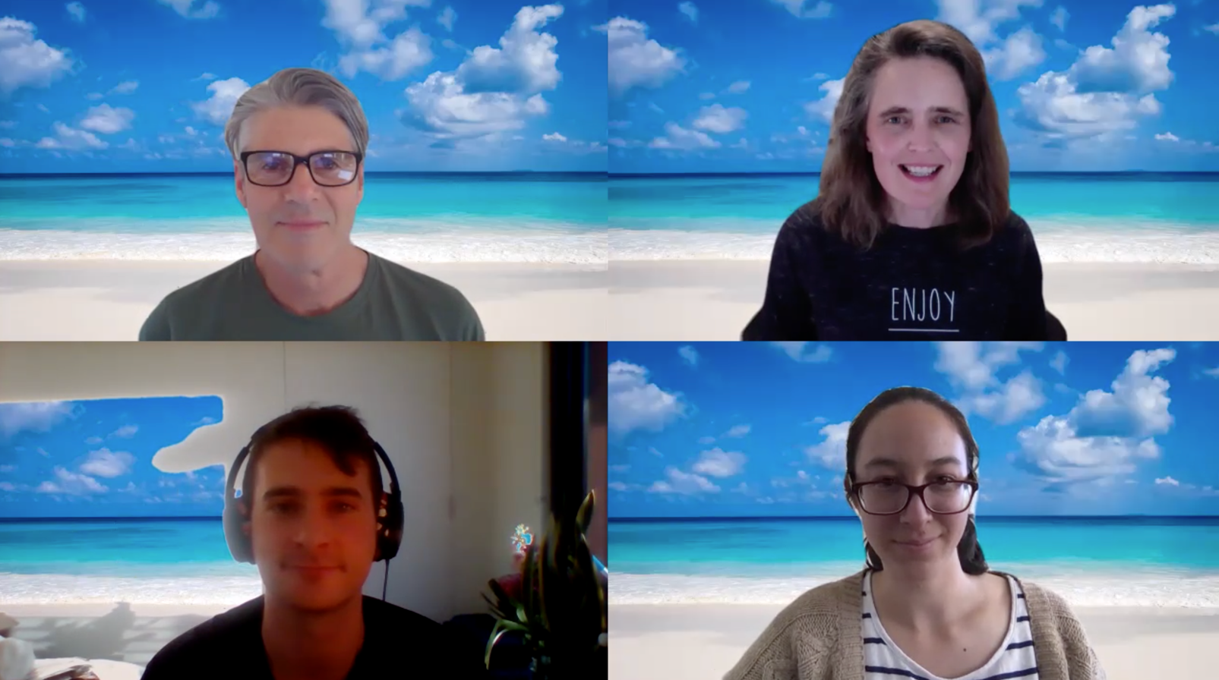
What have I learned about teaching this year?
Dr Jen Martin @scidocmartin

Slide 2
UniMelbSciComm
Suite of practical, skills-based subjects for science students (UG & PG)
“Science isn’t finished until it’s communicated”
SCIE90013 Communication for Research Scientists
SM1 & SM2: 100+ research-active Master’s (& PhD) students
Winter intensive
Communicating with inter-disciplinary scientific audiences

Slide 3
Our priorities:
1. Learn and practice the communication skills
2. Feel connected and engaged with us and each other
3. Student and staff wellbeing
What online practices should we keep into the future?

Slide 4
1. Skill development: what’s different online?
Writing ✅
Peer review ✅
Conferences ✅
Social Media ✅
Tutorial activities ✅
Panel Q&A sessions ✅
Public speaking ⚠️
15-minute one-on-one session for all students

Slide 5
“I can’t believe the teaching staff offered an individual session for everyone in the class – I learned so much in my 15 minutes about how to talk about my research”

Slide 6
2. Feel connected and engaged: how to create community?
Connecting with our students as individuals ✅
Live polling ✅
Lots of peer interaction ✅
Accessible staff ✅
Modelling authentic communication ⚠️
Weekly themed teaching update videos

Slide 7
“The teaching staff have really taken the situation we are in and used it to find new ways of connecting with us and making us feel supported. Constantly seeing their friendly faces on weekly update videos makes me feel very connected to this subject”

Slide 8
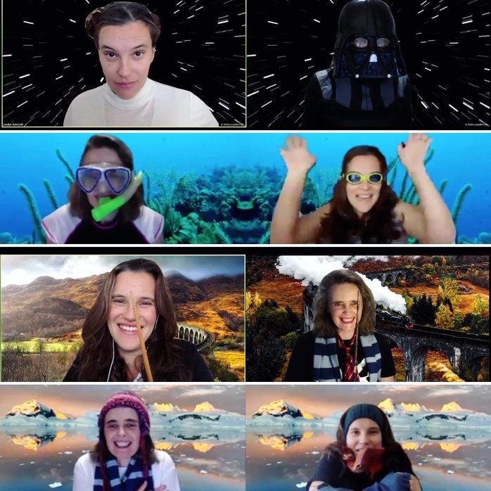
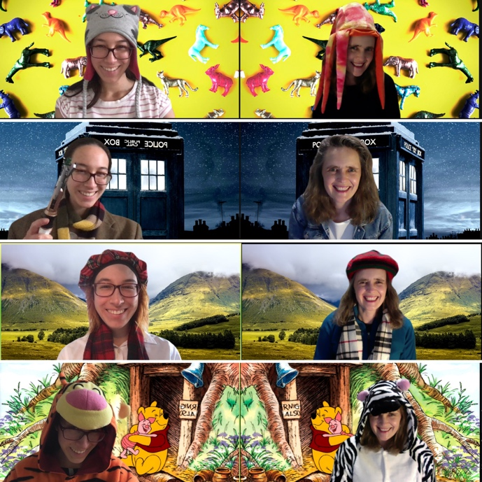
“The sense of community you created in this subject was unlike any other subject I've taken (in person or online)”

Slide 9
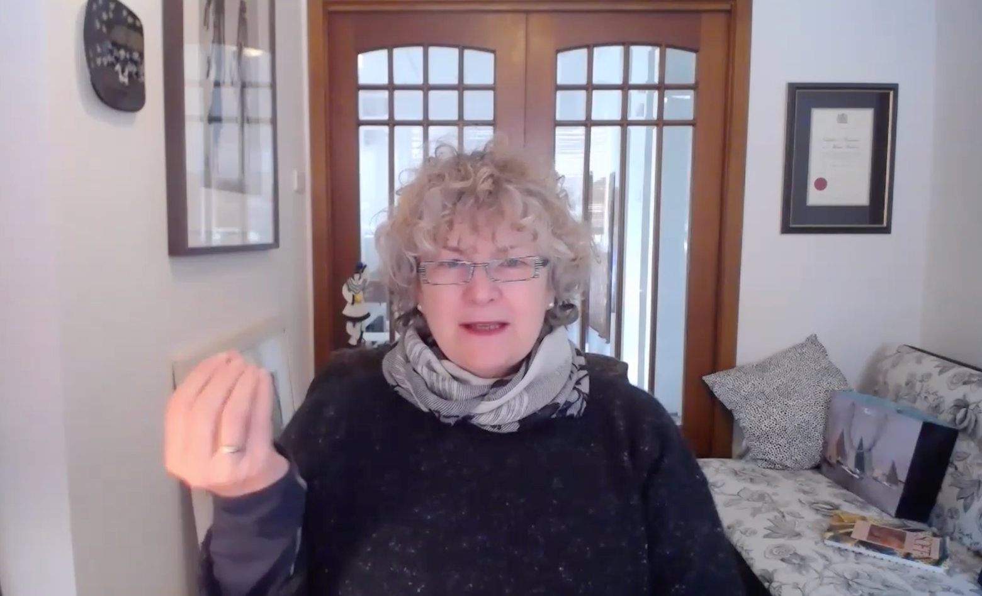
Student Wellbeing
Strategies to tackle procrastination ✅
Open discussions about imposter syndrome ✅
Support for working with supervisors ✅
Practical lockdown support ⚠️
Q&A sessions with Clinical Psychiatrist Associate Professor Sandra Radovini

Slide 10
“I felt so much calmer after the mental health session with Sandra – I don’t feel alone in my anxiety anymore about why I can’t get my work done. I know more about how to actually DO self-care.”

Slide 11
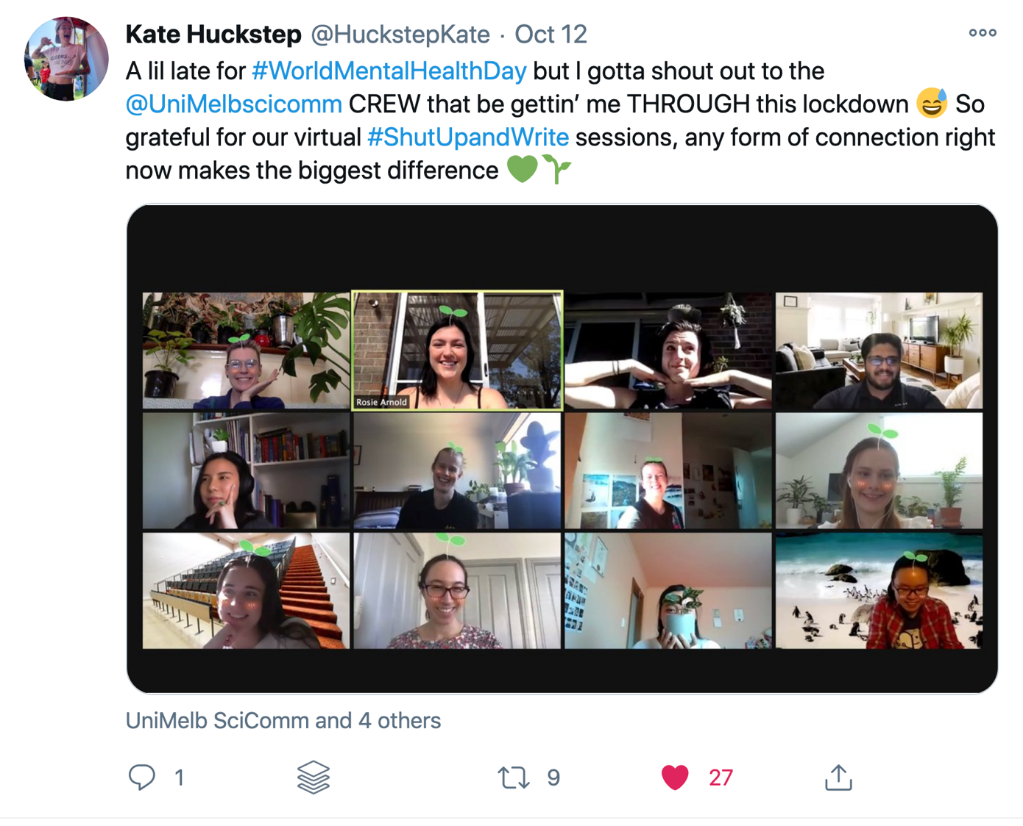
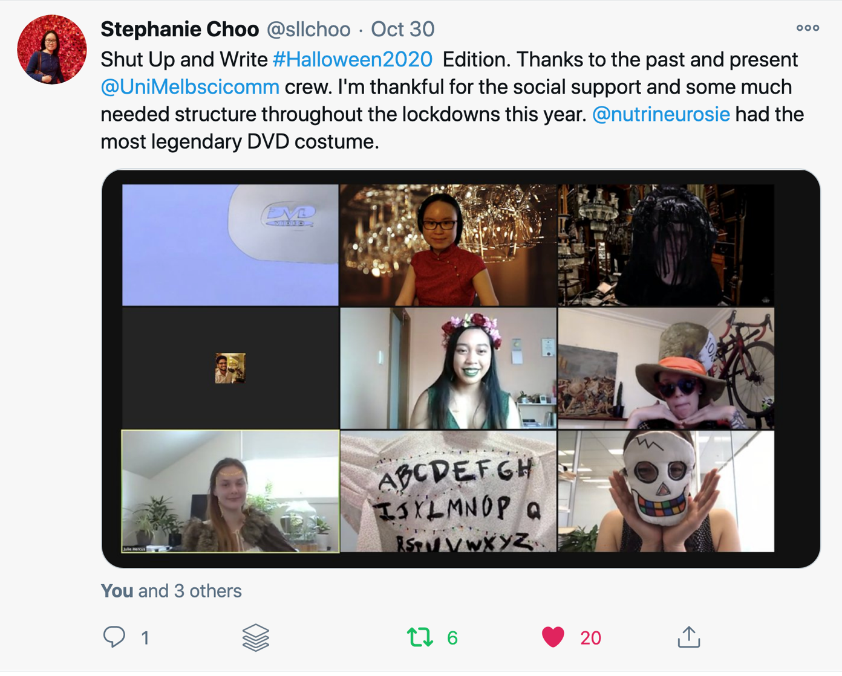
Student Wellbeing
Shut Up and Write: 2 – 5pm, 5 days/week
“I’m thankful for the social support and some much-needed structure throughout the lockdowns this year”
“Any form of connection right now makes the biggest difference”

Slide 12
Staff wellbeing
Power and joy of a team
Frequent, clear communication
Fun, social time and connection matters
What have I learned about teaching?
We’ve found innovative, effective ways to teach online and connect with our students, but what is sustainable?
Reflect further on teaching online when not in a pandemic

