Slide 1
Inclusive reflection and ePortfolio pedagogies for blended and online learning
Inclusive Learning Symposium, 2025​
Kate Mitchell (Senior Learning Designer – ePortfolios)​
Asli Mccarthy (Lecturer)

Slide 2
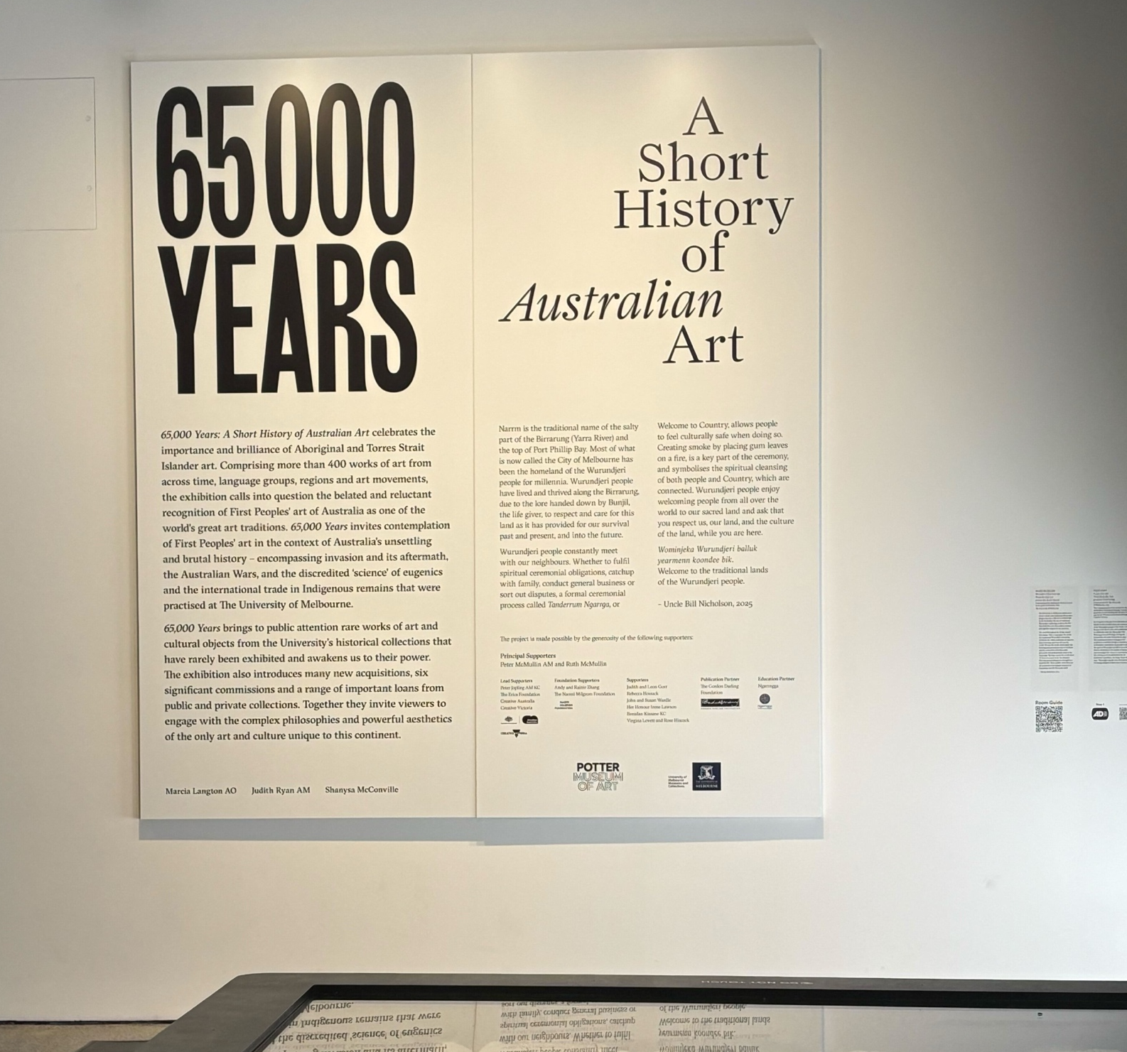

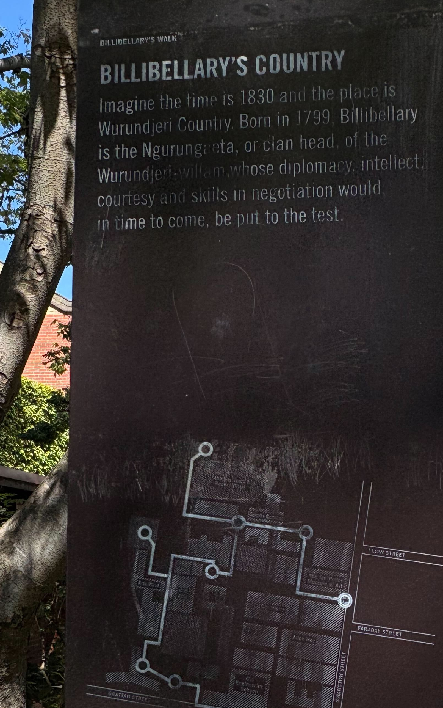
Acknowledgement of Country
Acknowledgement of Country

Slide 3
Overview
What is ePortfolio pedagogy and its advantages?
What is accessibility and inclusion in ePortfolios?
Underpinning principles of inclusive reflection and ePortfolios
Examples, considerations and takeaways

Slide 4
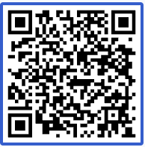
Quick poll
What is your experience with ePortfolios?
What is your experience with UDL?
Join by Web: PollEv.com​/katemitchell
Join by SMS: Send katemitchell to +61 480 025 509
Page [4]

Slide 5
ePortfolio pedagogy and reflection
Reflection
Reflection/Reflective practice forms the core of ePortfolio pedagogy.

Slide 6
ePortfolio pedagogy advantages
      Reflection and ePortfolio pedagogies can support :
        Deep learning
        Identity development
        Resilience, wellbeing and inclusion
        (Watson et al., 2016; McLellan, 2021; Dave & Mitchell, 2025)
      ! Poor implementation and support may undermine or contradict these aims.
      (McCarthy et al., 2025)

Slide 7
Access vs. accessibility
Access is not accessibility
We refer to physical and digital accessibility
Digital accessibility should meet WCAG in spirit and in practice
Accessibility needs to be part of but is not the whole of inclusion
Accessibility is the minimum threshold for UDL
UDL when done well, encompasses accessibility and other forms of representation and inclusion.
Acronyms:
WCAG: Web Content Accessibility Guidelines
UDL: Universal Design for Learning

Slide 8
Underpinning principles
AAEEBL Digital Ethics in ePortfolios (v.3)
Accessibility principle:
ePortfolio platforms and pedagogy should be accessible to diverse creators and diverse audiences.

Slide 9
What this means for ePortfolio pedagogy
Educators and students should be educated about:
Accessible design
Content creation
ePortfolio tools

Slide 10
Inclusive Content: Language in ePortfolios
"Language choices impact how individuals or groups of people are perceived and how they receive health care."
  Deakin Principles for inclusion in health professions education

Slide 11

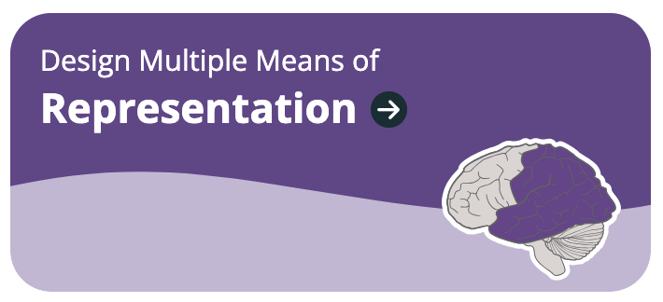

Universal Design for Learning
Design for:
Welcoming Interests and Identities
  Sustaining effort and persistence
  Emotional capacity
  Perception (accessibility)
  Interaction (accessibility)
  Building knowledge
  Language and symbols
  Strategy Development

Slide 12
Choice, autonomy, authenticity
Welcoming interests and identities
Optimise choice and autonomy
Optimise relevance, value and authenticity
Nurture joy and play
Building knowledge
Cultivate multiple ways of knowing and meaning-making
Expression and communication

Slide 13
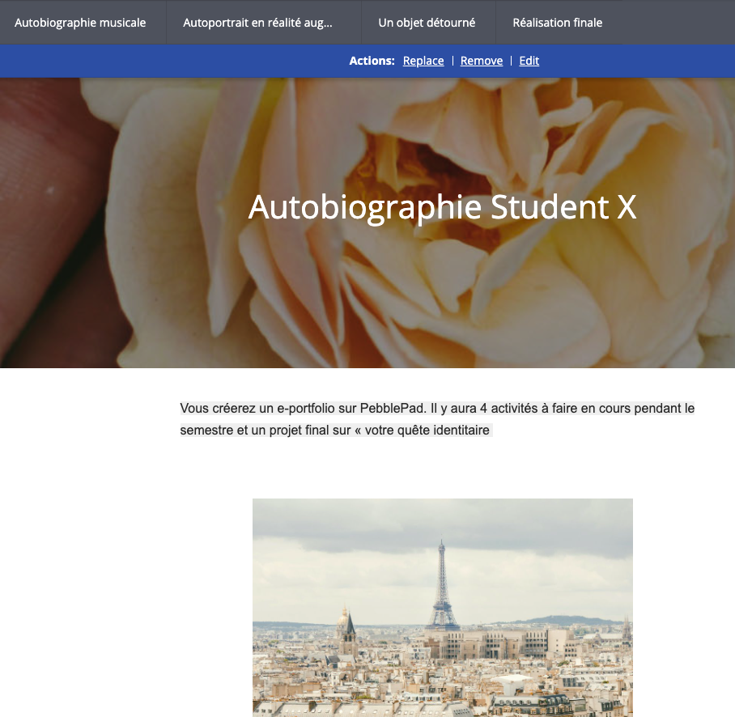
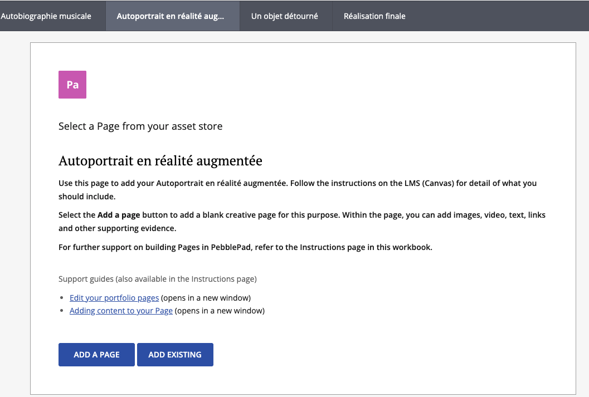
Choice in assessment – Global French Studies
Global French Studies – Thank you to Dr Antonia Wimbush and Dr Diane de St Léger
Providing choice for students in assessment (TLI news)
Acknowledgement to Dr Melitta Hogarth

Slide 14
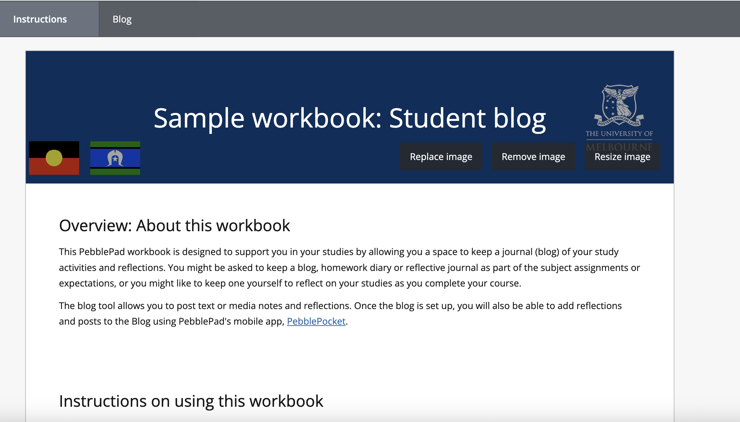
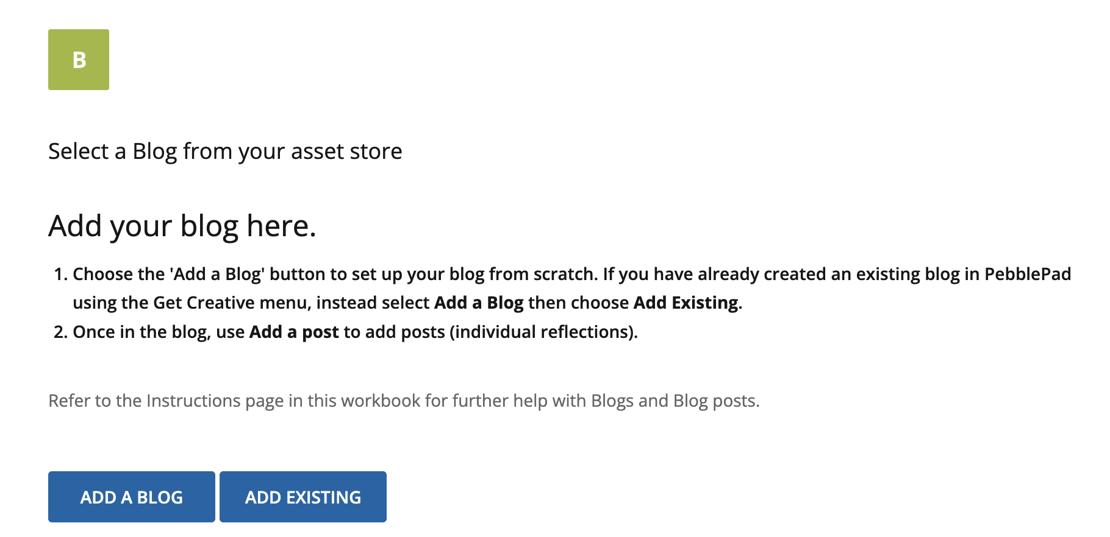
PebblePad blog workbooks

Slide 15
Reflection, goal setting and supports
Promote reflection
Set meaningful goals
Anticipate and plan for challenges
Connect prior knowledge to new learning
Optimise relevance
Clarify meaning and purpose of goals
Cultivate multiple ways of knowing and meaning-making
Graduated supports and sustaining persistence

Slide 16
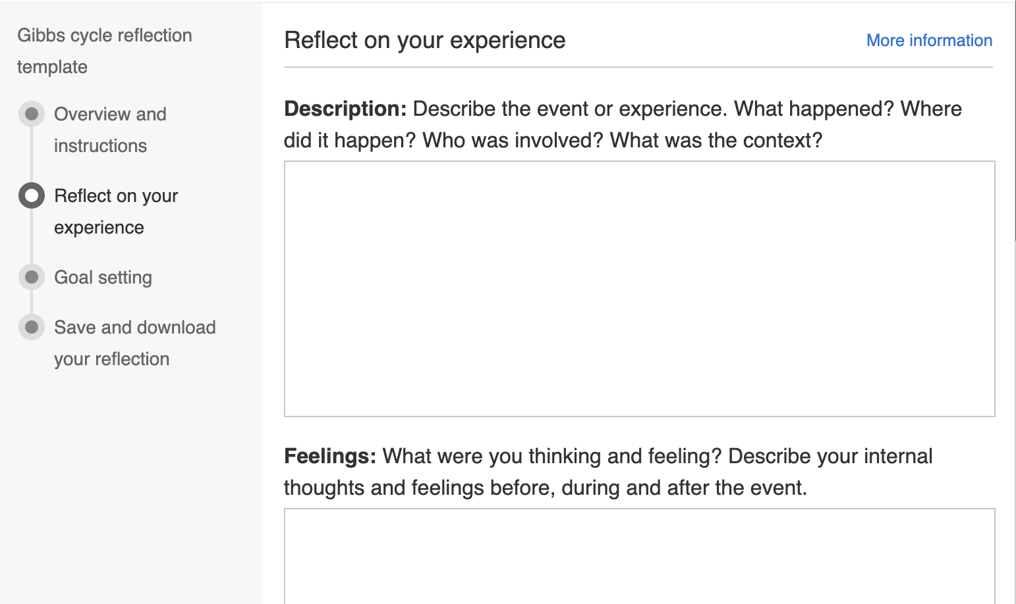
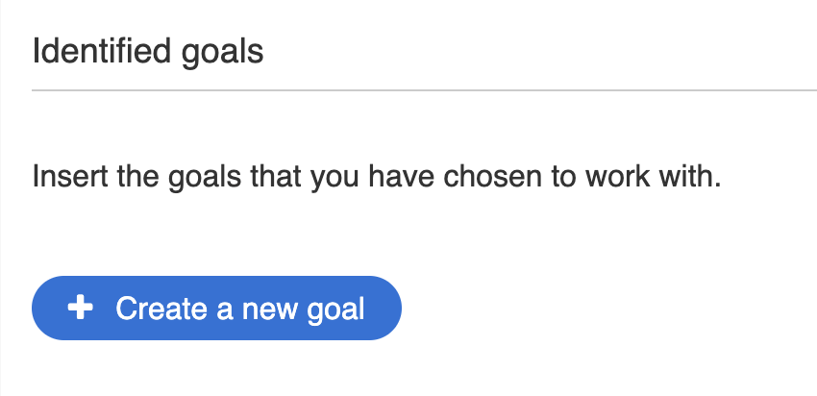
H5P documentation tool
TLI News – Quick teaching tips for the first few weeks

Slide 17
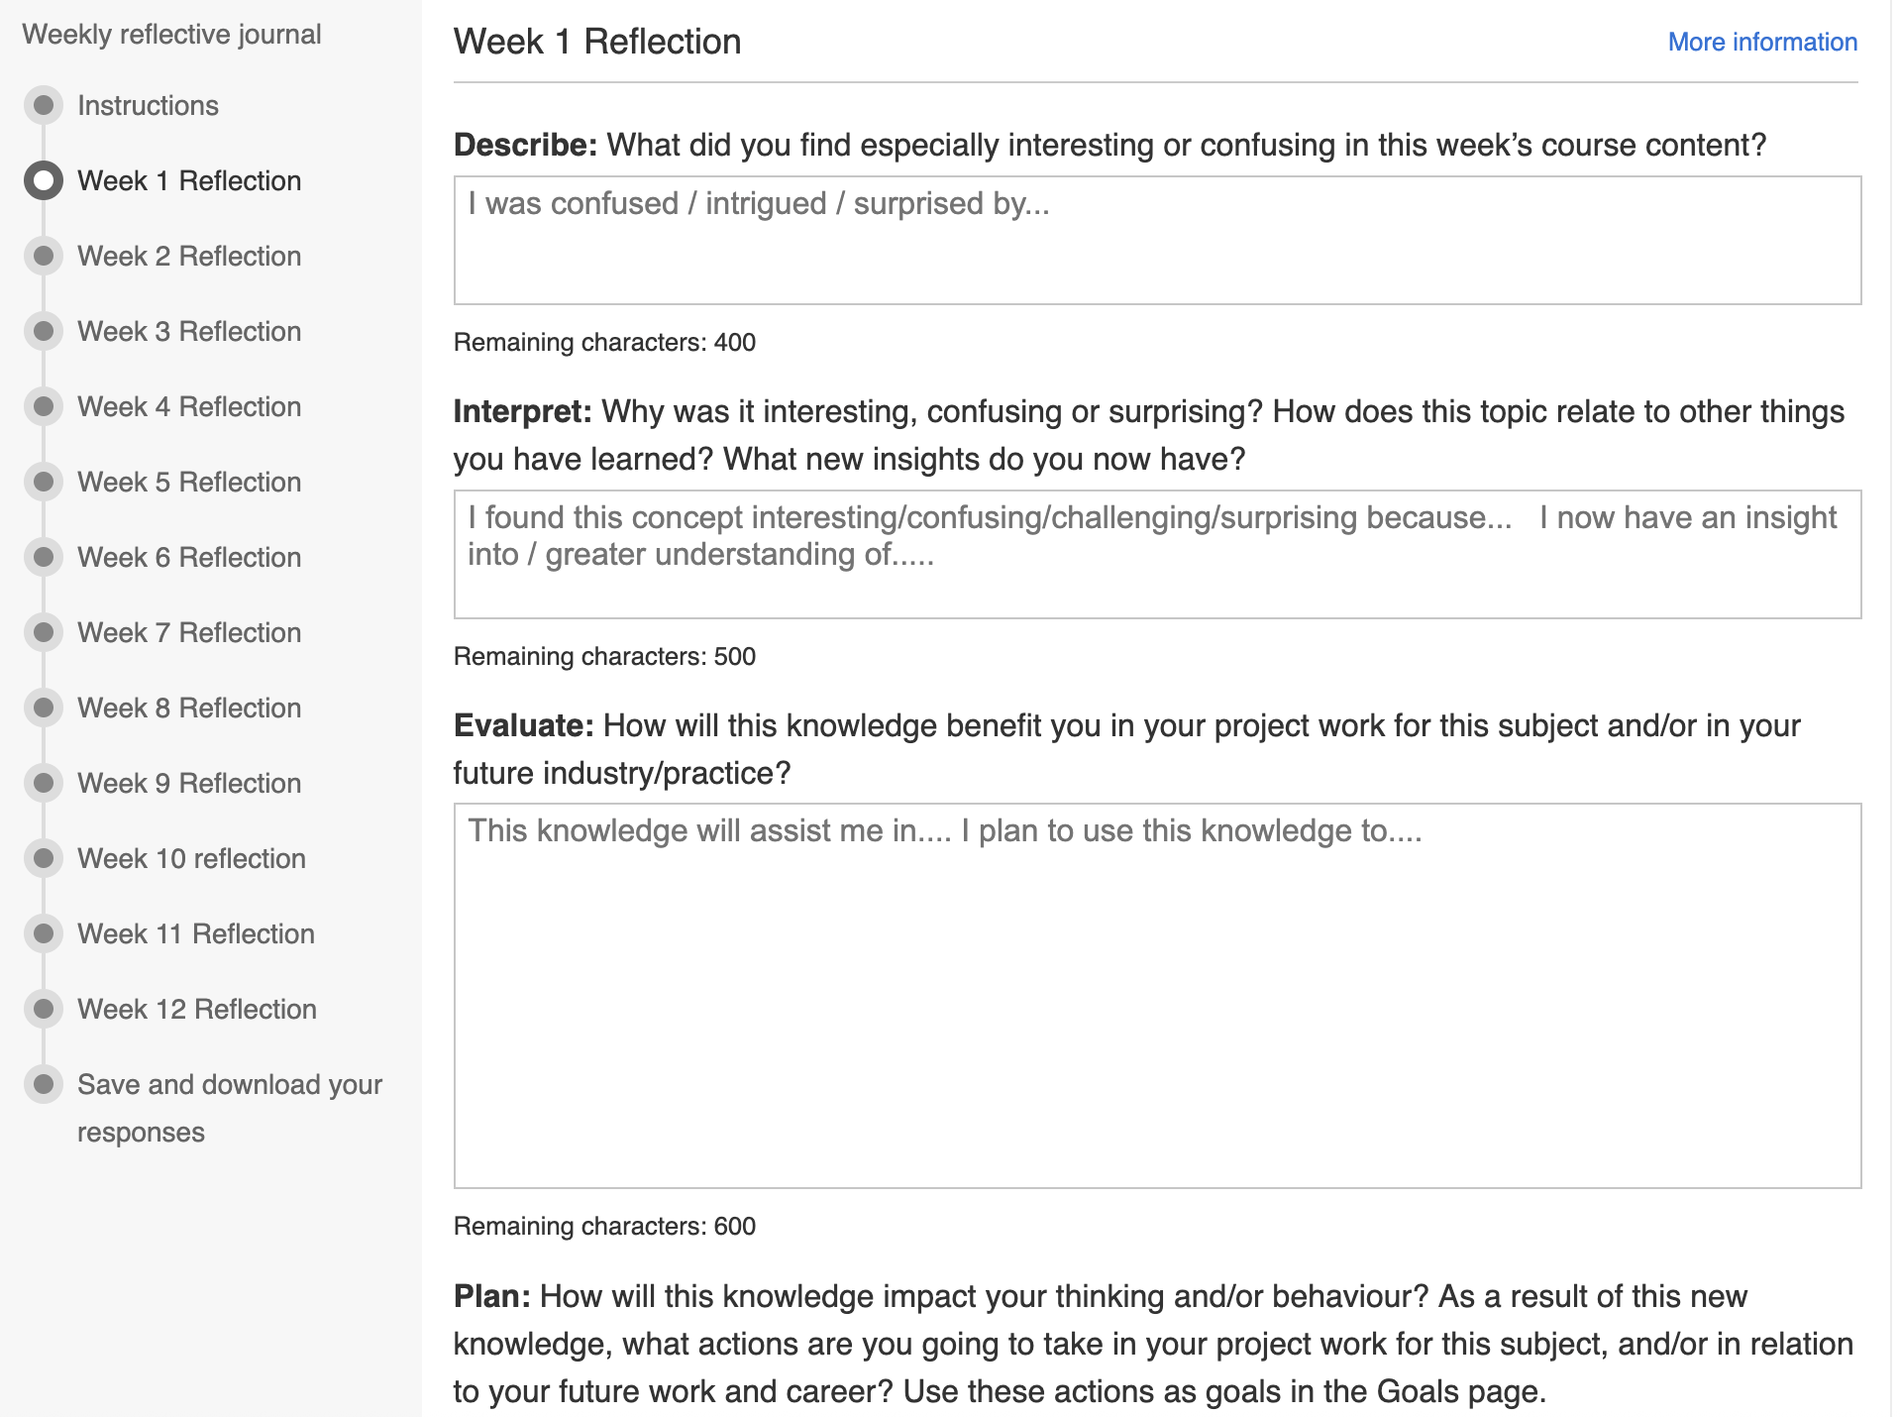
H5P journal template

Slide 18
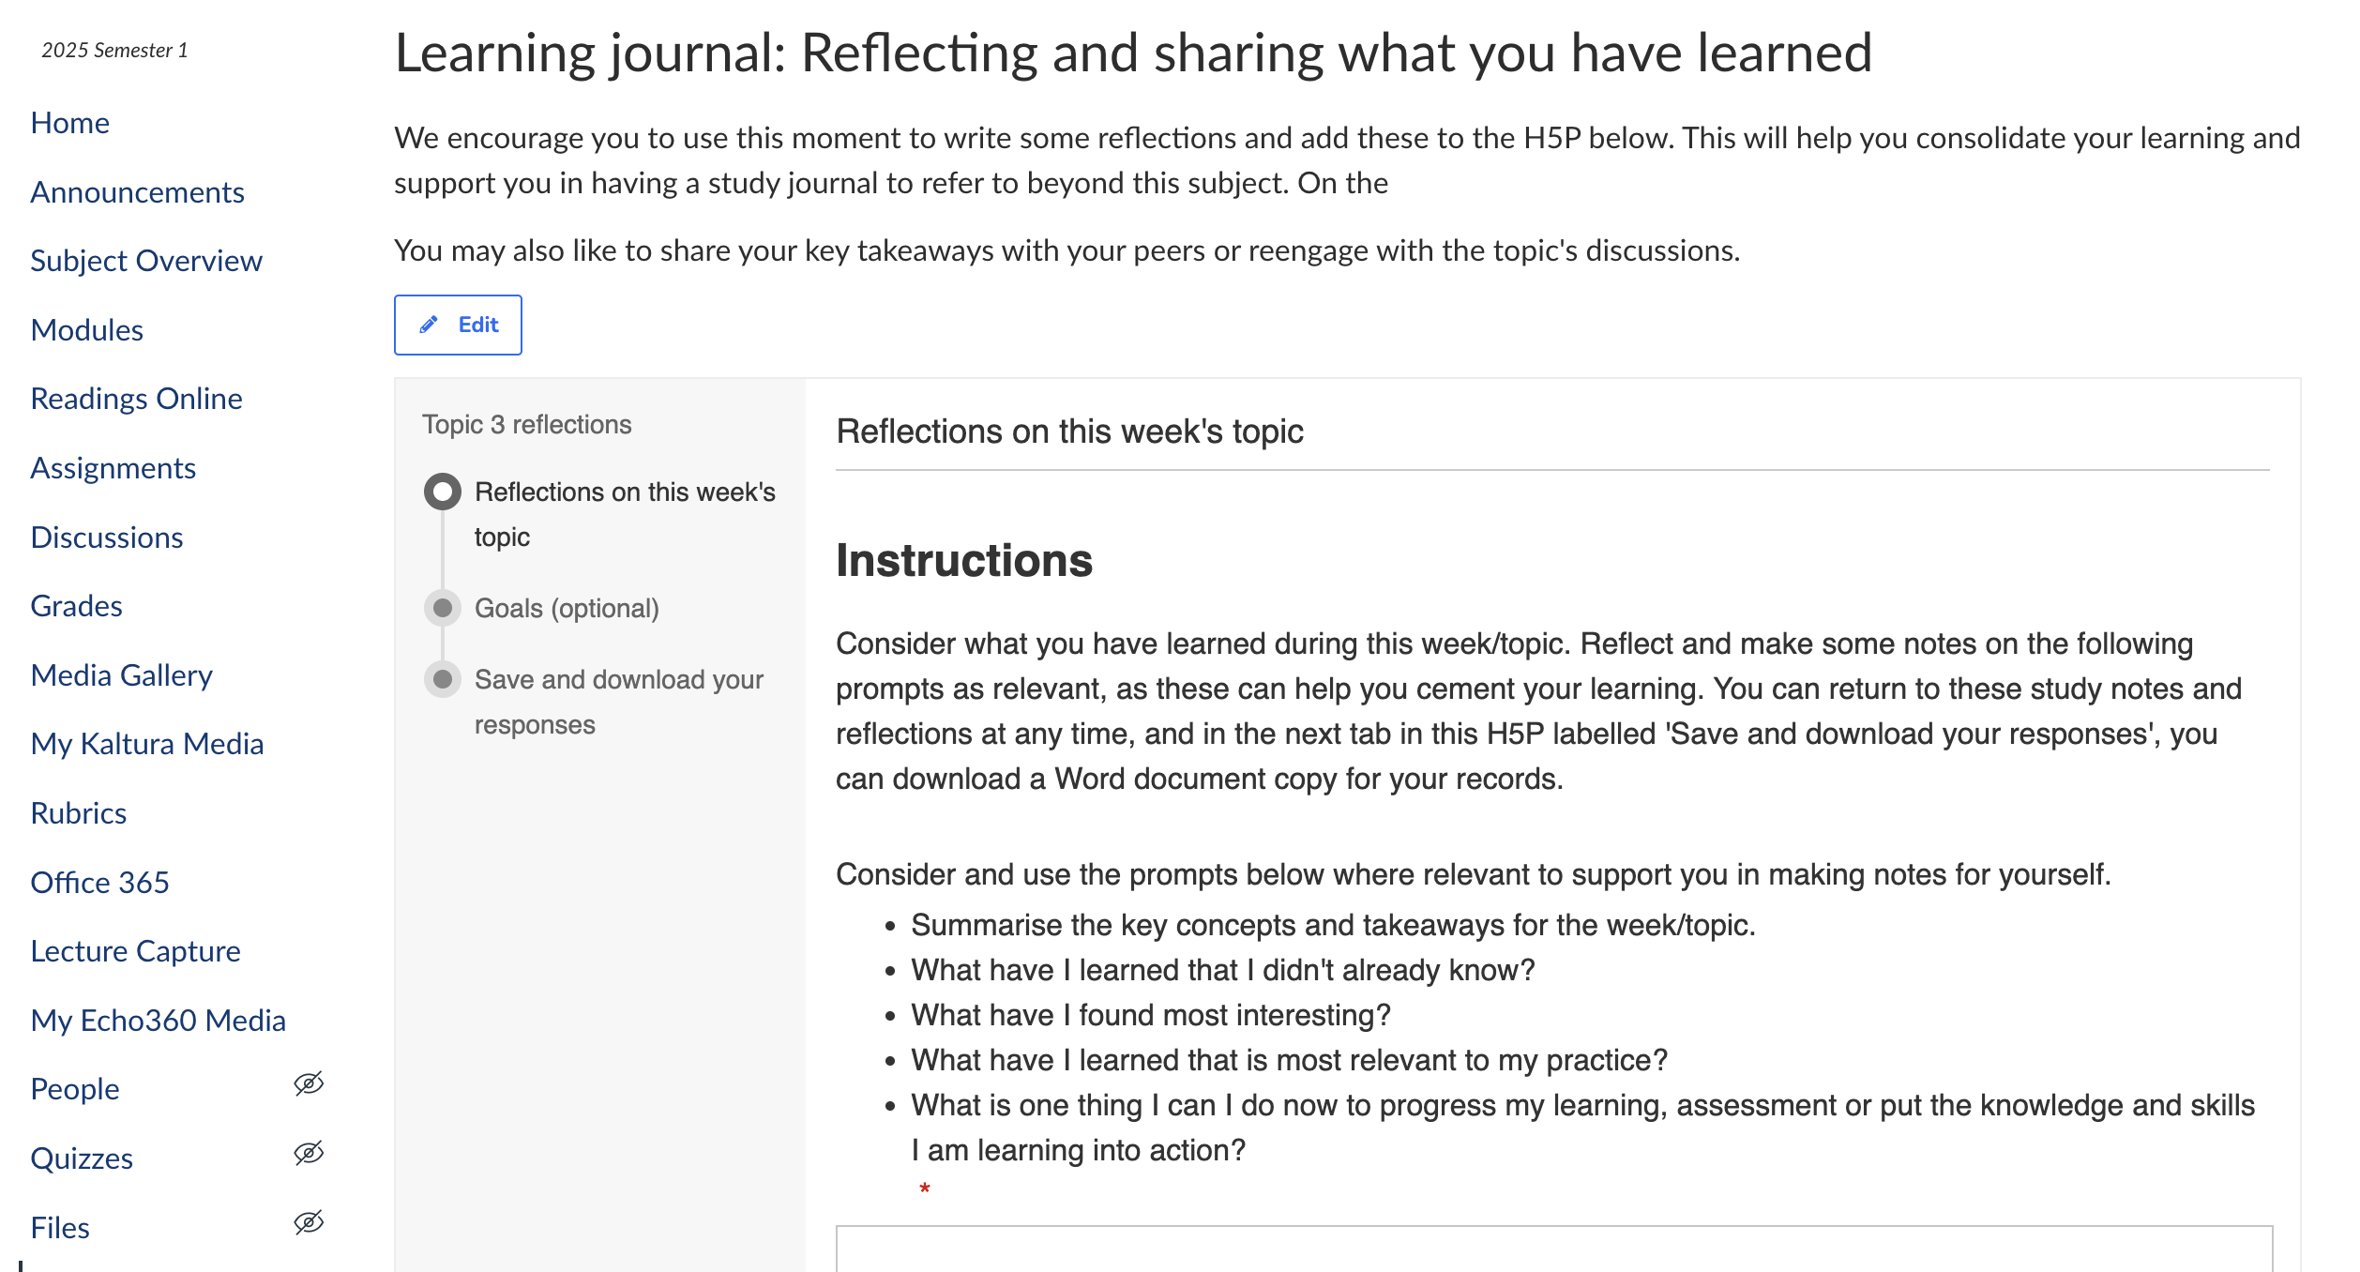
H5P embed in LMS (Canvas)

Slide 19
Accessibility of tools and media
Perception and interaction
Optimise access to accessible materials and tools
Organise information and resources
Alternative formats
Supports (language support, graduated supports, technology support)
Multiple ways to perceive information

Slide 20
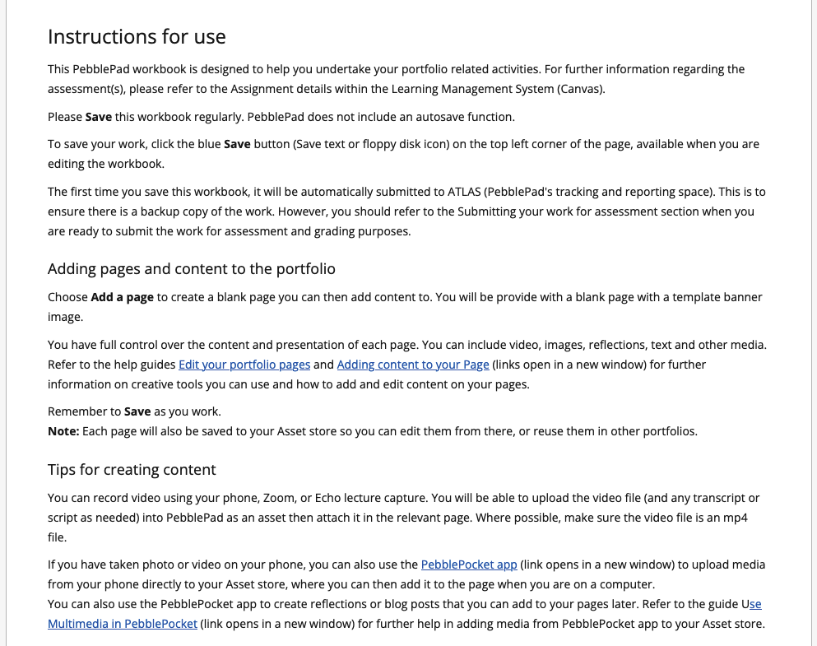
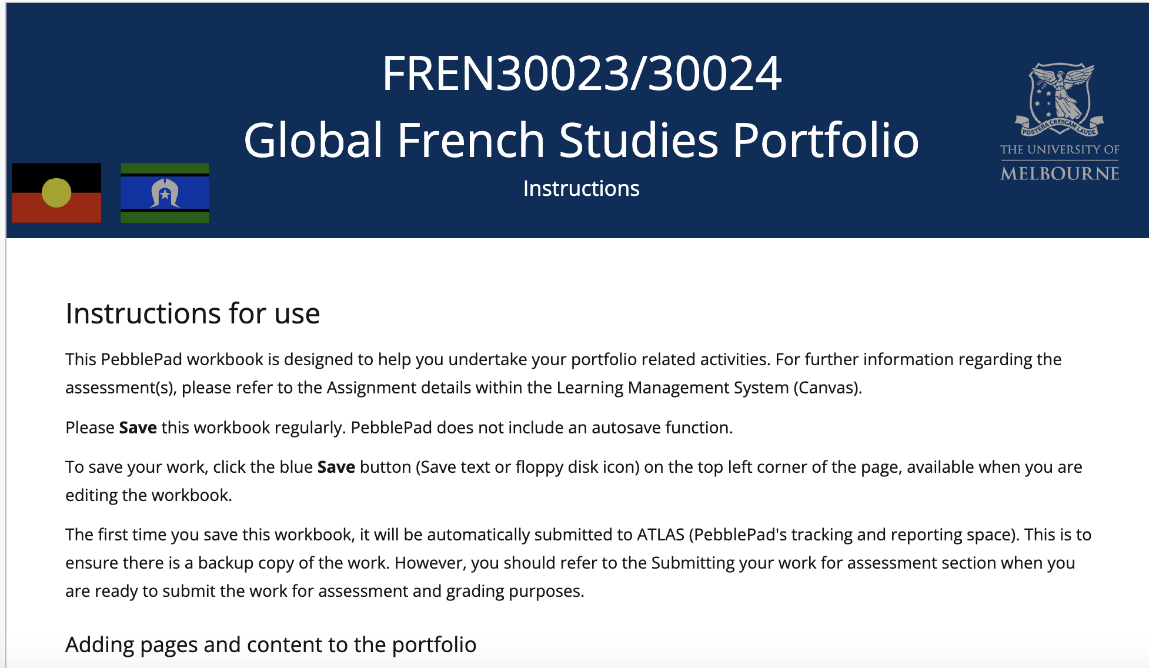
PebblePad accessibility

Slide 21
Challenge exclusionary practices
UDL 6.5 highlights “challenge exclusionary practices”
What does this mean for you as an educator in supporting and challenging students?

Slide 22
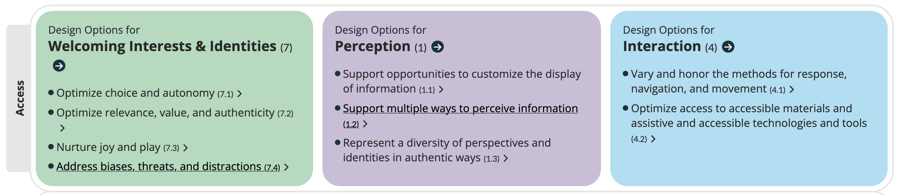
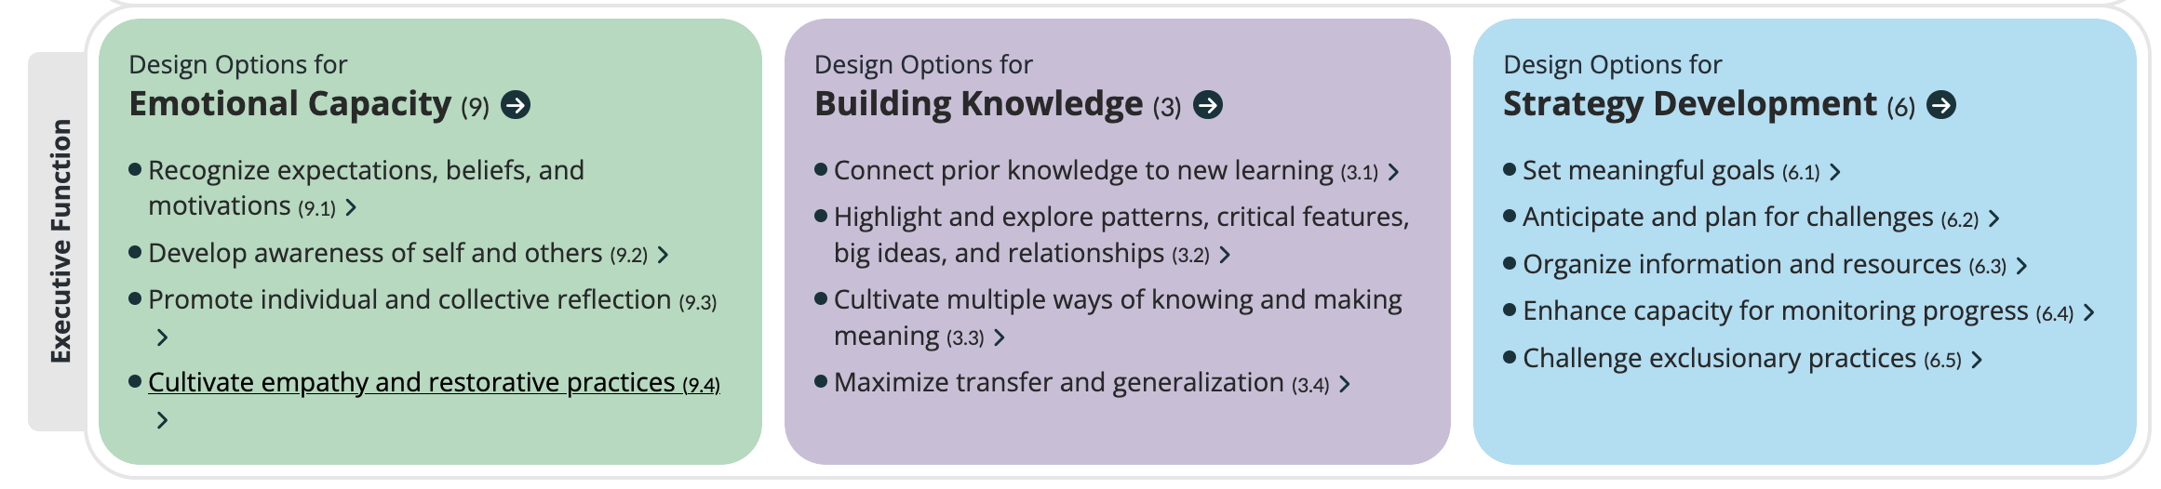
For students
Student portfolio development may prioritise accessibility (Access) and Executive Function aspects of UDL

Slide 23
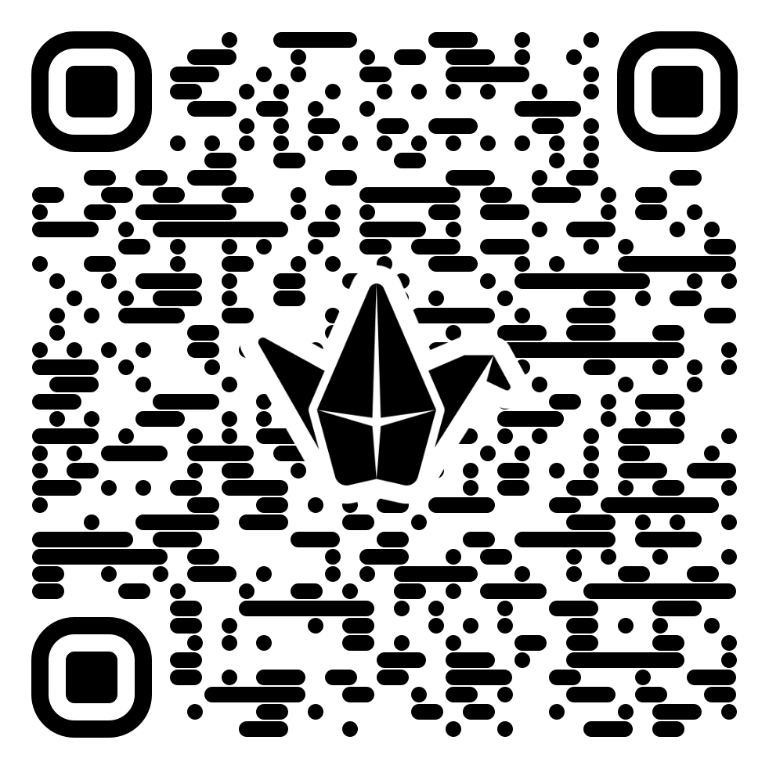
Activity: Strategies to increase inclusivity
Add to the Padlet
https://unimelb.padlet.org/mitchellkm/InclusivePortfolios
Page [23]

Slide 24
Thank you
Questions and feedback welcome
Kate Mitchell: mitchellkm@unimelb.edu.au
Asli Mccarthy: asli.mccarthy@unimelb.edu.au

