Slide 1
Mid-Year Tutor Training Day 2015

Slide 2
Agenda
9.00am – 10.00am: General introduction; introduction to specific tutoring issues and satisfaction surveys; ‘Getting to know you’ exercise.
10.00am – 10.40am: Group discussion of questions posed – feedback to whole group;
10.40am – 11.00am: Effective Teaching
11.00am – 11.15am: Break

Slide 3
Agenda
11.15am – 11.45am: Group discussion of scenarios – feedback to whole group. Informal mentoring relationships for new tutors established.
11.45am – 12.40pm: Administrative Practices – OHS Responsibilities, Tutor Contracts & Timecard Entry, HR20 & Tax Exemption Forms; Attendance; Temporary Lab Transfers; ISIS registration process.
12.40pm – 1.00pm; Online Submission and Marking – Turnitin – Geoff Saw.
1.00pm – 1.45pm: Lunch Break

Slide 4
Agenda
1.45pm – 2.30pm: Cognitive Psychology introduction to the subject in Room 1120 (Dr Meredith McKague); Personality & Social Psychology introduction to the subject in Room 1123 (Dr Simon Laham);
2.30pm – 3.15pm: Cognitive Psychology QM Briefing in Room 1125 (Geoff Saw); Personality & Social Psychology briefing session for Lab Class 1 in Room 1123 (Dr Simon Laham).
3.15pm – 4.00pm: Personality & Social Psychology QM briefing session in Room 1125 (Geoff Saw).

Slide 5
Tutoring Issues and Satisfaction Surveys
In 2012 the University moved to online Student Experience Satisfaction Surveys.
The effect of this is that we are more visible individually, and as a result of a lower response rate, students who are dissatisfied are more likely to comment.
Within 6 months of graduation, all UoM students complete an online satisfaction survey. In comparison to other departments across the country, we rate 38 out of 39.

Slide 6
Tutoring Issues and Satisfaction Surveys
The University is expecting us to raise our position to be in the top 5 within 5 years (although statisticians in the School have shown that this is in fact may not be possible).
While this appears on the face of it to be unachievable, the differences between universities are in the hundredths of a percentage point.

Slide 7
Tutoring Issues and Satisfaction Surveys
What are the issues that students raise as not meeting their educational needs?
https://www.youtube.com/watch?feature=player_embedded&v=UeH_JcyCnRk
https://www.youtube.com/watch?v=etBf6HzRGWQ

Slide 8
Satisfaction Survey Comments
The 2 hour tutes have been really helpful and I think I gained a lot of knowledge from these. I especially liked how they were another component of the course not a recap of our lectures as I don’t think they would have been as engaging if it was just like a recap.
The tutorials were a fantastic opportunity to discuss aspects covered in the lectures, gain educational support and learn further skills. The tutor did a fantastic job in presenting the dryer areas of the course so that they were interesting, this helped to make the experience enjoyable.

Slide 9
Satisfaction Survey Comments
As with every other psychology subject I have studied at The University of Melbourne, the tutorial/practical sessions have been an almost absolute waste of time. I strongly suggest that you change your attitude so that students are inspired to do their work instead of becoming discouraged.
I was appalled to find that each of my lab classes ran for far less than the allotted 2 hour time.

Slide 10
‘Getting to Know You’
On your name tag is a letter – A to D. Please locate the other members of your group, and find a table to sit together.
Introduce yourself to the group and provide 3 facts about yourself (these do not need to be too personal!).
Introduce your partner to the group.

Slide 11
Tutoring Issues
There are 8 questions to discuss in your groups. Group A, Questions 1 & 2; Group B, Questions 3 & 4, and so on.
These questions are based on events described by tutors in the past.
The aim of this exercise is to establish the combined wisdom and experience of the group, so that all tutors feel well-equipped in the classroom.
Appoint a scribe who will present a group summary just before the break.

Slide 12
Tutoring Issues
How will you set the atmosphere in the first lab class in order to make clear what your expectations are for the rest of the semester, at the same time as recognising the students’ expectations?
How will you go about learning student names so that you are able to refer to all your students by name? Why is it important to learn all students’ names?
If you are an experienced tutor, list 3 key pieces of advice that you have learnt from your own tutoring that might help a new tutor starting out? What challenges do the new tutors in the group feel they may face? Can those of you who have tutored before give some advice to address these?

Slide 13
Tutoring Issues
Among the students in your lab classes are some characters that you describe as: (1) The Defiant Student; (2) Your Personal Stalker; and (3) The Apathetic Student. What are the defining characteristics of these students and what works to manage them?
What components are important in making sure a tutorial runs well? What sorts of things have not gone well in the past?
How will you involve students in your class to ensure that your teaching is interactive and engaging? What activities can you use besides lecturing?

Slide 14
Tutoring Issues
What are some of the ways you can create a learning environment which incorporates the different personalities of your students, and where all students feel comfortable in contributing? How can you encourage students who are more reserved to actively participate in classes without feeling uncomfortable?
What strategies will you put in place to ensure attendance is properly recorded? How will you make sure you don’t have any accidental (or intentional!) stowaways in your class?

Slide 15
Principles of Effective Teaching

Slide 16
Effective Teaching
“Teaching is one of the most delightful and exciting of all human activities when it is done well, and one of the most humiliating and tedious when it is done poorly.
…
Good teaching, though never easy, always strenuous, and sometimes painful, is nevertheless its own reward.”
Ramsden, 2003
Notes:
0:00

Slide 17
Effective Teachers focus on:
Empathy
Stimulation and challenge
Clear goals and transparent standards
Clear explanations
Carefully prepared materials
Opportunities to rehearse, articulate, apply concepts
Opportunities to receive feedback on progress
Encouragement to think critically
Opportunities to learn with others
Advice on how to study (metacognition)
CSHE, 2014
Notes:
0:01
A lot of these you may already do, some of them you might want not have recognized in your work, others you might not have known were important.

Slide 18
1. Empathy
Understanding students’ abilities
Empathy with the person as a student
2. Stimulation and challenge
Passionate / Interested in your topic
Build on previous knowledge (ZPD)
Applicable to students’ lived experiences
3. Clear goals, transparent standards
Setup class expectations in first class
Maintain expectations throughout semester
Introduce activities (and outcomes) at start of each class
CSHE, 2014

Slide 19
4. Clear explanations
Knowing basic concepts > emphasizing detail
If you’re not sure, be honest
5. Carefully prepared material
Practice your lab slides / activities / timing
Talk with your head tutor, principal tutor, convenor
Set up the room before class
6. Opportunities to rehearse, articulate, apply
Central to current theories of learning
Student activities, group work, pair work, debates
Videos => discussions of major concepts
Closed questions => open questions
CSHE, 2014
Notes:
0:02

Slide 20
7. Receive feedback on progress
Formal: Marking of assignments
Forward: marking guide, consultations, practice exams
Informal: Q&A, discussions, “show of hands”
8. Encouragement to think critically
Pairs => groups => class
Create a “safe” environment to talk
9. Opportunities to learn with others
Student experience survey:
“I frequently study with other classmates”
“I never study with other students”
Melb vs. Overall
12% 18%
34% 20%
CSHE, 2014
Notes:
0:03
Point of #9 – set up group work in your labs, be transparent about it, encourage them to talk outside of class, to study together, to set up study groups.

Slide 21
10. Advice on how to study
“HOW” not “WHAT” to study
Rote learning, group discussion, free writing
Apply general concepts > reciting specific detail
Melb Uni Online resources
If you need help:
Other tutors in your course
Head tutor
Principal tutor
Convenor
Administration (12th Floor)
CSHE, 2014
Notes:
0:04

Slide 22
Sessional Teaching Staff Orientation Program
The University runs an interactive online induction for sessional teachers: http://cshe.unimelb.edu.au/prof_dev/sessional_teachers/oist.html
The course explores educational theory including principles of small group teaching, strategies for student engagement, feedback, encouraging active learning and self-evaluation techniques, and includes a final task of critiquing a filmed tutorial.
All sessional teachers at the University are welcome to participate and all who finish the course will receive a certificate of completion.

Slide 23
Applying Principles of Effective Teaching to Tutoring Issues

Slide 24
Tutoring Scenarios
There are 8 scenarios to discuss in your groups. Group A, Scenarios 1 & 2; Group B, Scenarios 3 & 4, and so on.
Be as creative as you can about ways in which the situations could be managed, and what you could do to improve things.
Appoint a different scribe who will present a group summary.

Slide 25
Scenario 1
You have returned assignments at the end of a lab class. All students have been told in advance that they should wait two days before making contact to discuss their mark to give them time to absorb and reflect on the comments. However, one student insists on talking to you immediately after class. How will you deal with this?

Slide 26
Scenario 2
A student from your lab class attended an alternative class on a lab transfer in the previous week. They publicly declare that the details about the assignment given out by the tutor in the other lab class to their students is contradictory to the information you have told your class. What will you do to maintain the confidence of your students?

Slide 27
Scenario 3
You are the tutor of a third year class and seem to have a very quiet group. When you ask questions to the group no one responds, the room is filled with silence and running classes is becoming a struggle. How will you overcome this challenge? What changes could you make to the structure of the lab class? What changes might you make to how you go about running your lab classes more generally?

Slide 28
Scenario 4
You have organised group work for one of your lab classes which is worth 10% of the final mark in this subject. While you are describing the task, two students announce that group work is a waste of time. They do not want to provide help to the other students in the group who have not completed any of the background reading. What is the best way to reassure these two students?

Slide 29
Scenario 5
You are a tutor of a first year class who generally participate well. There are two students in your class who are dominating the room. They regularly challenge your authority and are highly critical of most of the content areas that are taught, arguing that they are a waste of time and not what psychology is really about. Most other students are quiet and when they do speak they are often shut down. How do you deal with the situation?

Slide 30
Scenario 6
You are the tutor of a second year class and the tutorials have been running well. This week you are provided with material from the lecturer that doesn’t appear to be enough. The class looks like it will run closer to one hour instead of two. What do you do to ensure the class will run for the full time period?

Slide 31
Scenario 7
In the lab class about statistical analysis for the assignment you think that, by and large, students have understood the material. However, based on overheard conversations between students, you suspect that the students still have no idea how to apply what they have learnt to the analysis involved in their assignment. What would be the best way forward?

Slide 32
Scenario 8
You have a student who frequently asks questions during the tutorials. Often it is to clarify something they have misunderstood, or asking you to repeat material. They also ask you to clarify material covered in the lectures. You can see that the other students are beginning to tune out, or feel frustrated. How do you handle the situation?

Slide 33
OHS Matters Swaved Marcinski OHS Advisor Faculty Medicine, Dentistry & Health Sciences

Slide 34
OHS Induction
Melbourne School of Psychological Sciences

Slide 35
Agenda
Emergency response,
Security,
Risk management,
Consultation,
Online training modules, and
Other information for your awareness.

Slide 36
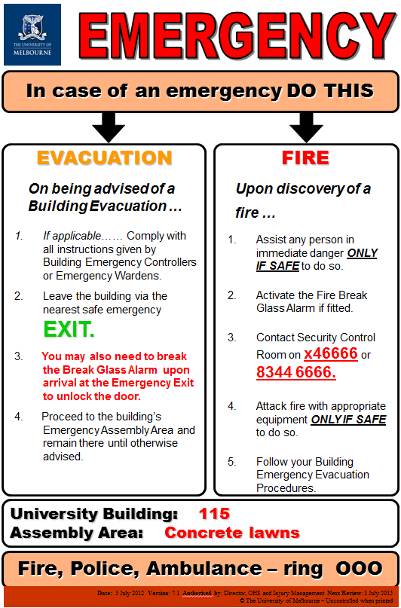
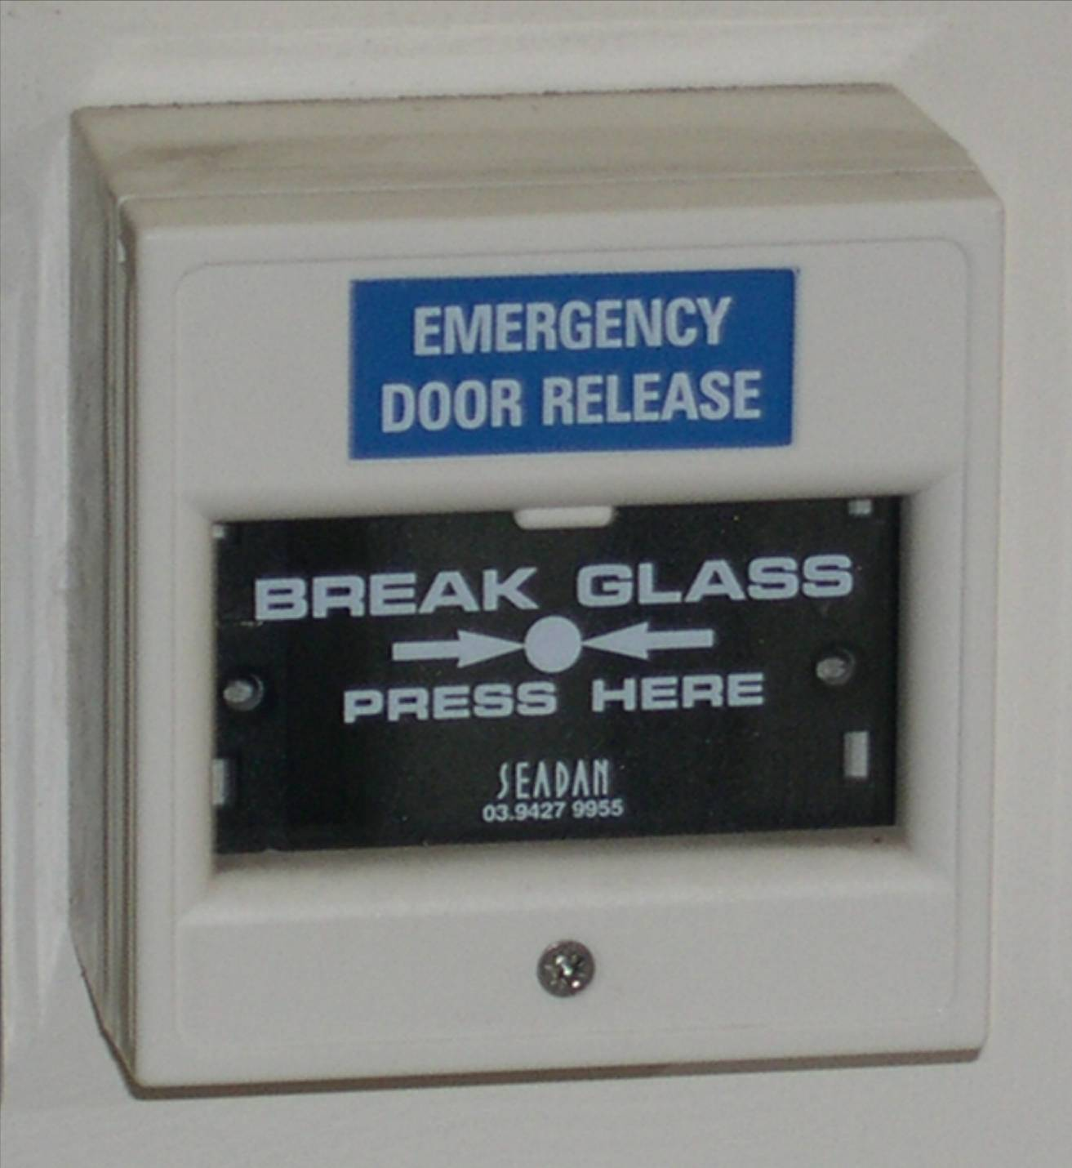
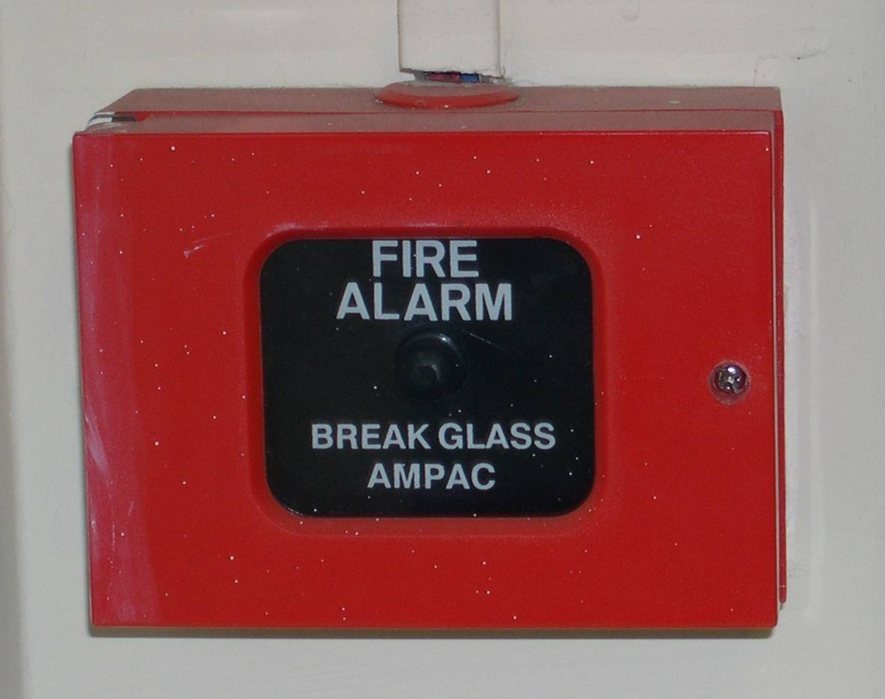
Emergency Response
Internal Alarm – Notifies Security
Alarm Notifies MFB

Slide 37
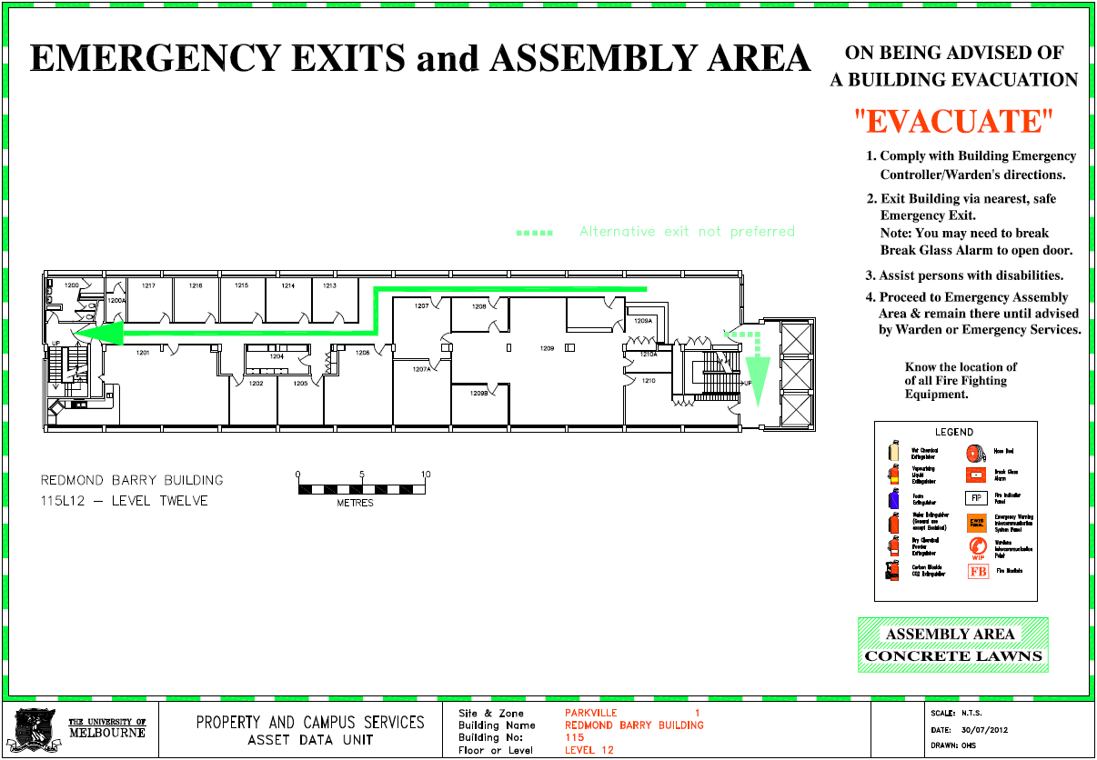
Emergency Assembly Area

Slide 38
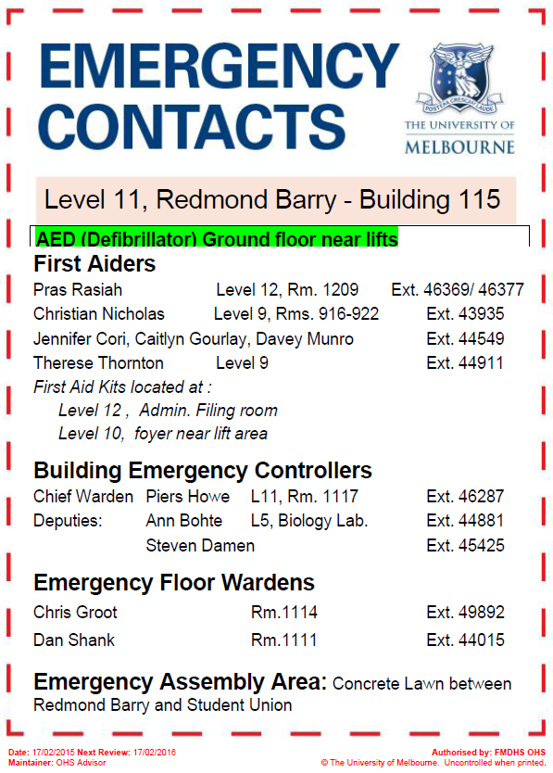
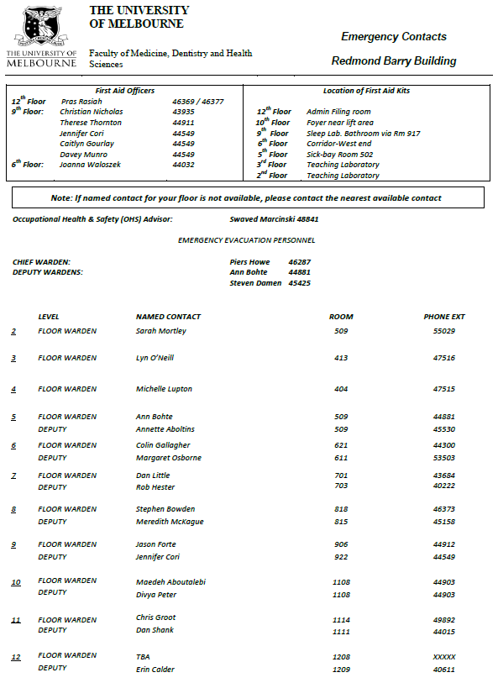
Emergency Contacts
Posted near lifts

Slide 39
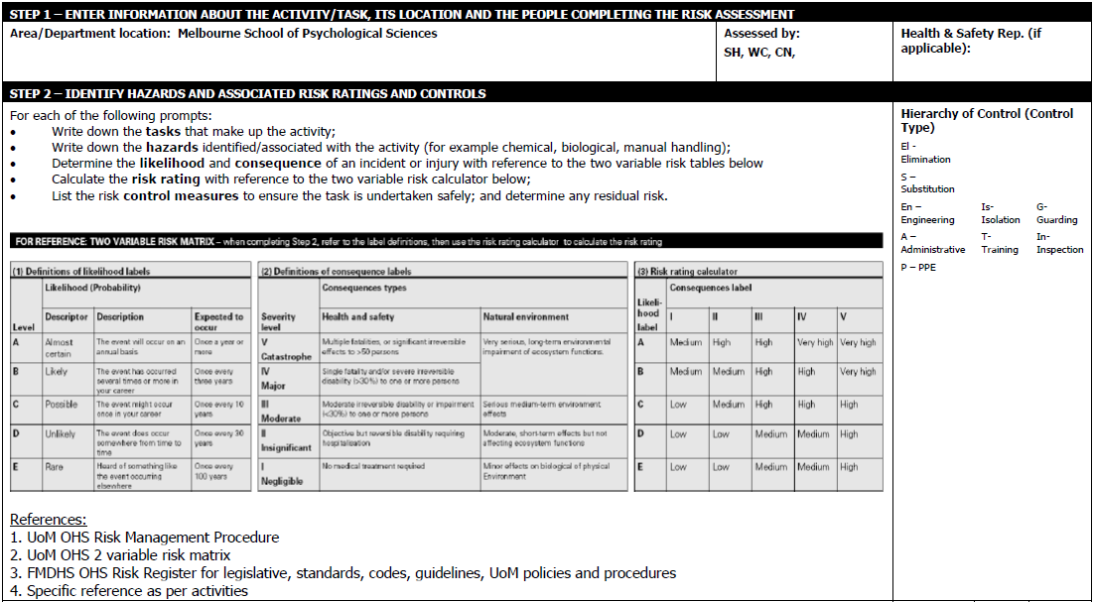
Risk Management
Risk Register – identifies local hazards and control measures in place to reduce the level of risk.

Slide 40
Hazard and Incident Reporting
Reporting information and help is available at: http://safety.unimelb.edu.au/tools/incident/
Report all incidents to your supervisor immediately, followed by a formal Incident Report within 24 hours.
Submitting Formal Incident Report:
STAFF (via Themis) >staff self-service > EHS applications > Create incident report

Slide 41
Health Hazards
Staff are required to complete the Health and hazard assessment questionnaire (HR15)
Completed form to be sent back to Occupational Health Nurse

Slide 42
Electrical Safety
All broken/damaged equipment must be reported to your supervisor or OHS or nominee.
All unsafe equipment is to be removed from use and tagged-out with a yellow CAUTION tag, available from OHS Advisor or on the OHS noticeboard.
Staff Facilities contain various appliances – signs posted for hazard awareness.

Slide 43
Security and Access
After hours constitutes between 7.00 am and 7.00 pm Monday to Friday or on weekends.
For access, please complete the following:
Review the University After Hours Risk Management Procedure
Consult your Supervisor to complete the ‘After Hours Form’ – send form back to OHS Advisor

Slide 44
Security and Access
Unisafe app:

Slide 45
Smoking Policy
The University is tobacco free. Smoking is only permitted at designated areas: http://tobaccofree.unimelb.edu.au/
UoM is in a transition phase and will become completely tabacco free.

Slide 46
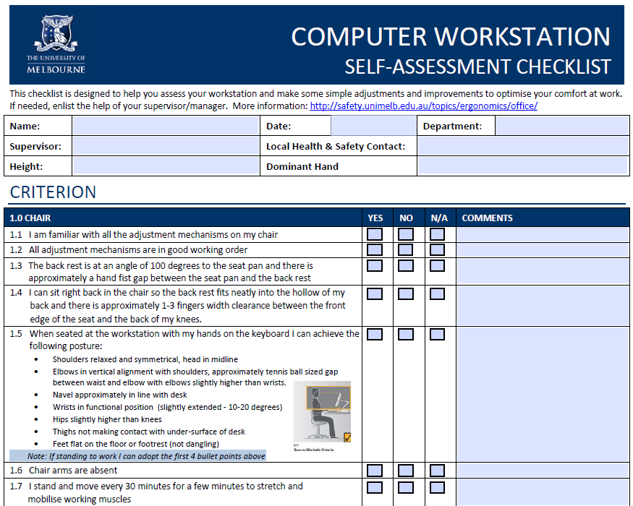
Manual Handling and Ergonomics
Complete and send back to your OHS Advisor
For further assistance contact your OHS Advisor

Slide 47
OHS Policy, Procedure and Training
The University has in place an OHS Policy that governs its commitment to safety, supplemented by various procedures and guidelines.
Each member must complete mandatory OHS training within SIX WEEKS of receiving induction.
Consisting of selected or all of the following:
Roles and Responsibilities
Manual Handling
Risk Management
Incident Reporting and Investigation

Slide 48
Consultation
The School of Psychological Sciences has an OHS Committee which meets quarterly to discuss OHS issues.
Any issues/matters wished to be discussed may be raised on your behalf.
Minutes are displayed on the OHS noticeboard located within the lunch room on level 12 of the Redmond Barry Building.

Slide 49
Issue Resolution
The University has in place an Issue Resolution procedure found on the intranet site.
Your supervisor is the first point of contact for any matters relating to OHS.
Any OHS matters not being addressed by your supervisor – contact your OHS Advisor.

Slide 50
Workplace Bullying and Occupational Violence
The University has in place:
Equal Opportunity Policy
Discrimination, Sexual, Harassment and Bullying Procedure
Members are required to complete ‘Promoting Workplace Behaviours’ training.

Slide 51
NOTE: Email Summary will be sent out

Slide 52
Administrative Matters

Slide 53
Tutor Manual 2015
You will have all received a Tutor Manual when you came in today.
I won’t spend time reading it out (and much is familiar to experienced tutors), but it is an important document that you should be familiar with.
Section 2 relates to effective teaching principles; Section 3 outlines your responsibilities as a tutor; later sections describe policies with respect to extensions, plagiarism etc.

Slide 54
Administrative Issues
As we are now dealing with such large numbers in our undergraduate subjects, realistically the only place where students get personal interaction with academic staff is in their Lab Classes.
Psychological Sciences is anxious that students’ educational experience is as positive as possible; and to that end, is encouraging a much closer relationship between tutors and students.

Slide 55
Administrative Matters
The department has made a commitment to supporting tutors with rates of pay that are (somewhat) aligned with the amount of work tutors do.
The other side of that is that tutors are expected to attend all lab briefing sessions and take all the classes assigned.
Tutors are asked to never swap classes. If there is an emergency that prevents you from teaching a class, please let me know immediately.

Slide 56
Contracts & HR20 forms

Slide 57
Pay Schedules
In the University ‘Salaries and Loadings’, initial tutorials are equivalent to 3 hours work and repeat tutorials the equivalent of 2 hours.
The breakdown of the hours is:
Initial Tutorial: 1 hour preparation, 1 hour delivery, 1 hour marking;
Repeat Tutorial: 1 hour delivery, 1 hour marking.

Slide 58
Example Tutor Contract
Tutorial delivery (six lab weeks across the semester):
1 initial tutorial x 2 hours 12 hours
1 repeat tutorial x 2 hours 12 hours
One hour preparation per hour initial tutorial 12 hours
One hour tutor briefing meeting per initial tutorial 6 hours
Marking (2000 words) @ 2 per hour (48 scripts*) 24 hours
Student Contact 12 hours
Lab report marking consistency meeting 2 hours
Total: ~80 hours (+ Tutor Training)

Slide 59
Head Tutor
The Head Tutor position recognises the impact on workload resulting from 150 students or more in Third Year subjects.
In addition to the hours as a tutor, the Head Tutor will be paid for approximately an extra 52 hours over the semester.

Slide 60
Senior Tutor
The Senior Tutor position recognises the impact on workload resulting from > 450 students and many tutors for each subject.
In addition to the hours as a tutor, the Senior Tutor will be paid for approximately an extra 140 hours over the semester.

Slide 61
Principal Tutor
There are three Principal Tutor positions responsible for each of 1st, 2nd and 3rd year subjects. In each semester, the 2nd Year Principal Tutor is one of the second year Senior Tutors and the 3nd Year Principal Tutor is one of the third year Head Tutors.
Principal Tutors are 2-year fixed term contracts (~0.4 EFT). Responsibilities of the position extend beyond the 13 week (including O-Week) semester periods

Slide 62
Principal Tutor
Principal Tutors:
ensure that the lab class materials for the subject in which they are Senior/Head Tutor are sufficient to fill the full two hour period in every class.
take a leadership role at tutor briefings (e.g., outlining the breakdown of the lab class into timed sections; suggest innovative ways of presenting the slides)

Slide 63
Principal Tutor
Principal Tutors visit one class for each tutor to provide feedback using a Peer Observation Feedback Sheet.
The Third Year Principal Tutor is responsible for assembling all third year attendance rolls.
In consultation with the third year subject convenors, the Principal Tutor forwards the extra work requirement (for students who failed to meet the 80% attendance hurdle) to the Tutor Coordinator who will follow up the students.

Slide 64
Principal Tutor
The Third Year Principal Tutor monitors the Discussion Board for all the third year subjects. Posts requiring an academic response are forwarded to the subject convener.
The Principal Tutors establish a list of representatives (one from each lab class), who communicate information/concerns to Staff-Student Liaison meetings.

Slide 65
Tutor Pay Schedule
You will have already received an individual contract detailing your total time commitment based on the subject and the number of lab classes taken. The total is converted to initial and repeat tutorials across 8 timecards.
In due course you will be sent an HR20 form to complete online. Please complete the bank details and upload the form as soon as possible after you have received it.
If you are new to tutoring you will also need to provide a Tax Declaration Form and a certified copy of your passport or Birth Certificate.

Slide 66
Tutor Contracts & HR20 Forms
At the bottom of your contract is a table that looks like this:
Timecard Type | Number of Timecards | Total Hours Submitted
2 Initial Tutorials + 5 Repeat Tutorials | 5 | 80
3 Initial Tutorials + 3 Repeat Tutorials | 3 | 45

Slide 67
Tutor Contracts & HR20 Forms
You will be required to submit the first 7 timecards during semester – Pras will enter the final timecard (Timecard 8) which will include any adjustment caused by absences or replacement classes.
Timecards are entered fortnightly on Wednesdays. Entry dates for Semester 1 are: Timecard 1 – July 29; Timecard 2 – August 12; Timecard 3 – August 26: Timecard 4 – September 9; Timecard 5 – September 23; Timecard 6 – October 7 and Timecard 7 – October 21.

Slide 68
Tutor Contracts & HR20 Forms
If the contracts have been processed in time for you to enter your first timecard on July 29, payment for your first timecard of 8 (fortnightly) should be in your bank account on August 6.
If your tutor contract string has not appeared in Themis before July 29, please enter a double timecard on August 12.

Slide 69
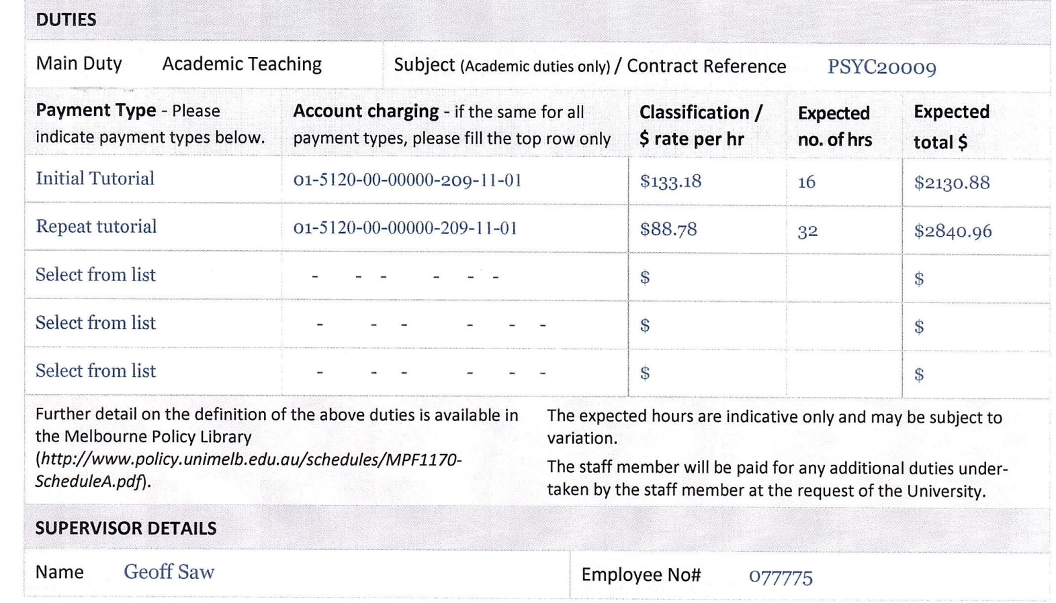
Timecard Entry
Subject
Themis Account Codes
Themis Subject Code
Approver:
1st Year – Chris Groot; 2nd Year – Geoff Saw; 3rd Year – Annie Blunden

Slide 70
Timecard Entry
Timecard Type | Number | Total Hours Submitted
2 Initial Tutorials + 5 Repeat Tutorials | 5 | 80
3 Initial Tutorials + 3 Repeat Tutorials | 3 | 45
What to enter into Themis fortnightly
How many timecards of each type

Slide 71
Timecard Entry
I have created 2 short videos to help you with timecard entry.
The first video explains the tables in your tutor contract and the meaning of the sections in your HR20 form.
This video can be found at: https://vimeo.com/120251043
The video is password protected; the case-sensitive password is ‘Timecards 1’. Please note that there is a space between the word ‘Timecards’ and the number 1.

Slide 72
Timecard Entry
The second video explains the Themis processes involved in creating a timecard template and entering a timecard.
This video can be found at: https://vimeo.com/120251179
The video is also password protected; the case-sensitive password is ‘Timecards 2’.
In addition, Pras will run a session for tutors in each of the year levels in the week starting March 9. I will send you details of these sessions.

Slide 73
Administrative Practices

Slide 74
Administrative Practices
To accommodate the impact of large numbers of students, there are some important administrative practices in place.
These relate to attendance rolls, Temporary Lab Transfers and the submission of Lab Reports.
The overall purpose is to support you in your ability to deliver the curriculum, assess student work and provide feedback in the most effective way.

Slide 75
Attendance Records

Slide 76
Attendance Records – ISIS
Since Semester 2, 2010, students have been able to register themselves into lab classes.
There are currently:
1200 students in MBB1 in 48 classes;
750 in Cognitive Psychology in 30 classes;
775 in Personality & Social Psychology in 30 classes;
510 in Capstone; and
between 200 and 320 students in the other third year subjects.

Slide 77
Attendance Records – ISIS
Places in classes have been very tight and there is no room for students to change classes.
There will be some third year classes starting at 26 students but attrition should rectify this.
If you mark more than the 48 (72) scripts listed on your contract, you will be paid extra.

Slide 78
Attendance Records – ISIS
Up to the end of Week 2, I may be making changes to registrations, but on Friday, August 7, the system will close and there will only be changes in very, very exceptional circumstances.
Students have been told that the final attendance rolls will be downloaded from ISIS at 5.00pm on Friday, August 7, and this version is the final word on their assigned lab class.
Discrepancies between timetables they may have printed prior to this date and the official roll cannot be used to justify attendance at the wrong tutorial.

Slide 79
Attendance Records – Rolls
Please be vigilant about attendance.
All tutors are provided with an electronic roll.
Please mark the roll in every class. It is much better to call out the names as it also serves the purpose of getting to know the students.
Students will be told that if they arrive late for class after the roll is marked, they must ensure that their attendance is recorded.

Slide 80
Attendance Records – Rolls
You will receive an updated ‘final’ attendance roll after August 7.
Please update your records from the first lab classes onto this final file.
Any student attending the first class who is not listed on the roll, must fill out a Temporary Lab Transfer form.
The tabs at the bottom of the electronic worksheets denote the different classes you are taking.

Slide 81
Attendance Records – Rolls
Mark Absentees “A”
(or Present “P”)
Enrolled Students
Your Lab Classes

Slide 82
Temporary Lab Transfers

Slide 83
Temporary Lab Transfers
If a student is not listed on your roll, they must complete a Temporary Lab Transfer Form. (It might be a good idea to take a few forms to class with you.)
When you have signed the form, the student takes it to their ‘home tutor’ (i.e., the tutor of their assigned lab class in ISIS).
Please add the name of any student not on your official roll in the orange section of your list below the assigned students.

Slide 84
Attendance Records – Rolls
Mark Lab Transfers “LT”
Insert Lab Transfers

Slide 85
Temporary Lab Transfers
If your room already has 25 students, you do not have to admit non-assigned students.
All second year Lab Transfer forms are forwarded to the Principal Tutors after the ‘home tutor’ has signed the form.
A maximum of 1 lab transfer per student per second and third year subject will be allowed without a medical certificate (or written documentation outlining the compelling reasons why the student was unable to attend the scheduled class).

Slide 86
Temporary Lab Transfers
The purpose of the processes involved in Temporary Lab Transfers is to ensure that Lab Classes (particularly those around lecture times) do not become oversized, and that you get to know all the students on your official lists really well.
At the start of semester, I will identify some lab classes that cannot accommodate any lab transfer students.

Slide 87
Grade Centre

Slide 88
Grade Centre
Some new practices were introduced last year to try to simply the processes surrounding determining excess absences and forwarding lab report marks.
In addition to maintaining your Excel spreadsheet, you will be entering your absences into the Grade Centre in LMS.
As soon as ISIS has closed, I will set up the columns for you for to enter attendance for each lab class.

Slide 89
Grade Centre
You will be able to access your students alone using your personalised ‘Smart View’.
Under ‘Manage’ in Grade Centre there is a category called ‘Smart Views’.
If you click your name in that section you will see just your own students. You can sort the lab class column so that the students are listed alphabetically by surname for each of the classes you teach.
You need to enter ‘1’ for present and ‘0’ for absent.

Slide 90
Grade Centre
If a student who is marked absent for a lab class subsequently presents you with a lab transfer form or medical certificate, please convert the ‘0’ to a ‘1’.
There may be a student who attended your first lab class who is not on your official class list. Please find their name in the Grade Centre and enter a ‘1’ for that student in Week 1.
Similarly, if you have a student on a lab transfer in your class on one of the other weeks of semester, please enter a ‘1’ for that week for that student.

Slide 91
Assessment Procedures

Slide 92
Lab Report Submission
For Cognitive Psychology, the due dates for the lab report are the day of the student’s official (even if they have been stowing away in an alternative) lab class in Week 8 (week beginning September 14).
For Personality & Social Psychology, the due date for the lab report are the day of the student’s official lab class in Week 5 (week beginning August 24).

Slide 93
Turnitin Online Submission
For all subjects, students will be uploading their assignments into Turnitin.
Please emphasise to your lab classes the importance of naming their assignment document correctly.
The document must be saved as: student family name_student number_subject code_ assignment name (i.e., SMITH_567345_ PSYC20009_Lab Report)’.

Slide 94
Entering Marks
For all subjects, tutors will be entering the assignment marks directly into the Grade Centre, using the same approach as for attendance.
There will be columns labelled with the assignment names and columns for late penalties for each assignment. Please enter your marks into the assignment column and late penalties into the appropriate column.
If the assignment was submitted late, please calculate the late penalty and enter it into the appropriate column with a minus sign (e.g., -10).

Slide 95
Entering Marks
The subject conveners will download the assignment marks when they have all been entered and ask you to make any necessary adjustments to ensure equivalent distributions between tutors.
When all report marks have been checked, the online comments will be released to the students.
Please make sure that you are prompt with your marking so that there is time for double marking of the fail grades.

Slide 96
Procedure for Remarking Assignments
If any students are unhappy with their results for their psychology assessments, please advise them of the following process:
Student will have to make an appointment with the tutor/marker to discuss their concerns. They must wait at least 48 hours from receiving the report back before meeting with the tutor. The tutor will explain comments and grades, but will not give them the numerical mark.
The mark will not be altered as a result of meetings between students and tutors.

Slide 97
Procedure for Remarking Assignments
If the student is still unhappy with their mark, they need to write a formal letter (in writing, not email) requesting a re-mark. The letter is to be addressed to the Academic Programs Convenor, Dr Meredith McKague but delivered to the 12th floor office. The letter should include their full name, student number, University of Melbourne email address, signature and a detailed justification of why they are requesting a re-mark.

Slide 98
Procedure for Remarking Assignments
If their application is approved by the Academic Programs Committee, their assessment will be re-marked and they will informed of the revised result.
Students will be made aware that they will be awarded the revised mark whether it be higher or lower than the original mark.

Slide 99
Lab Class Observation Feedback

Slide 100
Lab Class Observation Feedback
As you will have seen earlier in the job description of the Principal Tutors, all tutors will be observed for, at least part, of one of their classes.
The purpose of this is to assist your professional development and is not an attempt to ‘knock you over the head’ or demoralise you.
Most other universities do more professional training of their tutors. However, we recognise your time restraints and hope that this will be an adequate compromise.

Slide 101
Lab Class Observation Feedback
The feedback sheet addresses a number of focal areas:
Rapport and interaction/ engagement with students (use of names, etc);
Management/leadership of prac activities (i.e., clarity of purpose; individual/group management and involvement; time management);
Facilitating discussion (i.e., questioning technique; handling/responding to student questions and answers ; spreading discussion around to avoid domination).

Slide 102
Lab Class Observation Feedback
Clarity of explanation (e.g., use of analogies, illustrations, examples);
Structure of the lab class (i.e., variety of activities; approaches; strategies);
Use of student worksheets/handouts (i.e., the way that they are integrated into the PowerPoint content).

Slide 103
Thank you for your attention. I hope that you have a great time tutoring this semester.

